Slide 1
Inclusive Web Design 101:
Beyond Accessibility
(Date)

Slide 2
Agenda
What, Who, and Why of Inclusive Design
POUR Concept
What Laws Affect Accessibility?
What Standards/Guidelines Affect Accessibility?
Examples of Website Accessibility Features
Perspectives From Those Who Need Accessible Design
Web Accessibility Resources/Training Matrix

Slide 3
What Is “Inclusive Design”
Anyway?
Inclusive design means:
Going beyond the base level of access to information
Making something valuable, not just accessible, to as many people as we can.

Slide 4
Accessibility
& Inclusive Design
Accessibility is an outcome
Inclusive Design is a process
Derek Featherstone – Level Access
Notes:
Accessibility – targets people with disabilities, many times checked/reviewed at the end
Inclusive Design- design products that are accessible by as many people as possible

Slide 5
Who Is Inclusive Design For?
EVERYONE!
57 million Americans (~20%) identify as having some type of DISABILITY

Slide 6
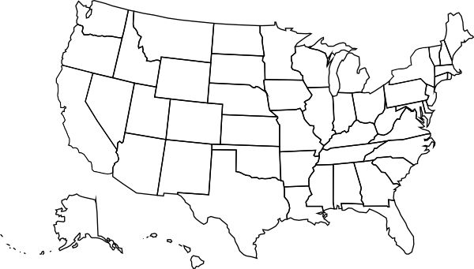
Think About This…
California and New York – 57 million
Notes:
New York and California combined is about 57 million.
Can you imagine if you built a website but then provided a disclaimer that it can’t work in New York or California?

Slide 7
Who Is Inclusive Design For-2?
Disability types:
Visual
Hearing
Motor
Cognitive
But what about?
• Temporary Disabilities (broken bone, carpal tunnel, seizures, sleep deprivation….)
• Aging, English as a second language population
• Many more…
Notes:
Blindness, low vision, color-blindness
Deafness and hard-of-hearing
Inability to use a mouse, slow response time, limited fine motor control
Learning disabilities, distractibility, inability to remember or focus on large amounts of information

Slide 8
Why Should I Care About
Inclusive Design?
1. Right Thing to Do
Difficult to imagine life without access to all the web has to offer
For many, a limited and frustrating web experience is their reality
Accessible web provides equal opportunity

Slide 9

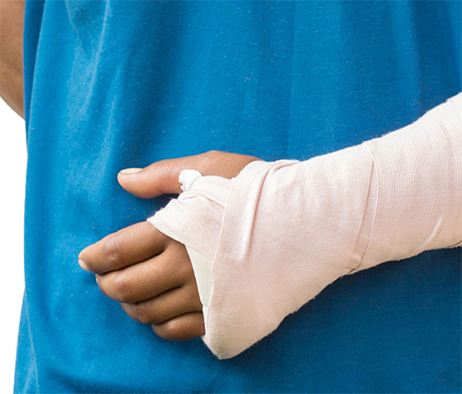
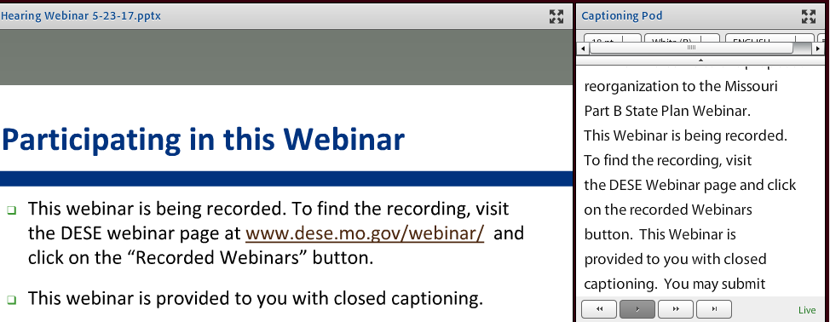

We are ALL just temporarily able-bodied
Notes:
Inclusive design benefits all kinds of circumstances beyond someone identified as ‘disabled.’ Someone with a fractured wrist, someone in a noisy environment, someone who prefers to read AND listen to a webinar, or someone who is aging, these are just a few examples of those who benefit from inclusive design.

Slide 10
Guiding Principles
POUR Concept
Perceivable
Operable
Understandable
Robust
Notes:
The guiding principles of accessibility. These principles put people at the center of the process.

Slide 11

Perceivable
Input into the brain via senses
Think: touch, hearing, sight….
Examples…
Alt-text for all images
Form elements labeled
Tables are for data
Color contrast
No pictures of text
Closed-captions for video

Slide 12
Operable
Not everyone uses a standard keyboard and mouse
Navigate content by multiple methods – search features, site indexes and site maps
Use proper page headings, bulleted lists, etc.
User-controlled time limits
Video or moving content should allow for pausing, rewinding or fast-forwarding
Notes:
Many times, sites are designed around the concept of using a mouse. Most assistive tech devices emulate keyboard functionality, not mouse.

Slide 13
Understandable
Language should be as easy to understand as possible
Navigation consistent and predictable
Form controls clearly labeled
Notes:
Language – how simple should it be? If you are familiar with your audience’s background, this will help guide. But if you don’t know their background, err on the side of caution by using simple language.
Usability and accessibility are not mutually exclusive categories. Significant overlap between the two

Slide 14
Robust
Web content should not require specific technologies or version
Strike a balance between pushing innovation and considering the technologies used by your audience
Notes:
In the past it was common to see sites optimized for certain browsers or versions of browsers. You do not see much of this now.
This does not mean sites need to be developed for the lowest common denominator

Slide 15
Why Should I Care About
Inclusive Design-2?
2. Smart Thing to Do
Opens your site to a wider audience (potential 20%+ or 57 million increase in users)
Good for search engine optimization (SEO), search bots, Google ranking, etc.

Slide 16
Why Should I Care About
Inclusive Design-3?
3. Lawful Thing to Do
Government-funded programs/schools, airlines, non-profits and even private companies are required
Reduce Legal Liability - even if you aren’t legally obligated (like government is), you can be subject to an ADA complaint.

Slide 17
What Laws
Affect Accessibility?
Section 504
Section 508
Section 255 – Telecommunications
ADA – Title II (state and local government)
ADA – Title III (public accommodations)
IDEA – K-12 Education
And private companies hope they won’t get sued, but it has happened
  Winn-Dixie, Hobby Lobby, Five Guys, etc. (2017)
Notes:
These are the laws governing web accessibility.
Even though there are not formal rules yet on accessibility against private businesses, this has not stopped citizens, lawyers and the Department of Justice from enforcing the ADA.
Web Accessibility legal updates by Lainey Feingold - http://www.lflegal.com/category/accessibility-laws-and-regulations/legal-updates/

Slide 18
What Standards/Guidelines
Affect Accessibility?
Section 508
Web Content Accessibility Guidelines (International Standard)
Notes:
508 affects Federal government and those wo receive federal funds. The Web Content Accessibility Guidelines (WCAG) are an international standard that the latest version of Section 508 also integrated. In addition, many ADA Title II and Title III complaints reference WCAG to follow for compliance.

Slide 19
Section 508 Refresh
Major Changes
Restructuring provisions by functionality (vision, hearing, cognition, motor, etc.) instead of product type
Incorporating Web Content Accessibility Guidelines (WCAG) 2.0 by reference (Level A and Level AA) to websites, as well as to non-web electronic documents and software
What types of non-public facing electronic content that must comply
Notes:
These are the major changes related specific to website-related work

Slide 20
Think about this…
Back in 2009, the “Mobile First” approach appeared, where we design for smaller screens first (smart phones and tablets) then add more features and content for larger screens.
Now…“Accessibility First”
  Build as much of it in to design as possible
  Educate content editors
Notes:
The mobile and accessibility first concept both share similar philosophies in that we are building usability features into the initial design.
Then, the functionality is there when we need it.

Slide 21
Examples of Website Accessibility Features
W3C Web Accessibility Easy Checks
Image alternative text (pictures, illustrations, charts, etc.)
Defining headings throughout your content
Proper Color Contrast
Keyboard Access
Multimedia Alternatives
Notes:
Not a complete list
Multimedia alternatives such as captions, transcripts and audio descriptions for video.

Slide 22
Plain Language (Readability)
The more complex the material, the shorter the sentences should be
Sentences should average around 20 words
Vary with 35-word and some 3-word sentences.
Keep 3- and 4-syllable words to a minimum
Notes:
Readability is a AAA level guideline but an important one none the less, especially language used in government work
Mention in the standards to adhere to AAA where it makes sense and when possible

Slide 23
Plain Language
The more complex the material, the shorter the sentences should be
Sentences should average around 20 words
Vary with 35-word and some 3-word sentences.
Keep 3- and 4-syllable words to a minimum
Notes:
Readability is a AAA level guideline but an important one none the less, especially language used in government work
Mention in the standards to adhere to AAA where it makes sense and when possible

Slide 24
Perspectives From Those Who
Need Accessible Design
User Perspectives Video
“Accessible Design Matters”
Notes:
Developed by Missouri Assistive Technology after the Power Up Conference in April 2018.
6 minute video

Slide 25
Web Accessibility Resources
Missouri ICT Accessibility website
(launched January 2018)
Notes:
Maintained by Missouri Assistive Technology in collaboration with ITSD
Resource site for web accessibility
High Level Review of Site by category:
ICT Law
Electronic Documents
Meetings
Multimedia
Plain Language
Procurement
Social Media
Training Resources
Users & Technology
Websites and Web Applications
Will go into more detail about the training options

Slide 26
Web Accessibility Training
Recommended Role-Based Approach
Web Content Editors
(including documents editors)
Web & Application Testers
Web & Application Developers
Multimedia Developers
And more…
Notes:
For further training beyond basic accessibility training (this training)
Online training page set up for suggested training topics by what role or roles you play in the organization
For example, list of mostly free online courses for Web editors, application testers, application developers and so on.
Training outline based off of a training matrix from the State of Minnesota
Show role-specific table outlined in this document:
https://at.mo.gov/it-access/documents/role-based-high-level-training-plan-draft.pdf

Slide 27
Q & A
(Insert contact info here)
https://at.mo.gov/it-access
Note: Some presentation material adapted from presentations by Carie Fisher

