Slide 1
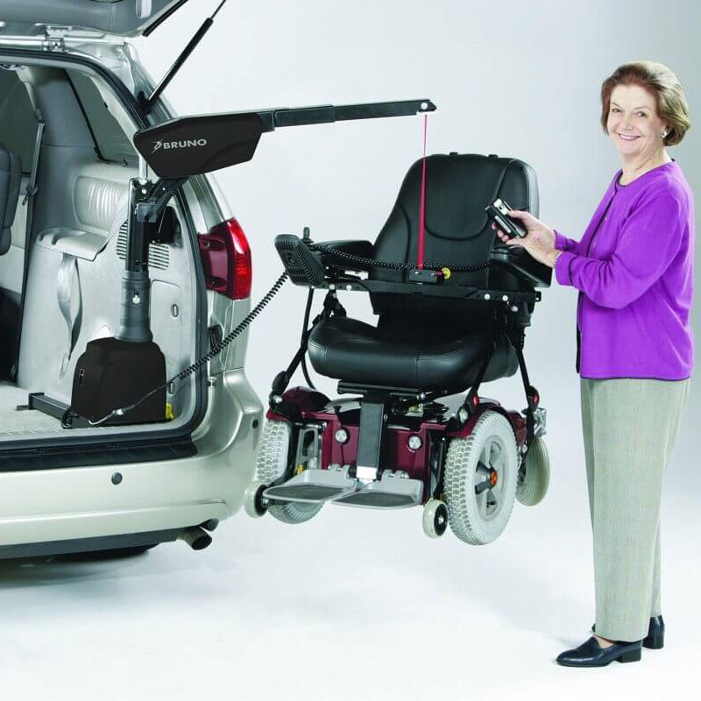
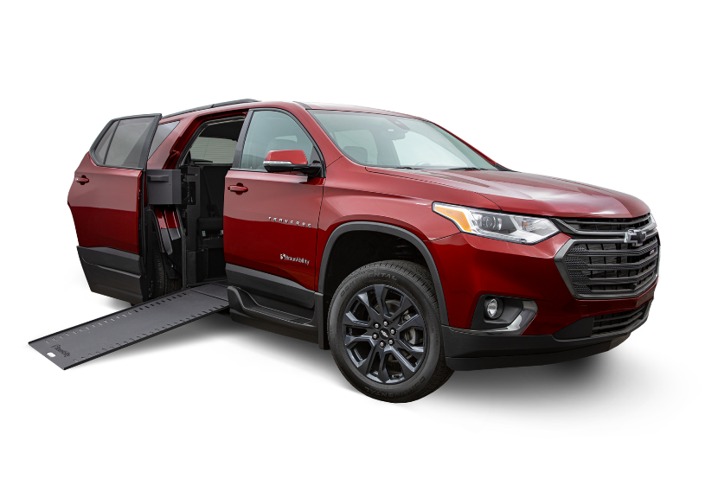
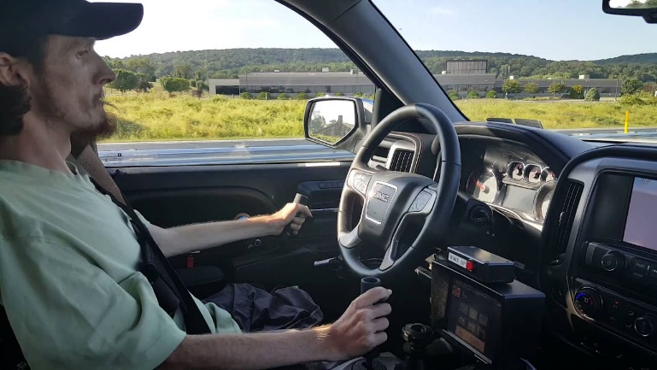
Vehicle Adaptations
Road to Independence
April 8, 2024
Stephen Kinstler
United Access

Slide 2
What do Automotive Mobility Equipment Dealers do?
Provide solutions to achieve independence through mobility.
Accessible Vehicles (Vans, Trucks, Cars, etc)
Transport drivers or passengers that remain seated in a wheelchair or scooter
Scooter and Wheelchair Lifts
Transport unoccupied wheelchairs and scooters
Driving Controls and Aids
Hand controls, high tech driving controls, transfer seats, left foot accelerators, etc.
Mobility Seats
Help ease entry and egress from vehicle
Notes:
We provide solutions that help people achieve freedom and independence.
Accessible Transportation, Vans, etc.
Transports drivers or passengers that are seated in mobility devices
Lifts for scooters and power chairs
Mobility Devices
Hand controls, high tech driving controls, transfer seats, left foot gas pedals, etc.
Here at United Access – we go beyond that – we also help provide our customers with a community – work with accessible sports programs, etc to help our customers achieve not only transportation but the ability to do the things they love!
Here at United Access – we go beyond that – we also help provide our customers with a community – work with accessible sports programs, etc to help our customers achieve not only transportation but the ability to do the things they love!
Here at United Access – we go beyond that – we also help provide our customers with a community – work with accessible sports programs, etc to help our customers achieve not only transportation but the ability to do the things they love!

Slide 3
Who Do Mobility Dealers Work with?
Who Do Mobility Dealers work with?
Disabling Diseases and Conditions
Amyotrophic Lateral Sclerosis – ALS – Lou Gehrig’s Disease
Cerebral Palsy - CP
Muscular Dystrophy - MD
Multiple Sclerosis - MS
Post-Polio
Spina Bifida
Stroke
Amputation
Mobility issues related to aging process
Injury-related Disabilities:
Brain Injury
Spinal Cord Injury – SCI
Traumatic Amputation

Slide 4
The Mobility Process… a Road Map for Independence
The Mobility Process
Diagnosis – Long Term Needs/Short Term Needs
Assessment with your Mobility Dealer/Funding
Entry/Egress Needs, Durable Medical Equipment Used
Driver Evaluation
Equipment

Slide 5
Mobility Dealer Assessment
Needs Analysis
Nature of the disability
Walking aids or Mobility equipment used
Current vs. Long-term diagnosis
Abilities/Stature:
Driver/Non-driver
Abilities and/or Physical Limitations
Seated Height (Top of head to floor while seated in a wheelchair)
Lifestyle
Daily ease
Traveler
Family size or number of passengers
Funding

Slide 6
Equipment Options
Scooter & Wheelchair Lifts
Mobility Seating
Lowered-floor minivans
Full-size vans
Truck Conversions
Driving controls
Lock down devices

Slide 7
Scooter and Wheelchair Lifts Stow an unoccupied wheelchair or scooter
Benefits
Compromises
Applicable to many vehicle types
Can be switched from one vehicle to another, with some limitations
Low cost option
Will not accommodate all scooters, power wheelchairs or vehicles.
Patient needs to be ambulatory or have a care-taker
May lose vehicle seating
Less flexible as condition changes
Not a large resale market

Slide 8
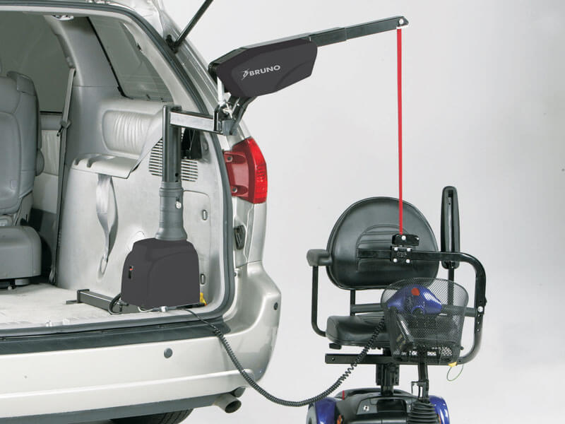
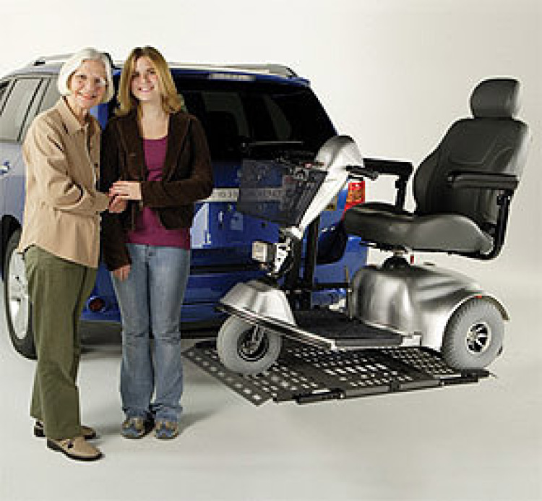
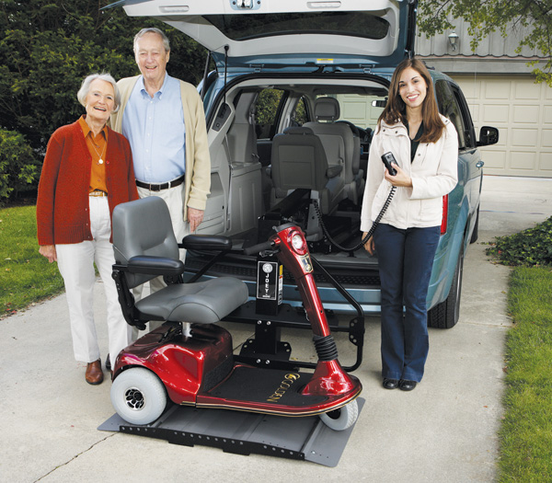
Vehicle Lifts
Basic Lift Types:
External Lift (platform and wheeled)
Boom/Interior Lift
Interior Platform Lift
Boom/Interior Lift
Interior Platform Lift
External Lift

Slide 9
Mobility Seating Providing Ease of Entry into the Vehicle
Benefits
Compromises
Applicable to many vans, minivans and SUV’S
Eases entry into a taller vehicle
No drill installation to increase re-sale value
Removable, can be transferred to other vehicles with some limitations
370 lb weight capacity
Still need to stow wheelchair, if applicable
Not able to work in many driver’s areas
Speed of entry and egress is limited

Slide 10
Options for seat transfer
Link by Adapt Solutions
Turny EVO by BraunAbility

Slide 11
How does a wheelchair accessible minivan differ from a standard minivan?
A lowered-floor (10 to 14 inches) increases door opening height, creating ease of entry for wheelchair users and greater interior height inside the vehicle.
Removable Driver and Front Passenger seats.
Multiple positioning options for comfort (Driver, Passenger, middle area position).
Middle row seats are removed for interior maneuverability.
A power kneeling system decreases ramp angle to allow a smooth transition upon entry and exit of vehicle.
One-touch entry system.

Slide 12
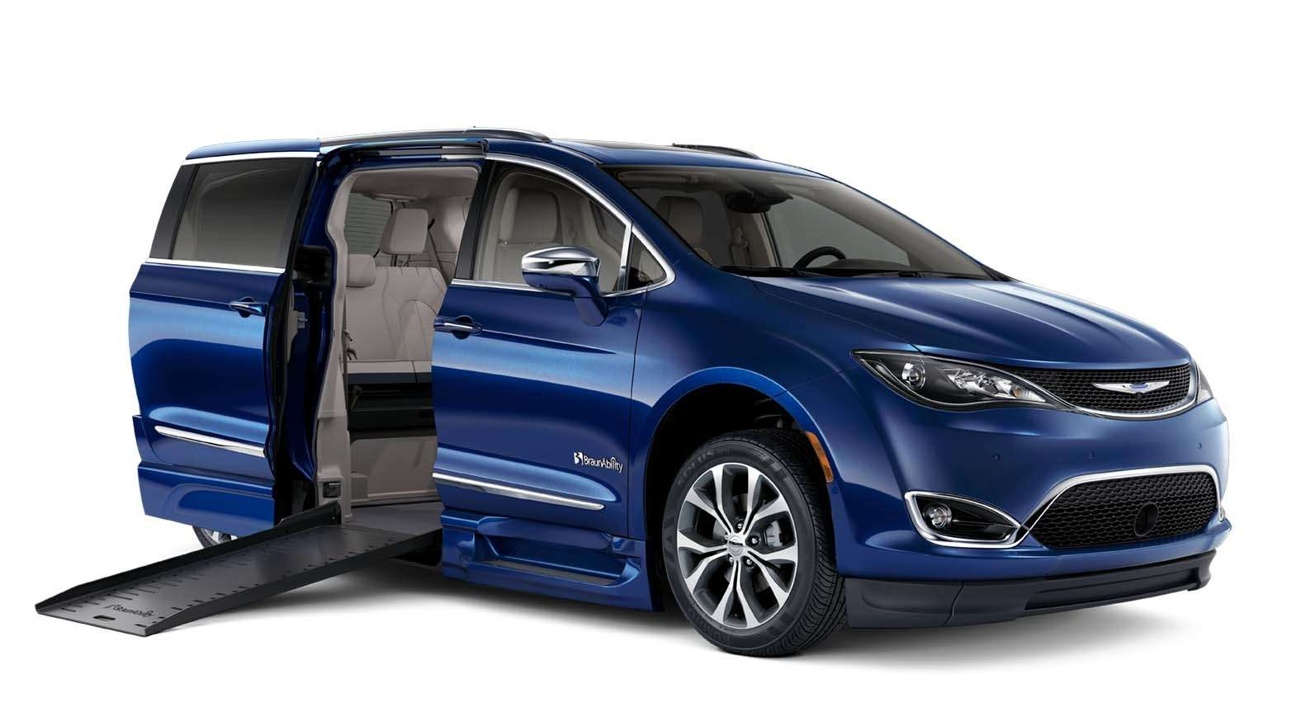
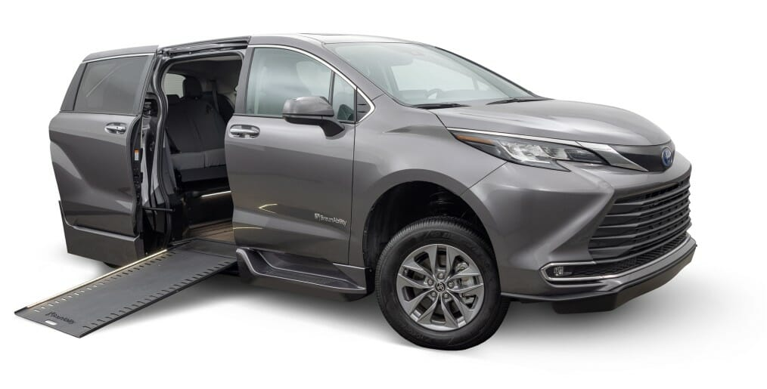
Lowered-Floor Minivan Side-entry
Foldout Ramp
Infloor Ramp

Slide 13
Wheelchair Accessible Minivan Advantages & Disadvantages
Benefits
Compromises
Can ride or drive from your wheelchair
Flexible seating arrangements
Long-term Solution
Resale opportunity
Vehicle Selection Limitations
Limited Passenger Capacity
Limited towing options
No all-wheel drive options*
Expense

Slide 14
Full-Size Van Adaptations Available
A lowered-floor to increase door opening height and interior height for wheelchair users.
Raised Roof to increase interior height.
Raised Door to increase door opening height.
Door operators and Lift to accommodate an
occupied wheelchair.
Transfer seats available.

Slide 15
Full Size Van Advantages & Disadvantages
Benefits
Compromises
Many customizations possible
Additional storage areas
Initial costs
Towing Capabilities
Weight Capacity
Gas mileage
Maneuverability & Parking
Speed of entry/egress
Customizations can be expensive
Less of a re-sale market

Slide 16
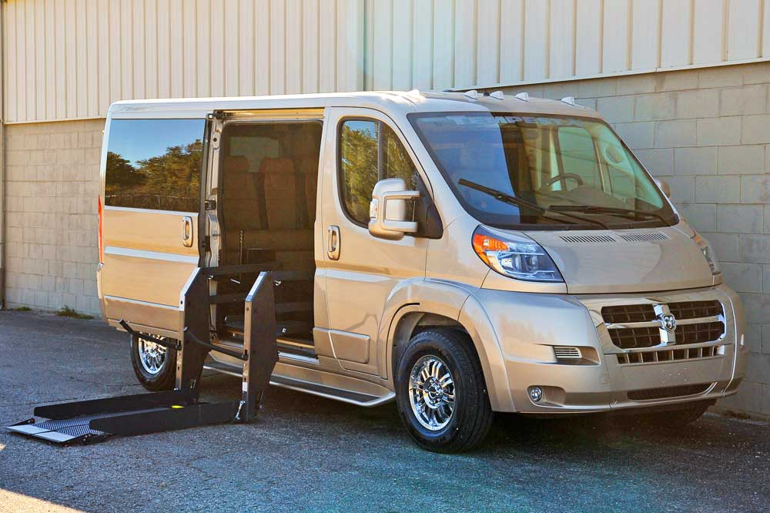
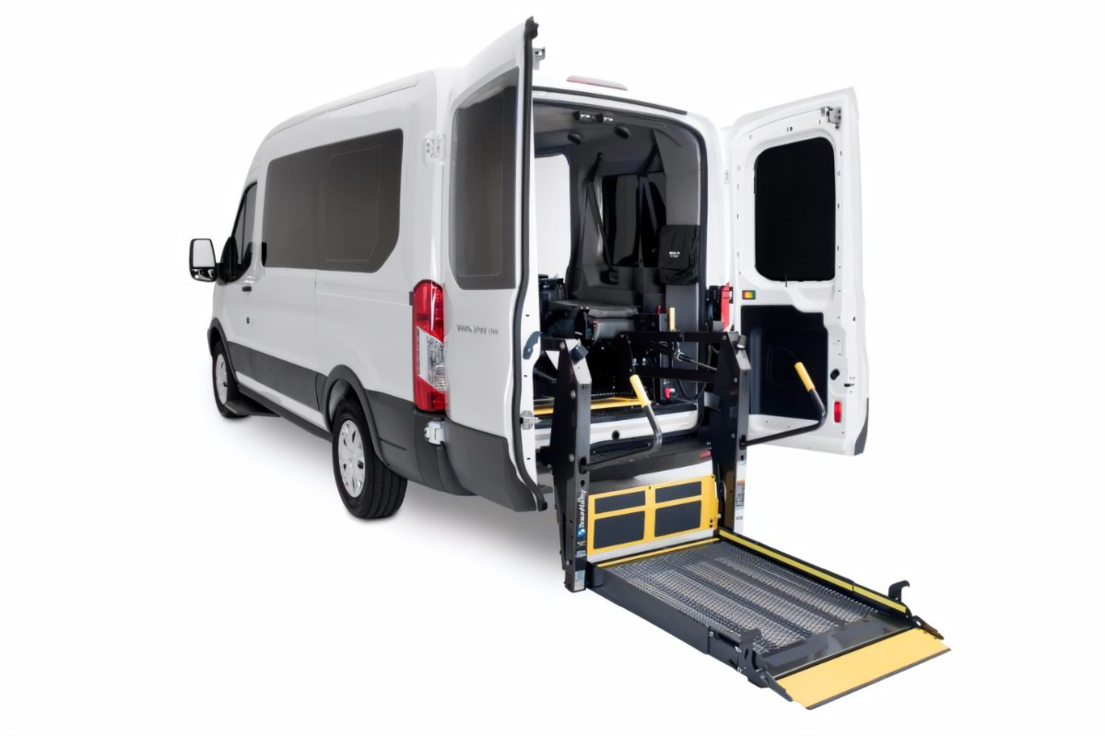
Options
Side Entry
Chassis:
Ford Transit
Ram Promaster
Mercedes Sprinter
Options:
Standard Top
High Top
Standard Wheelbase
Extended Wheelbase
Conversion Vans
Rear Entry

Slide 17
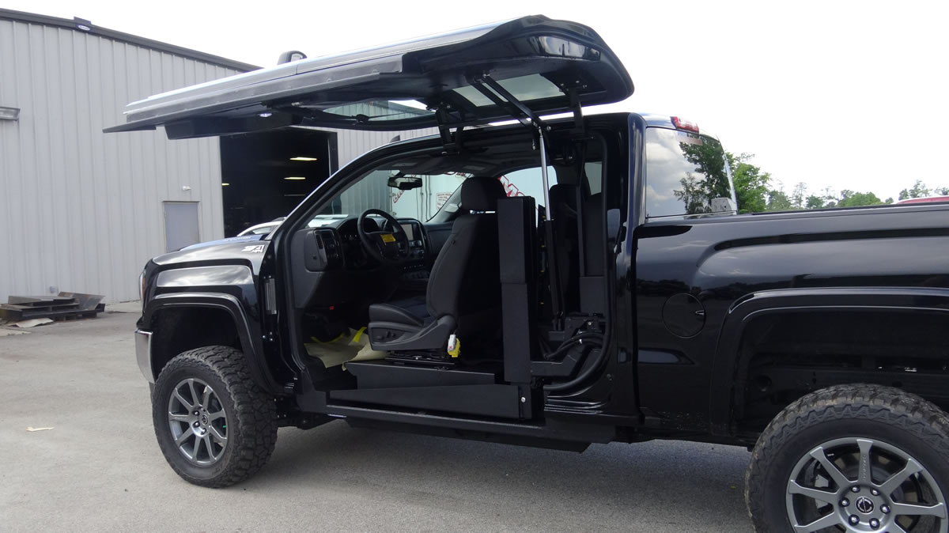
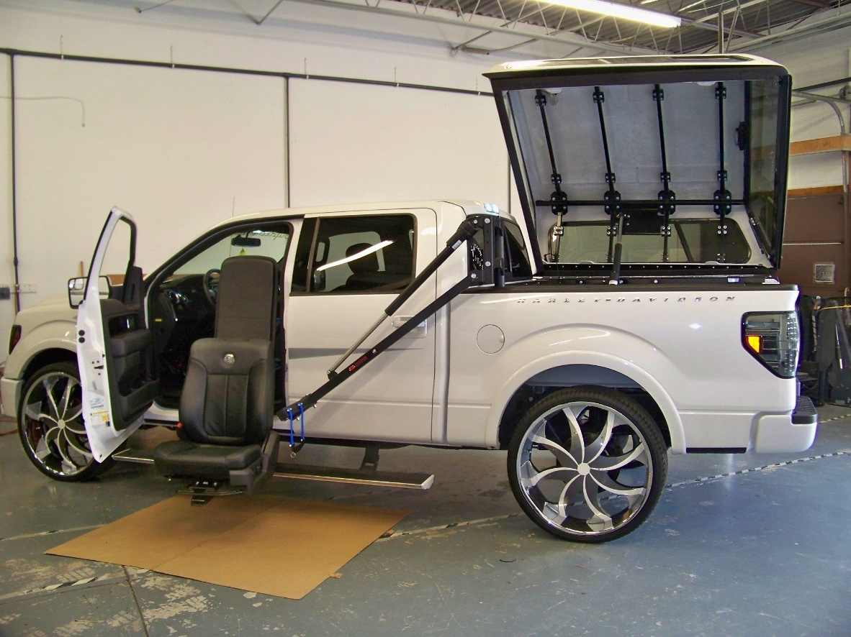
Additional Vehicle Modifications (Truck Conversions)
ATC Conversions
Access a Top Pickup Conversion

Slide 18
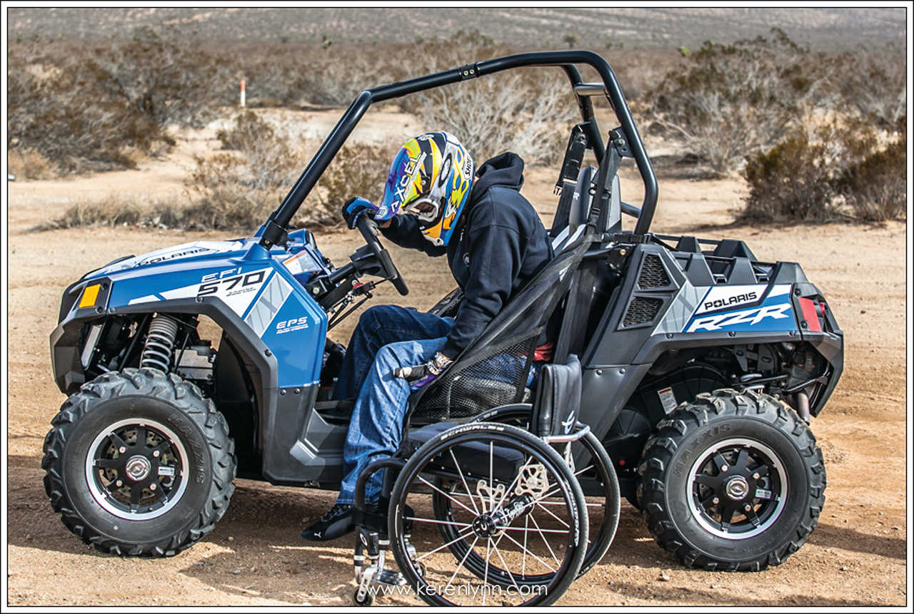
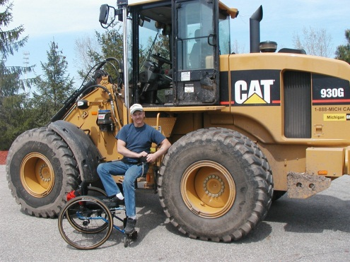
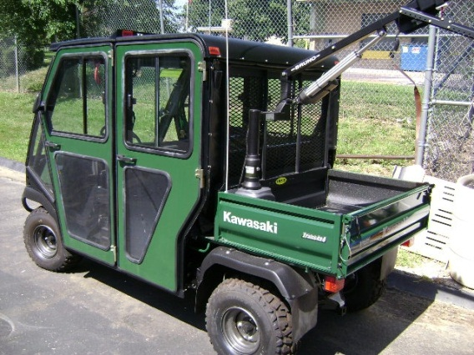
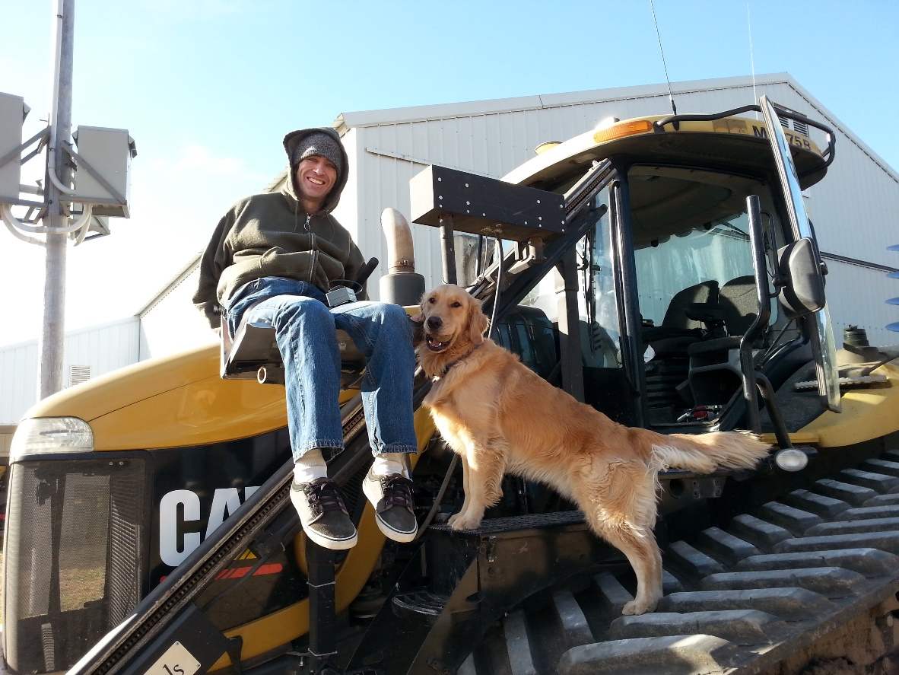
Additional Vehicle Modifications

Slide 19
Steering Devices

Slide 20
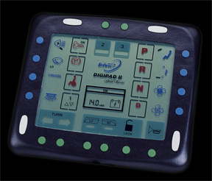
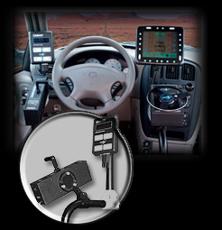
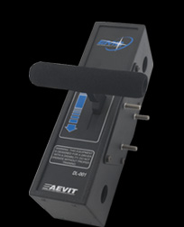
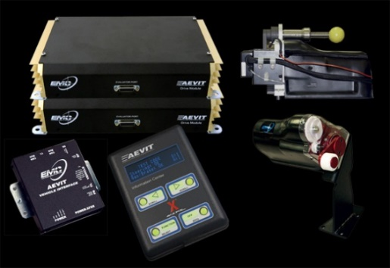
High Tech Driving Controls

Slide 21
The Future of Mobility
Hybrid Vehicles – Currently available on the 2021 Toyota Sienna and Up. Other manufacturers to follow.
Electric Vehicles – In development at this time. As States legislate a move towards electric vehicles, the mobility industry is facing significant challenges in developing this technology for accessibility.
Autonomous Vehicles – Offers tremendous promise but will not be available until there is a suitable chassis with enough room for a wheelchair seated passenger.

Slide 22
FAQ
How much do vehicle adaptations cost?
Are there used equipment or vehicles available?
Can you rent a wheelchair accessible van?
How long does the process take?
Does insurance cover vehicle modifications?

Slide 23
For questions or further information, we are available at your convenience.
United Access
888.939.1010
Stephen Kinstler
816-471-0305
Steve.Kinstler@unitedaccess.com

