Slide 1





Breaking Barriers
By David Carnahan & Sennora Williams
Breaking
BARRIERS

Slide 2



Agenda
Agenda
Ice Breaker
Introduction
MC5
Exploration
Conclusion
Questions

Slide 3





Ice Breaker
Let's Not Sugarcoat it...
ICE
BREAKER
What do you think David CAN’T Do?
What are things you do, that you don’t have to watch yourself do?

Slide 4


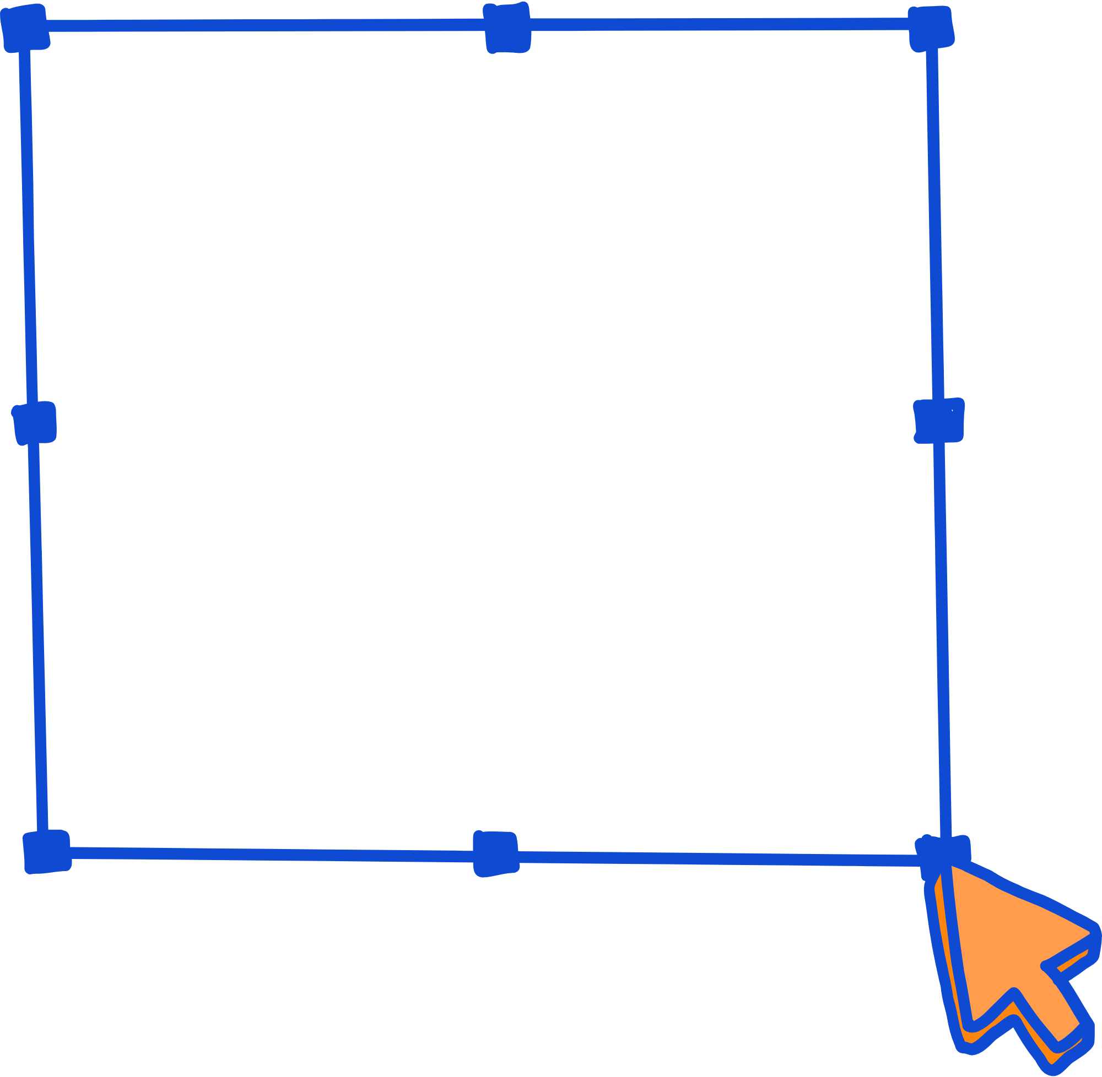
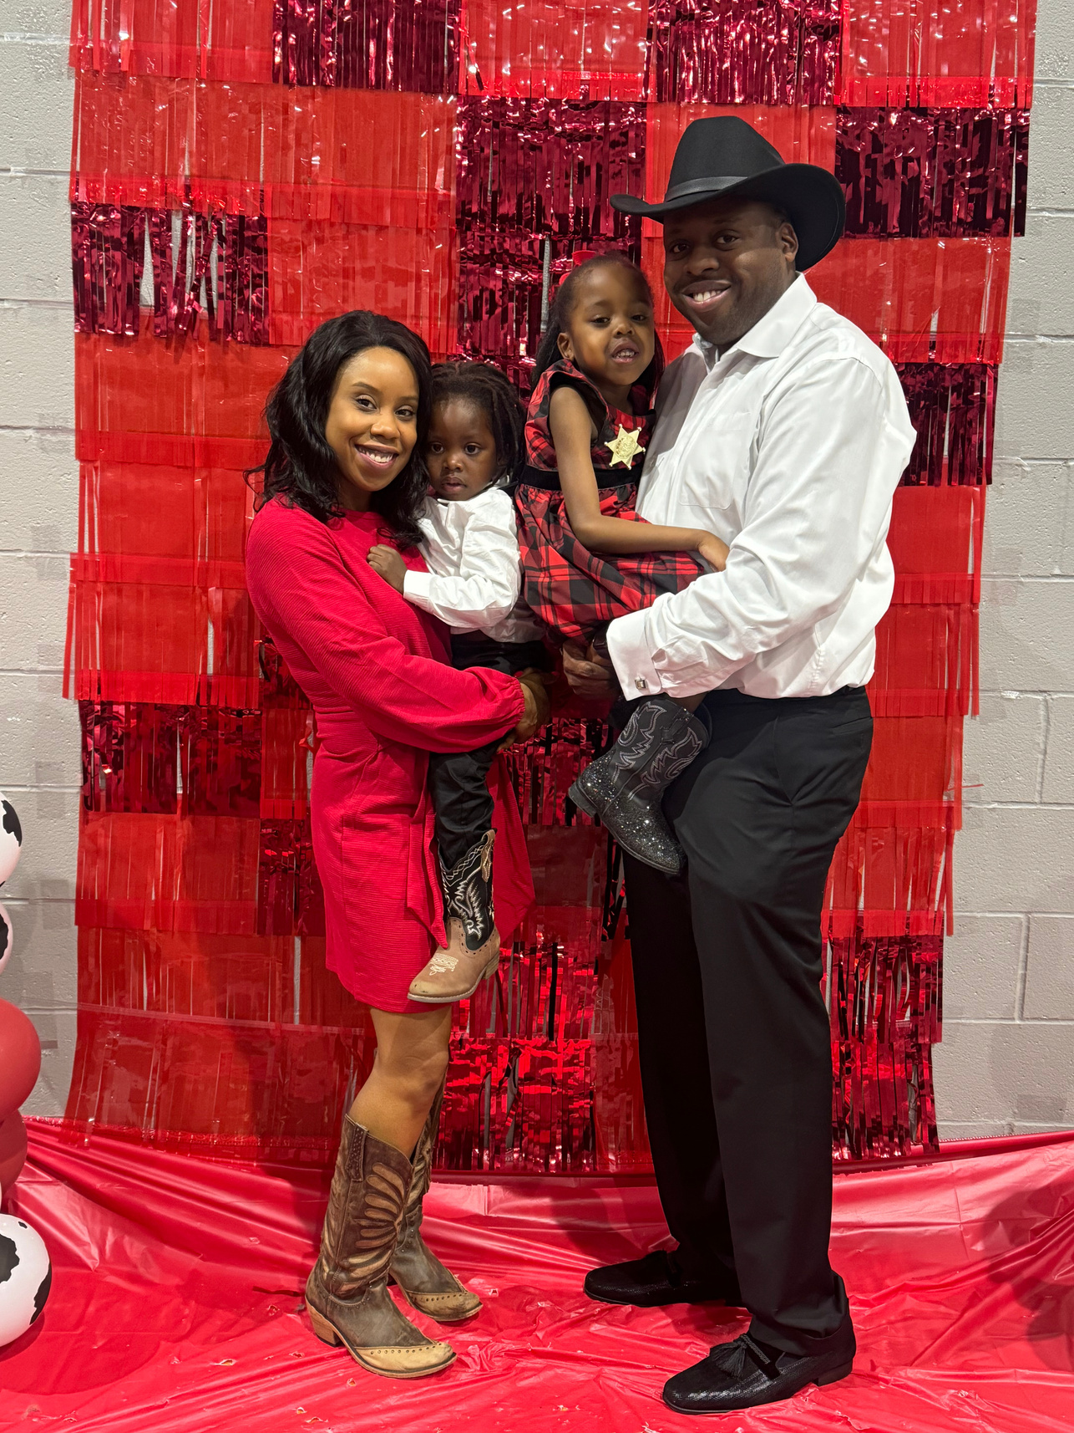
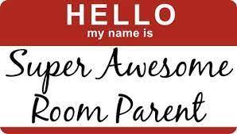



Introduction of Sennora
Hi there! I’m Sennora!

Slide 5
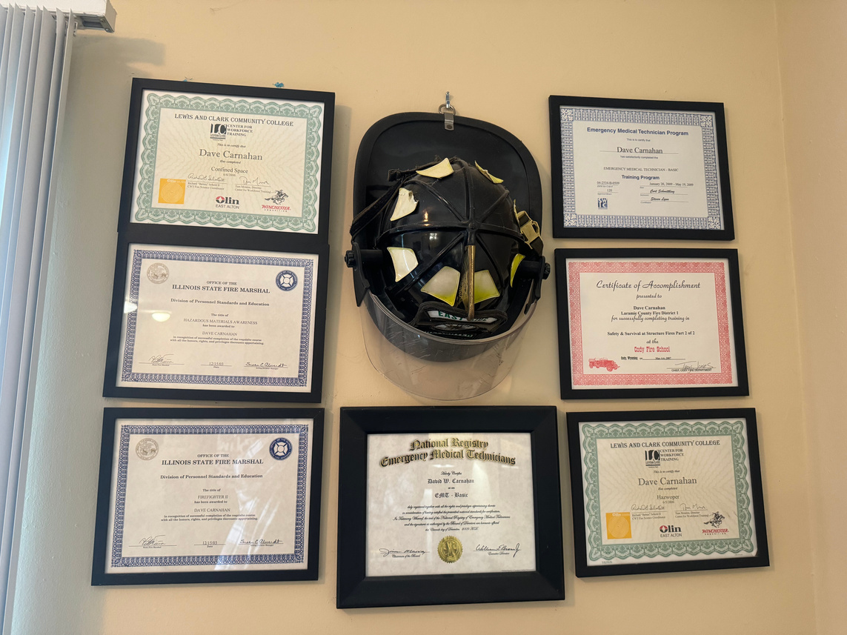
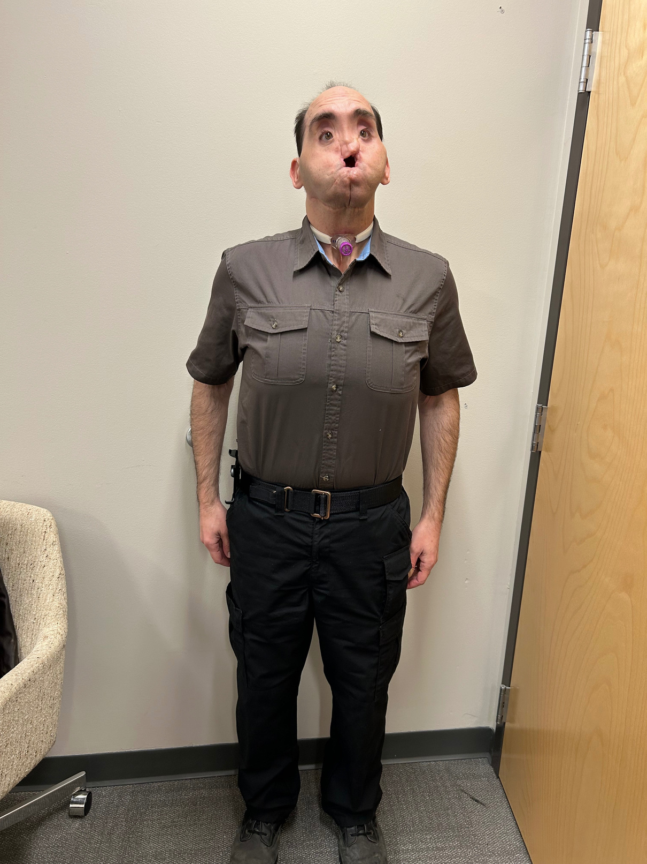



Introduction to David
Hi there! I’m David!

Slide 6


Culture
MC5
VISION
Changing the culture of adult care across Missouri
Change
Care
Celebrate
Communicate
Collaborate
The continuum of adult care in Missouri is satisfying, individually meaningful and person centered - striving toward person directed.
MISSION
MISSION ACTIVITIES
To promote and support ongoing collaboration within the adult care continuum to create environments where the dignity and value of each individual who lives or works there is repsected and celebrated.
Communication
Education
PIONEER NETWORK

Slide 7
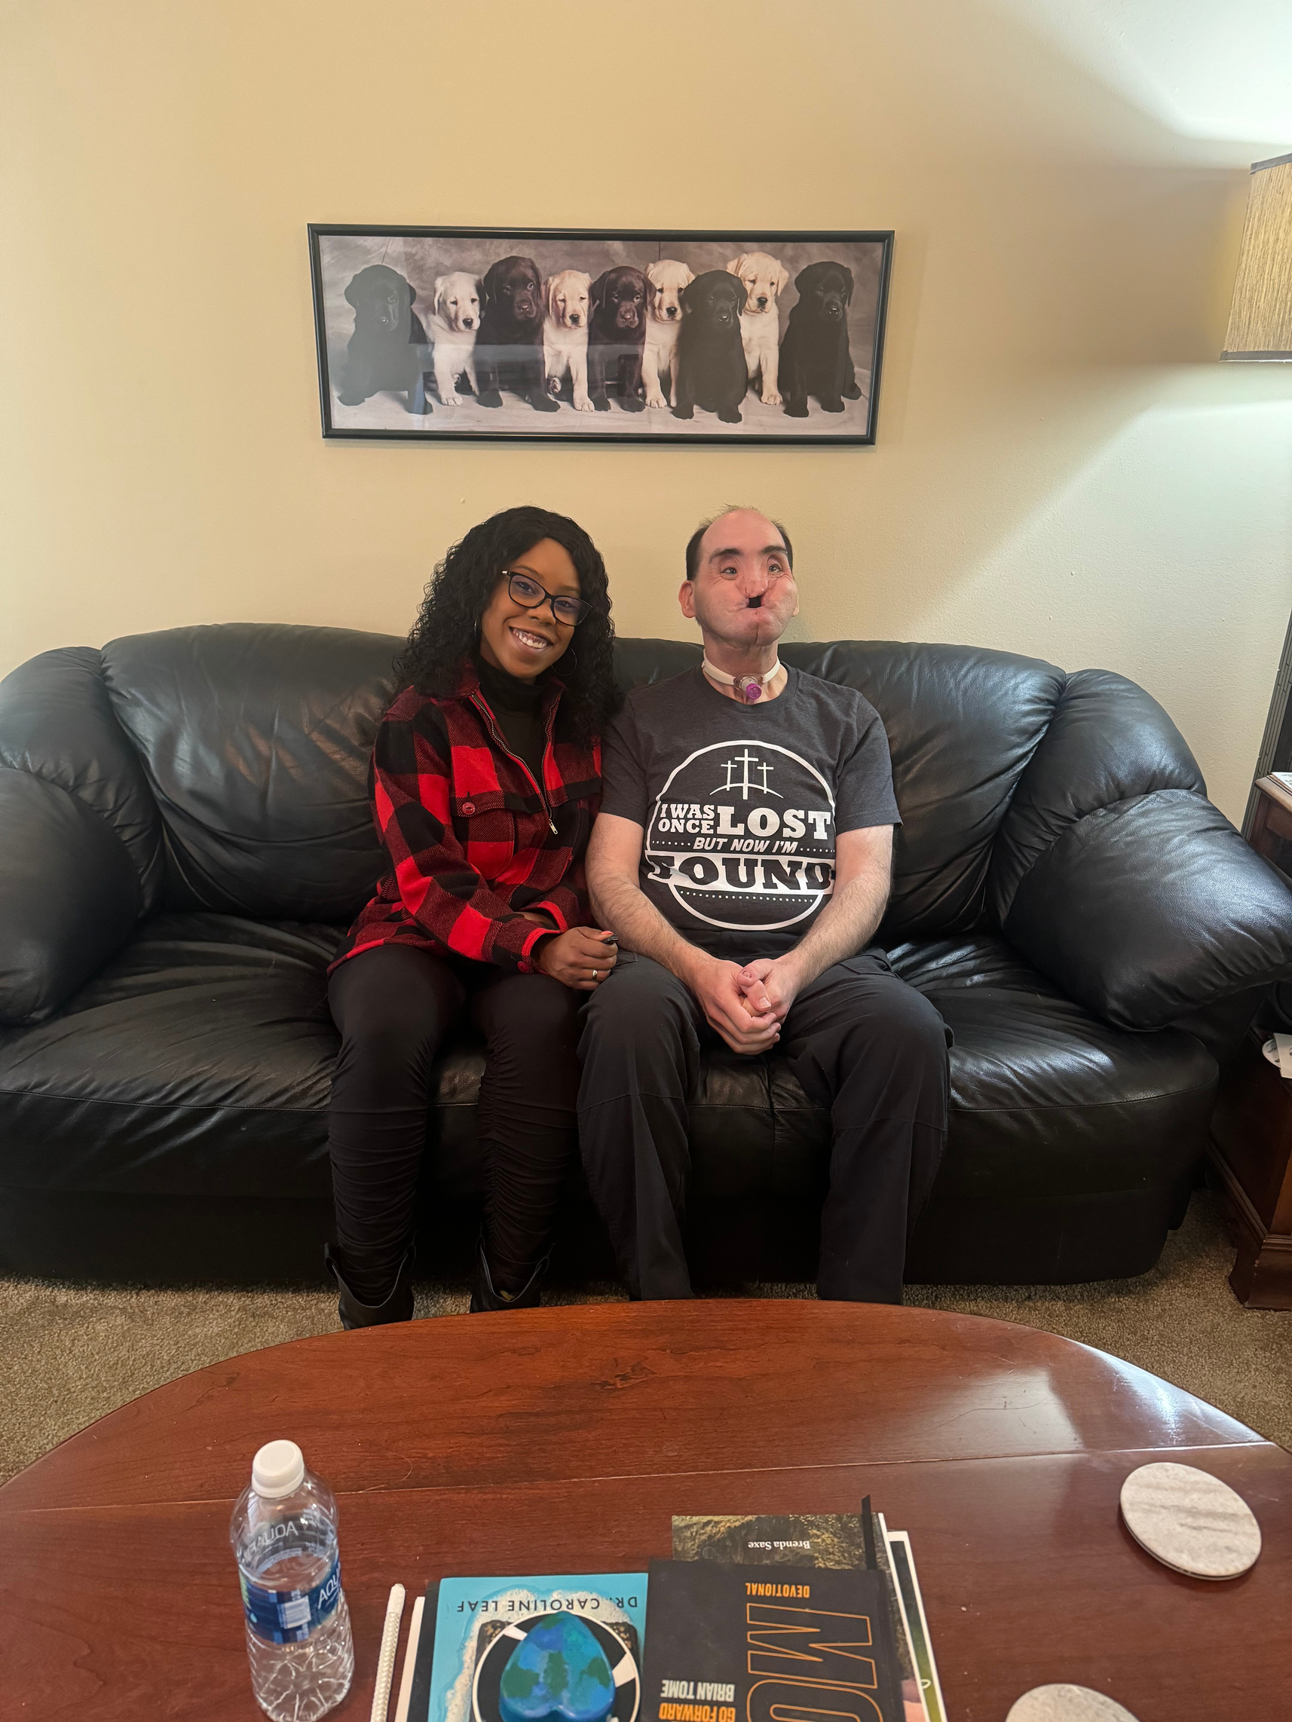


Our Intention
Our Intention
1
Talk To - Not About
2
Demonstrate
3
Call To Action

Slide 8
Milestones
Independence
Independence
The state of wanting or being able to do things for yourself and make your own decisions, without help or influence from other people.
Smart home technologies
Wearable health devices
Prosthetics and Exoskeletons
Automated Vehicles
Navigation and mobility aids
Milestones
Community
Community
ACHIEVED
A feeling of fellowship with others, as a result of sharing common attitudes, interests, and goals.
Social Media
Augmented and Alternative Communication Devices
Speech recognition software & text to speech
Captioning and sign language translation
Virtual and Augmented Reality
Work & Education
Work & Education
To perform work or fulfill duties regularly for wages or salary.
A discipline that is concerned with methods of teaching and learning in schools.
Accessible Computing and Mobile Technologies
Remote work technologies
Brain computer interfaces
E - Learning and Apps
Workplace Accomodation tools

Slide 9

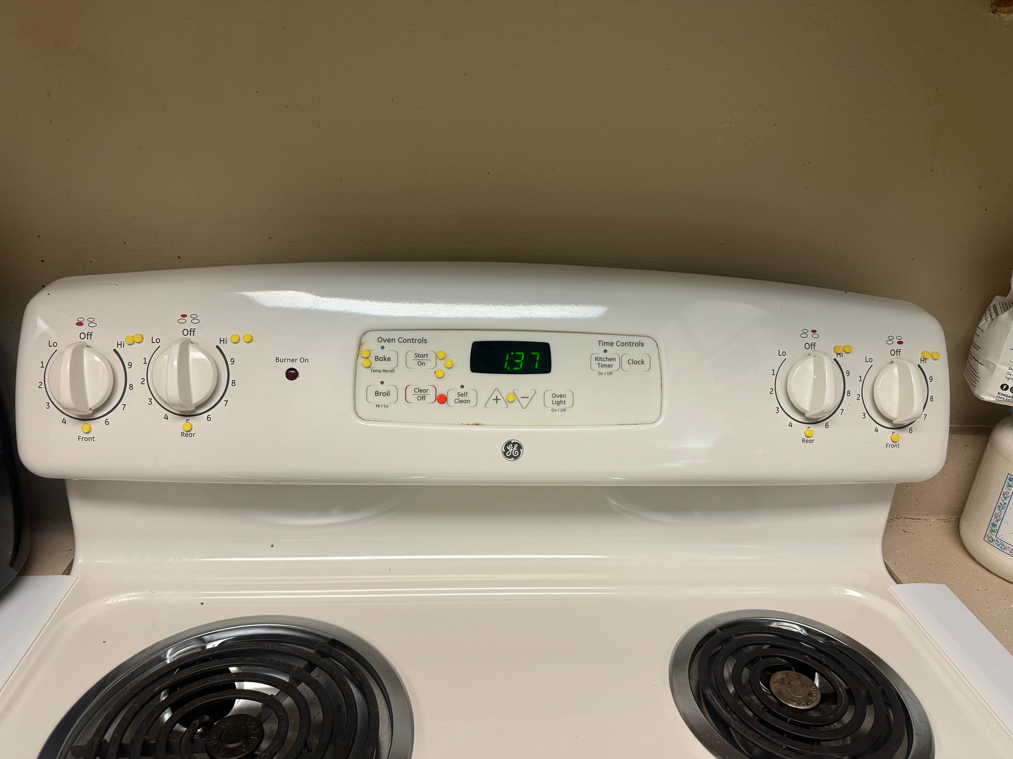
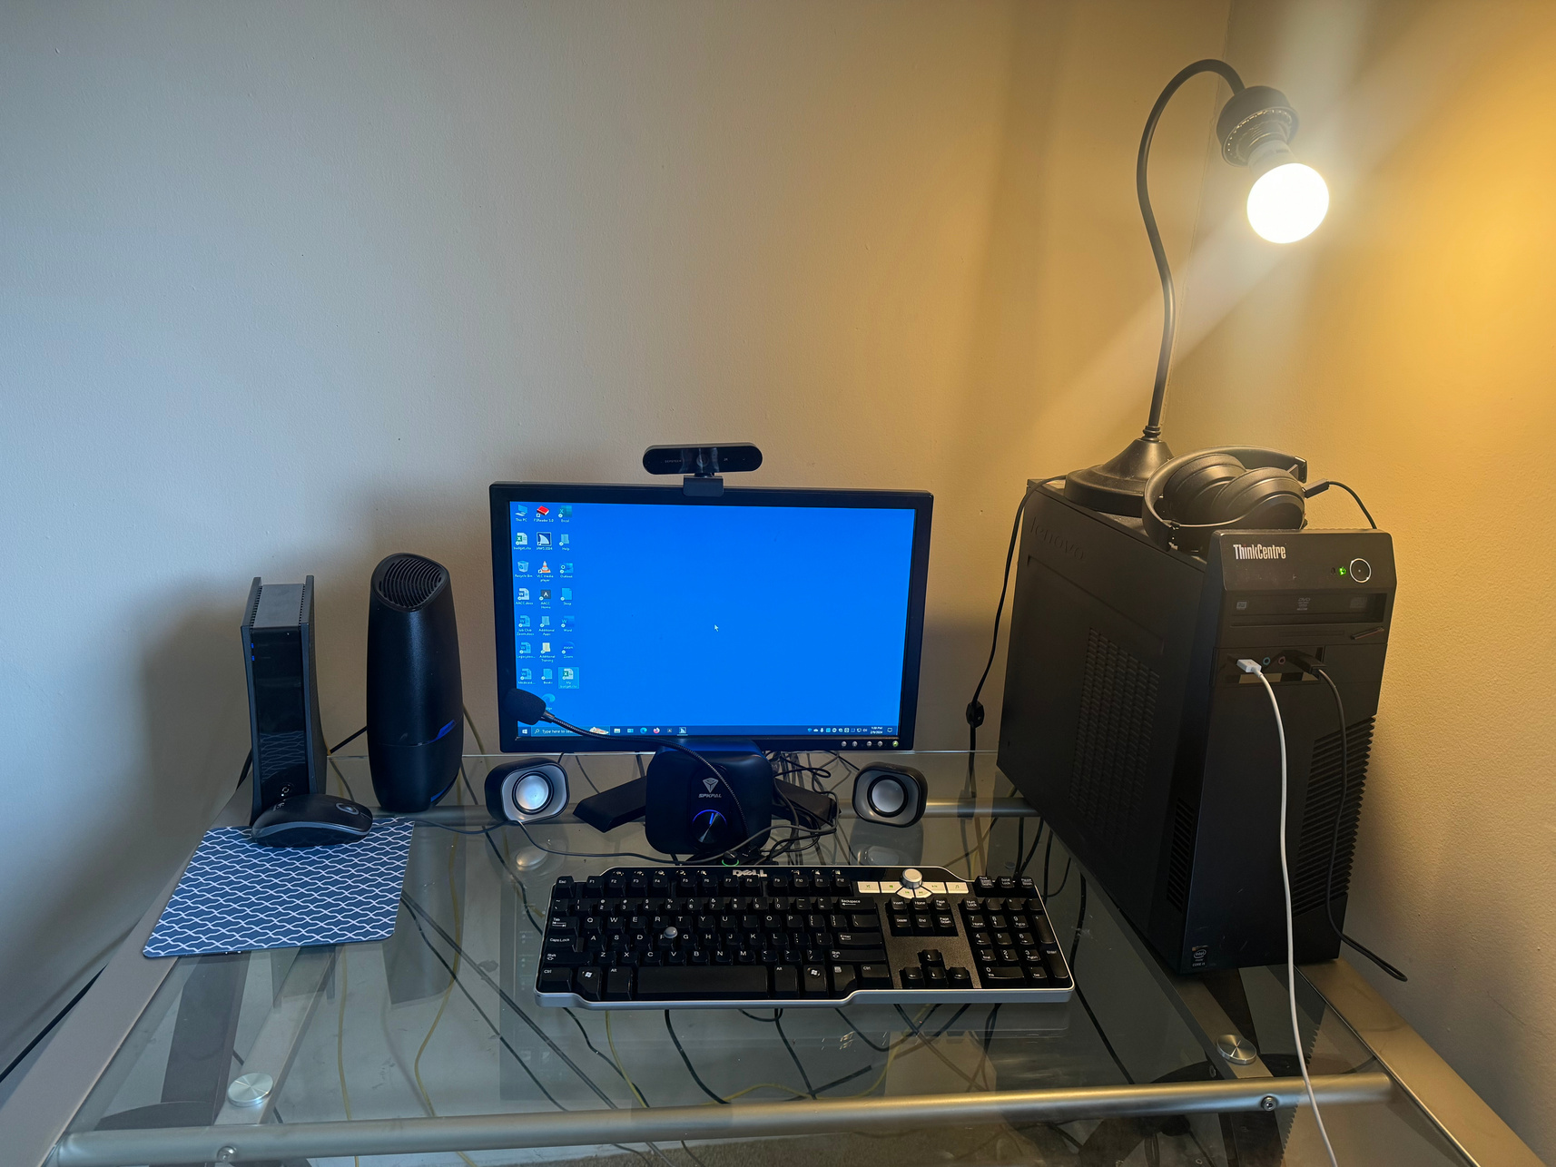
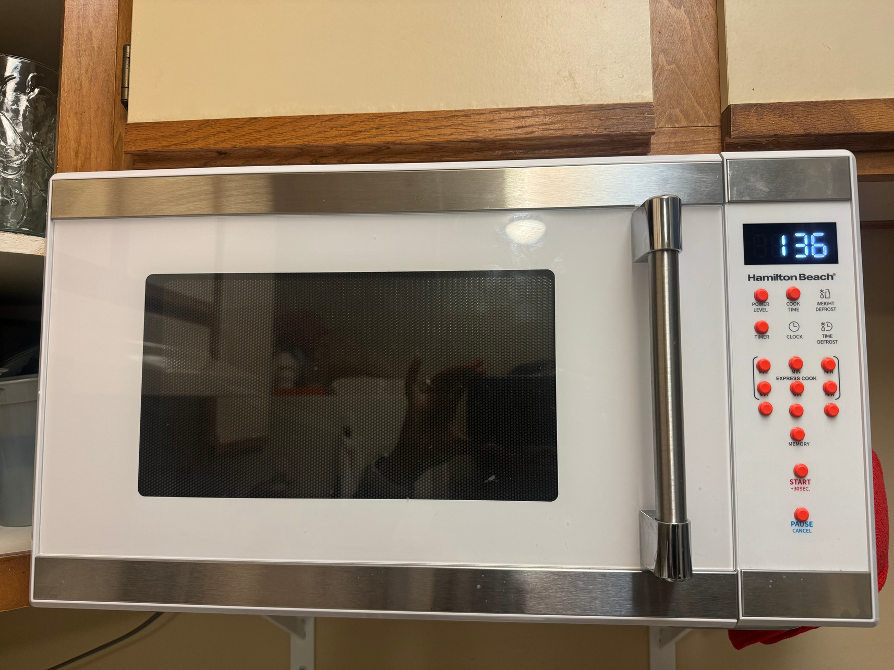
Adaptations

Slide 10


Consider this
MISUSE & MALICIOUS USE
ECONOMIC INEQUALITY
THINGS TO CONSIDER
DATA PRIVACY
AFFODABILITY
ACCESSIBILITY
CONFIDENTIALITY
CONFIDENTIALITY
BIAS & FAIRNESS
TRANSPARENCY & EXPLAINABILITY
JOB DISPLACEMENT
DEPENDENCE & AUTOMATION BIAS
SECURITY RISKS
REGULATORY & ETHICAL OVERSIGHT
ENVIORNMENTAL IMPACT

Slide 11
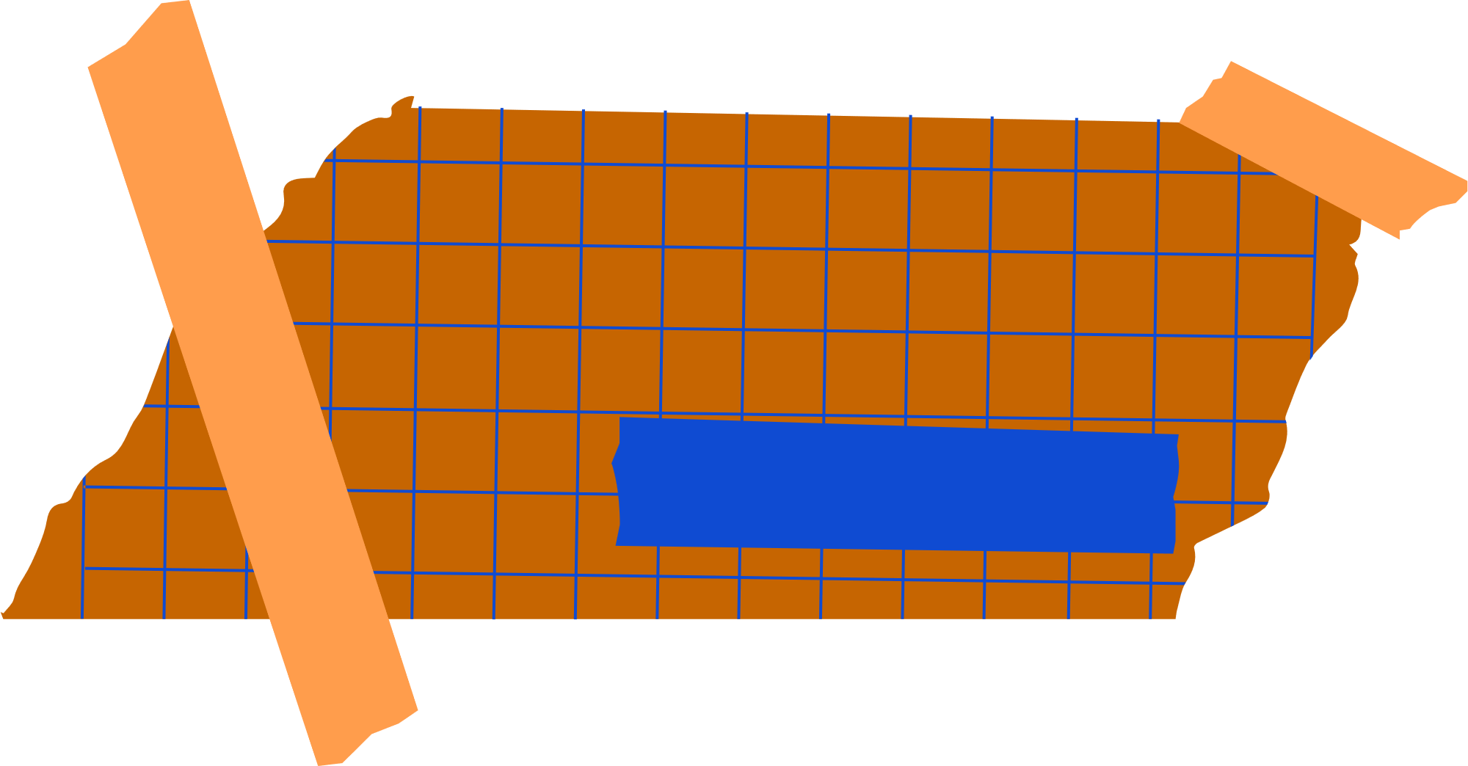






Take Action
Take
ZOOM In...
Action!
Open Minded
Abelism

Slide 12

Contact Us
CONTACT US
LEARN MORE
Sennora Williams
David Carnahan
MC5
MOMC5 Website
SWilliams@TheSWBrand.Com
DavidCarnahan80@Gmail.Com
MissouriMC5@Gmail.Com

Slide 13

End
THANK
YOU!

