Slide 1
EXPAND YOUR IMPACT
Virtual Group Training for Blind Individuals

Slide 2
Learning Objectives
Technology Training: VGT vs. 1:1 vs. self-taught (online)
Describe the differences between traditional assistive & self-taught (online) technology training programs & innovative, immersive, & intensive training courses.
VGT Strategies
List at least three unique approaches to teaching individuals who are blind or visually impaired in a virtual setting
VGT Pros & Cons
Compare & contrast the benefits & tradeoffs between group & one-on-one technology training of individuals who are blind or have low vision.

Slide 3
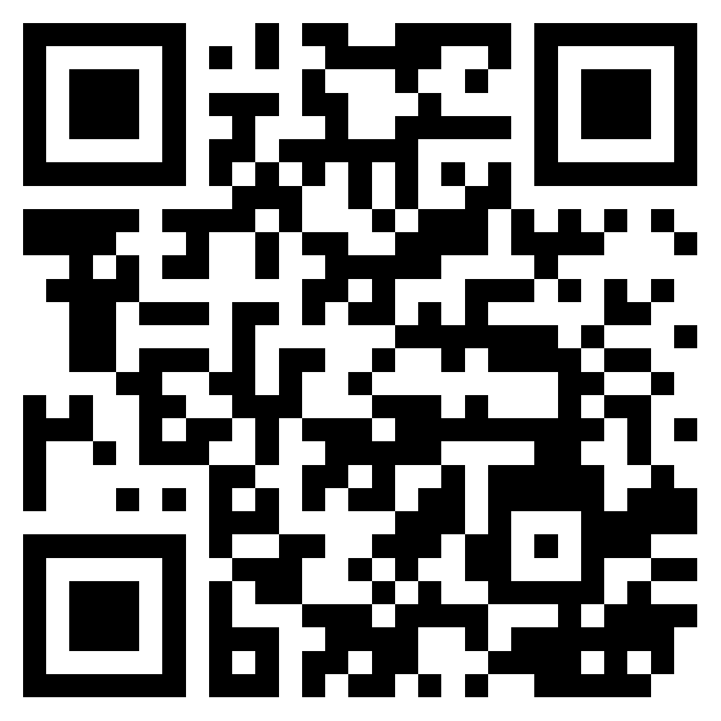
Meet the Speaker
Megan Aragon
Technology Services Administrator
East Texas Lighthouse

Slide 4
Virtual Group Training: Can it Really Work?
Can we effectively teach a group of adults with vision loss in an online class?
How do we keep everyone engaged?
How can we assist struggling students without holding up the class?
How do we keep technology issues from disrupting the flow of instruction?
Why & when would we choose group over one-on-one training?

Slide 5
TERMINOOOGY & COMPARISONS

Slide 6
What is VGT?
Up to 8 students & 1-2 instructors
2 or 4-week courses
Monday-Friday, 8:30 am –4:30 pm daily
Highly intense, live instruction
Lecture, group activities, & individual assignments

Slide 7
Comparing Training Options
Benefits | VGT | 1:1 | Self-Taught
Setting | High energy Virtual classroom Peer-to-peer learning | In-person or virtual Varying energy level | Passive Independent Online content
Content | Expertly curated High volume, comprehensive Timed cross-application tasks | Expertly curated Individualized content Broken up across sessions | Expertly curated Individualized content Broken up across sessions
Pace | Varies | Very fast Mirrors workplace Set by Instructor | Set by Student

Slide 8
The Big Reason for VGT
56%
Have obtained upward mobility

Slide 9
VGT Benefits
High Energy Environment
Eliminates Transportation Barrier
Peer Group
Speed & Structure
Mirrors Modern Workplace Expectations

Slide 10
VGT Drawbacks
Not quite the same as in-person
Possible distractions & conflicting priorities for employed students
Fast pace may overwhelm some students
Students may feel embarrassed to speak up when not understanding

Slide 11
When to Choose VGT
Teachers with strong:
Classroom management skills
Expertise in multiple applications
Technology troubleshooting skills
Desire to amplify & accelerate training
Students who are ready to:
Dedicate significant time to train
Keep up with a fast-paced class
Prepare for a professional

Slide 12
VGT Strategies That Work

Slide 13
Pre-Course Skill Assessments
Assessments combine a written application & live skill demonstration.
Why it works
Ensures students start at approximately the same skill level
Identify specific gaps in knowledge & learning styles
Allows for alternative recommendations if students are not ready for VGT

Slide 14
Screen & Sound Sharing
Allows teachers and students to share computer video and audio output.
Why it Works
Enables students & teachers with all vision levels to be effective
Students hear speech output and magnify their screens as needed
Teachers can troubleshoot technology more effectively
Teachers can confirm each student’s ability to perform assigned tasks

Slide 15
Screen & Sound Sharing Tips
Use alternate voice profiles when demonstrating screen readers to AT users
Use multiple accounts or devices to protect sensitive information
All notifications will be announced
Notes referenced with screen readers will be announced
Ensure other audio is not automatically reduced when joining a conference

Slide 16
Breakout Rooms
Breakout Rooms are a feature vital to the success of VGT courses.
Why it Works
Separates students for independent or group tasks
Allows co-instructor to assist a student without disrupting the whole class
Allows students to request help from instructors
Combines the benefits of one-on-one training with the benefits of VGT

Slide 17
Gamification
Games are fast-paced, interactive, and fun tools used to review content.
Why it Works
Fun & engaging
Quick & consistent review
Improves long term memory
Maintain high energy

Slide 18
LET’S PLAY JEOPARDY!

Slide 19
QUESTIONS?

Slide 20
THANK YOU!

