Slide 1
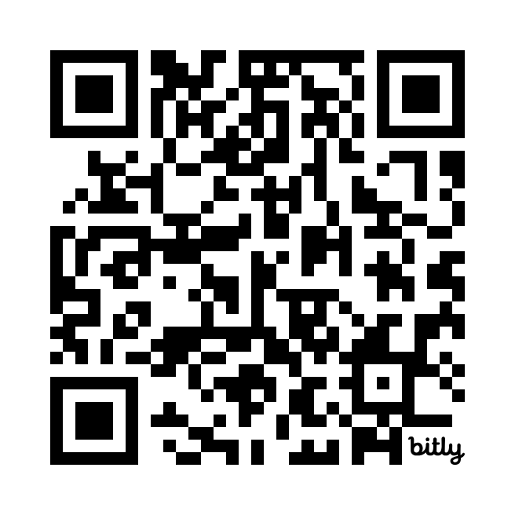
Introduction to AT Evaluations
A Beginner’s Guide
Jana Locke
it’s me,
hi
I’m the problem AT person,
it’s me
Locke-AT-eval

Slide 2
Presentation Disclosure
Financial:
Jana Locke has an employment relationship with Marshall Public Schools. There are no relevant financial relationships with ineligible organizations.
Non-Financial:
Jana Locke has no relevant non-financial relationships.

Slide 3
ABOUT ME
Education
SMSU - BS in Psychology
MSU - M.Ed in Education/Special Education
Currently - WWU - EdS in Educational Leadership
Professional
23 years in education
7 yrs = small district
16 yrs = large district
Current Responsibilities
Transition Coordinator
Process Coordinator
Special Education Department Head
Assistive Technology
Autism Consultant/IDAC
DESE Transition Liaison
Personal
From - SW Missouri
Currently - West-Central MO
Family
Husband - Ben
Former SE teacher
Now PE teacher
Son - Gavin
Freshman at MVC
Dog - Dude

Slide 4
Who are YOU?
Education representative
Teacher
Administrator
IEP service provider
Outside agency representative
VR
CIL
DMH
Individual or Family Member
Who else???

Slide 5
My AT Evaluation Journey

Slide 6
HELP!
Got an email…
WHO do we contact?
WHAT do we do?
HOW do we do this?
Contacted MO-AT
HELP!!!!
Volunteered for the expedition (aka adventure)

Slide 7
Google
GOOGLE, GOOGLE, GOOGLE
Begged, Borrowed, Stole
WAY more stealing than beg or borrow
Created my evaluation form template

Slide 8
Process
Started reviewing existing data
Previous evaluations
Previous IEPs
Interviews
Teachers
Service providers
Parent
Borrowed items
Device Loan ETC
Device trials and observations

Slide 9
Finishing up
Compiled my findings
Completed Assistive Technology Report
Shared with the evaluation team
The determination for AT usage should be a team decision, NOT an individual

Slide 10
Wisconsin Assistive Technology Initiative (WATI)
https://www.wati.org/
Student Information Guide Process Forms
Assistive Technology Consideration to Assessment
Assessing Students’ Needs for Assistive Technology

Slide 11
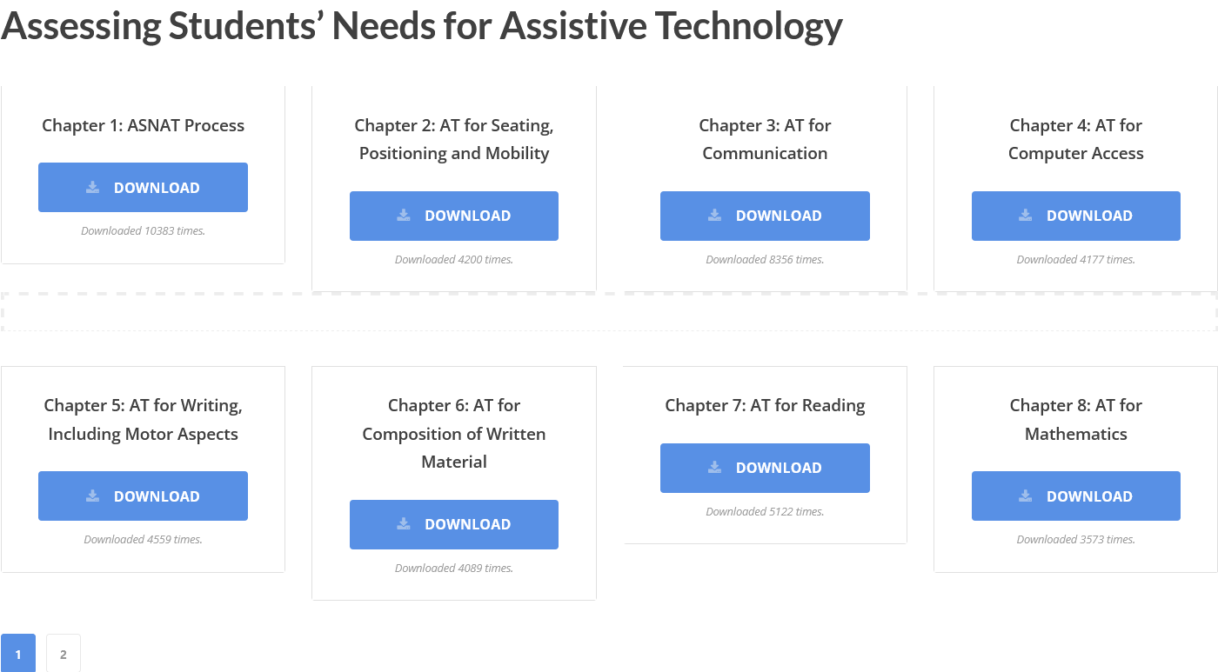
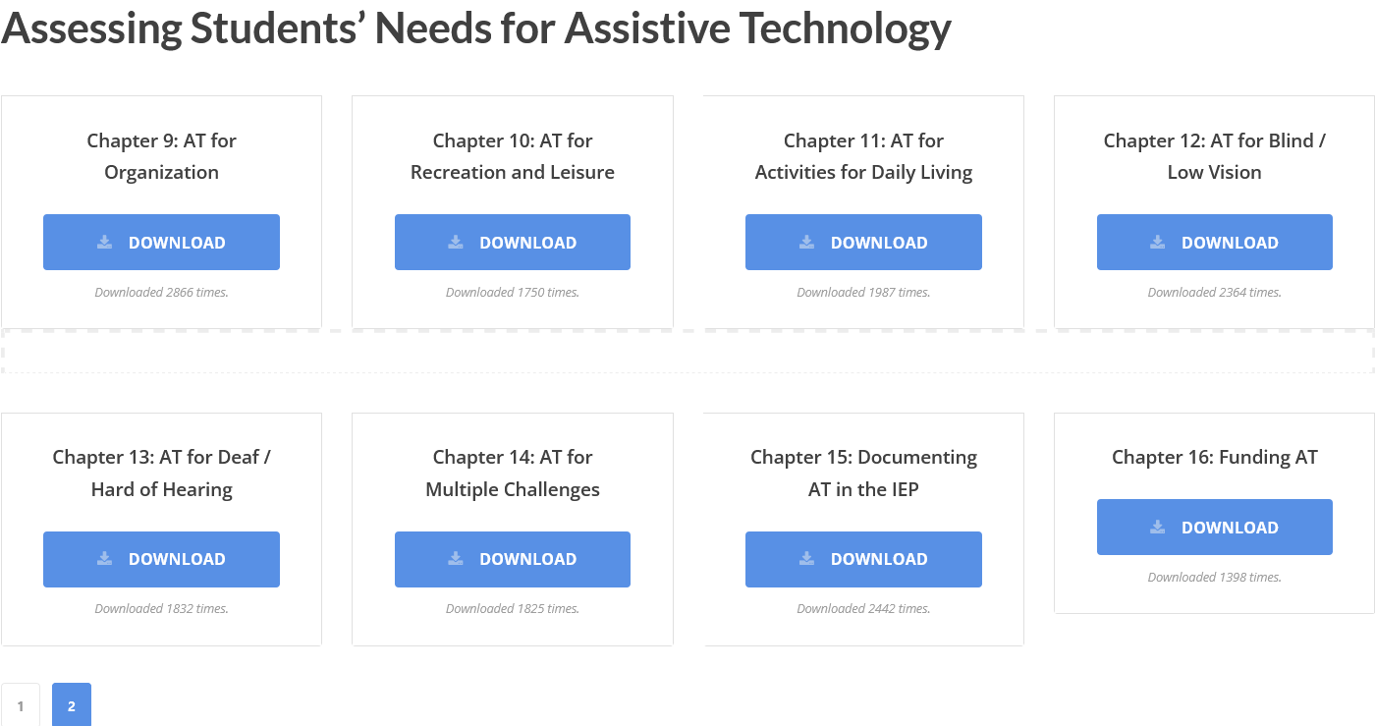
Assessing Students’ Needs for Assistive Technology

Slide 12
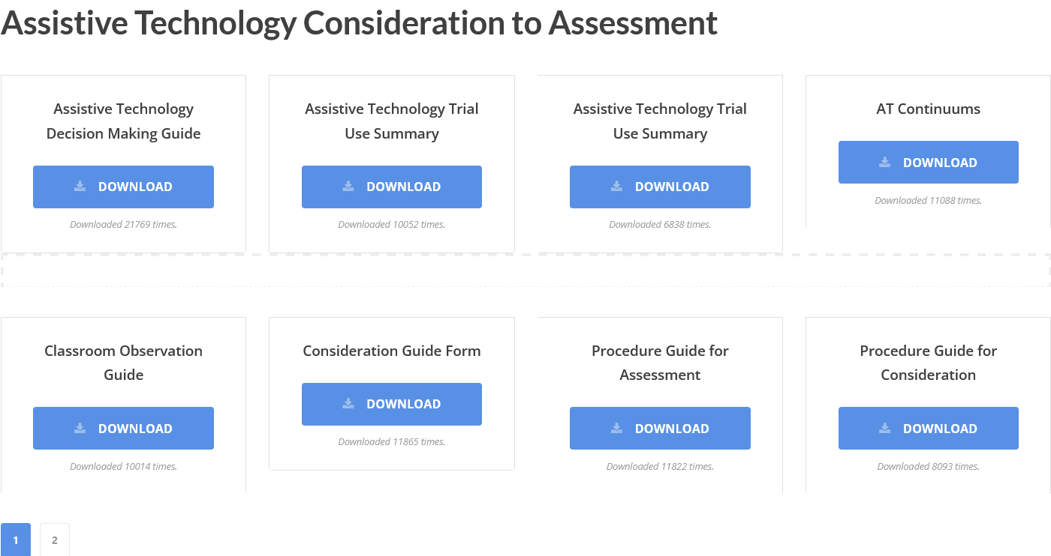
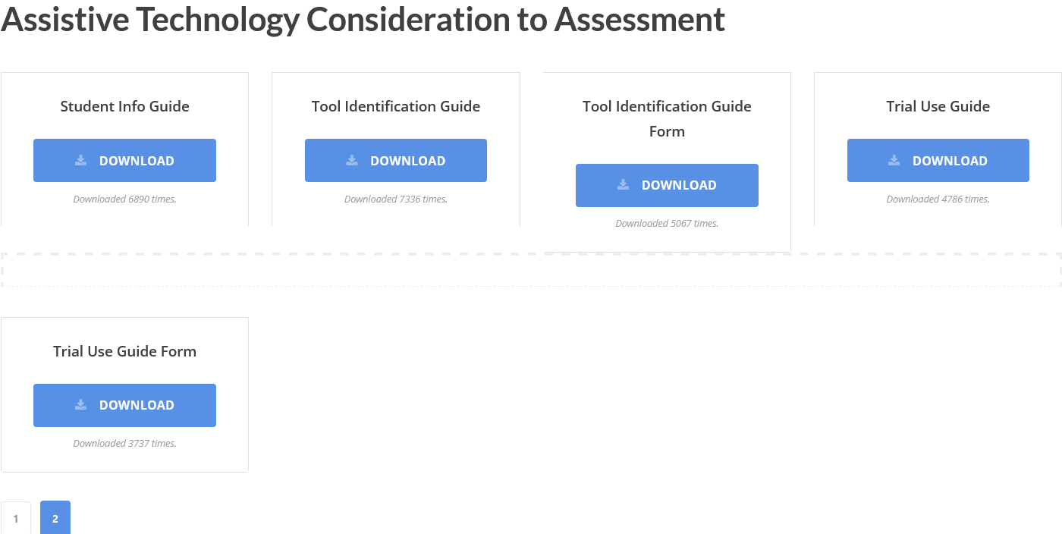
Assistive Technology Consideration to Assessment

Slide 13
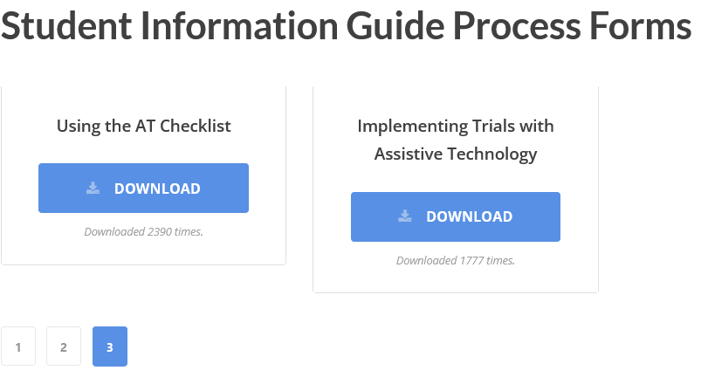
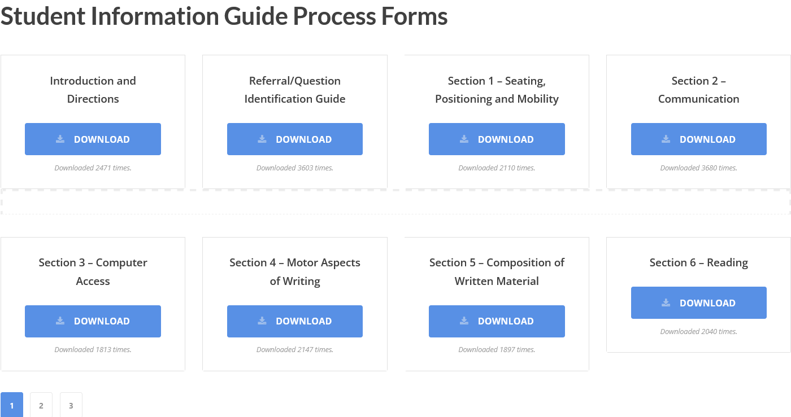
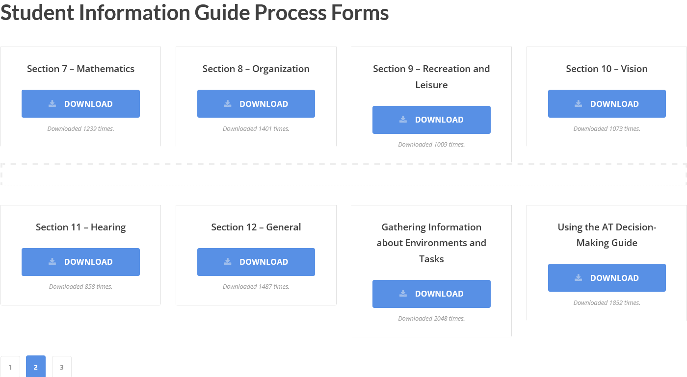
Student Information Guide Process Forms

Slide 14
ASSISTIVE TECHNOLOGY REPORT
I will give you the link to copy this!

Slide 15
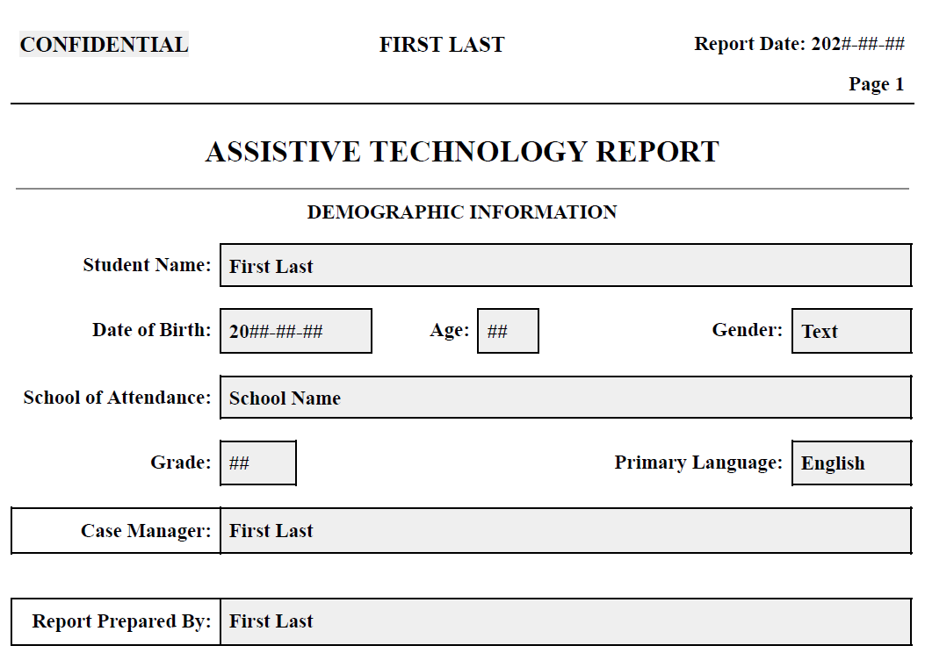
AT Report

Slide 16
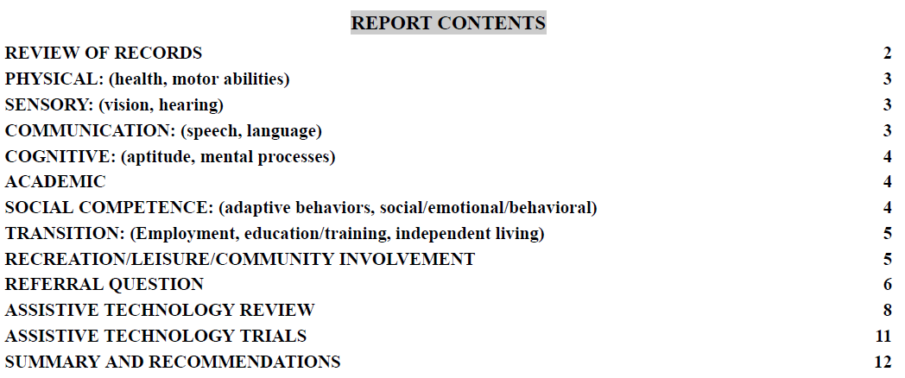
REPORT CONTENTS
Links for each section.

Slide 17
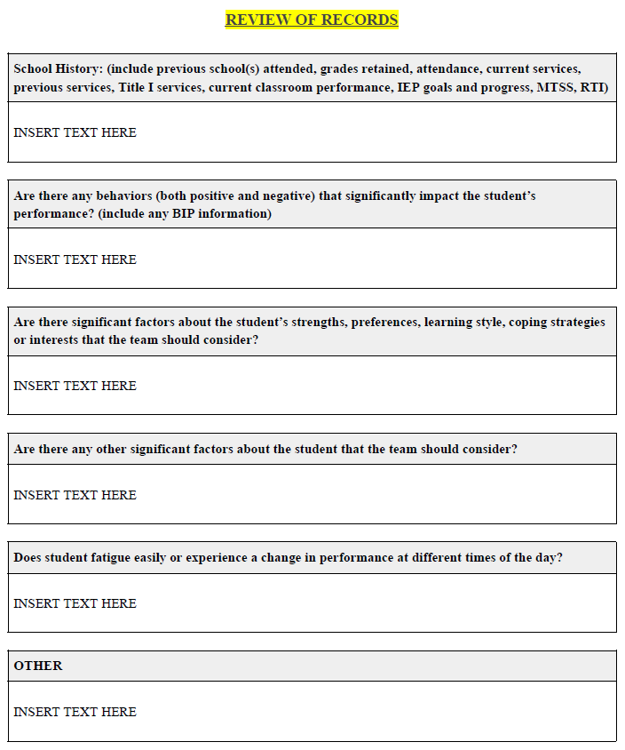
REVIEW OF RECORDS
Use previous IEPs and Evaluations
School cumulative file
School health records

Slide 18
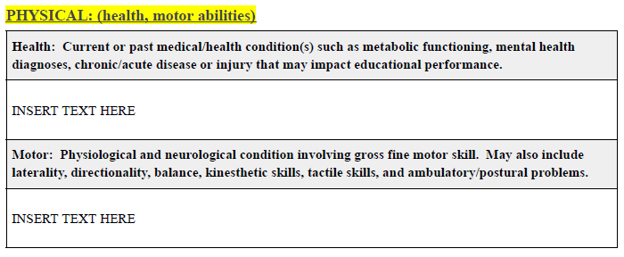
REVIEW OF RECORDS - PHYSICAL

Slide 19
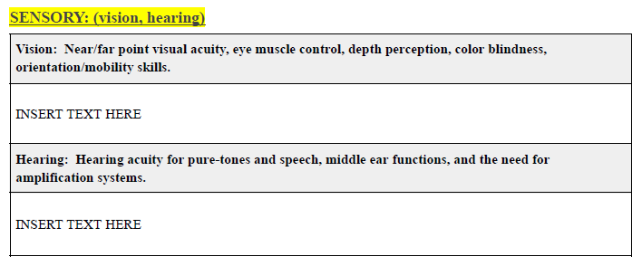
REVIEW OF RECORDS - SENSORY

Slide 20
REVIEW OF RECORDS - COMMUNICATION

Slide 21
REVIEW OF RECORDS - COGNITIVE

Slide 22
REVIEW OF RECORDS - ACADEMIC

Slide 23
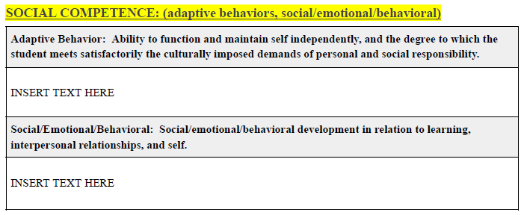
REVIEW OF RECORDS - SOCIAL COMPETENCE

Slide 24
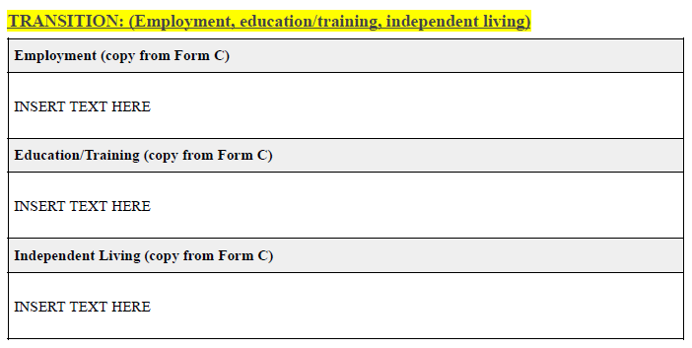
REVIEW OF RECORDS - TRANSITION

Slide 25
REVIEW OF RECORDS - RECREATION/LEISURE/COMMUNITY INVOLVEMENT

Slide 26
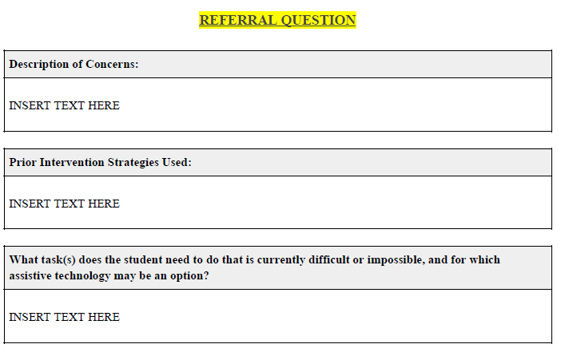
Referral Questions

Slide 27
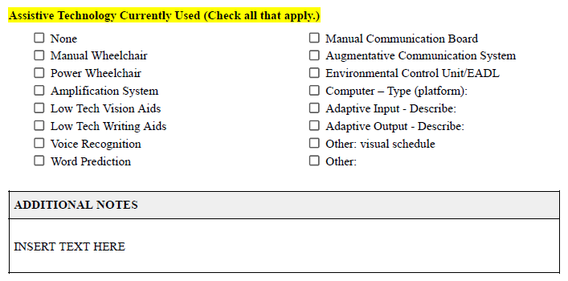
CURRENT AT USE

Slide 28
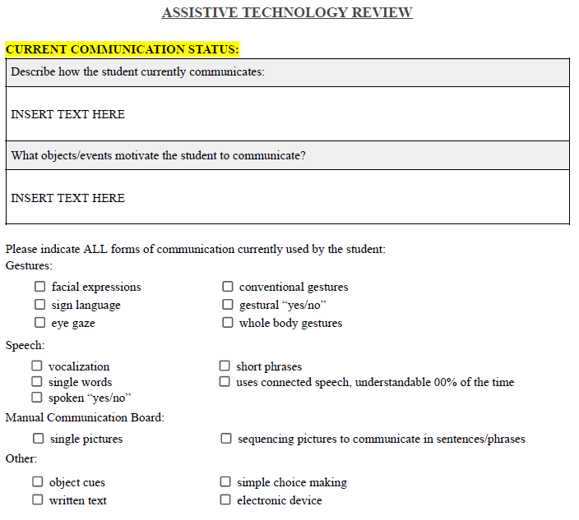
AT Review

Slide 29
INTERVIEWS

Slide 30
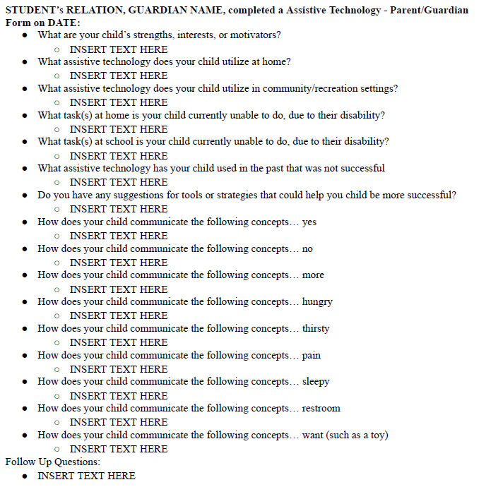
Details on Student

Slide 31
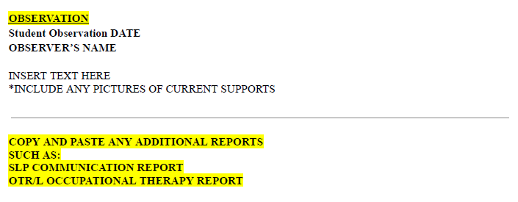
OBSERVATION

Slide 32
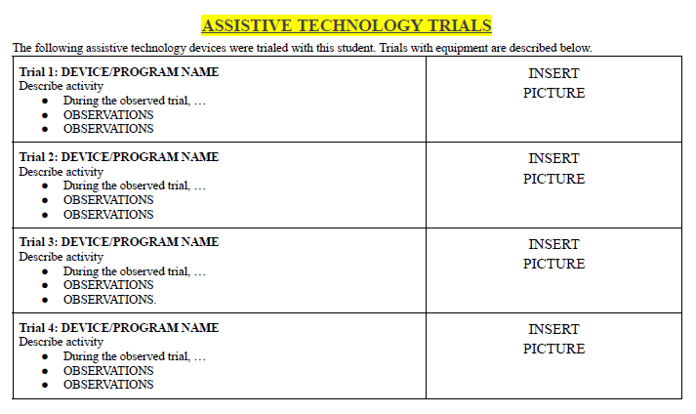
AT Trials

Slide 33
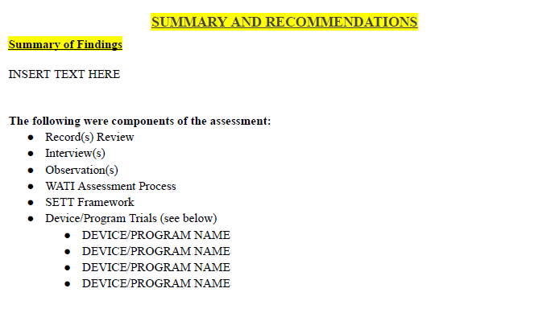
SUMMARY AND RECOMMENDATIONS

Slide 34
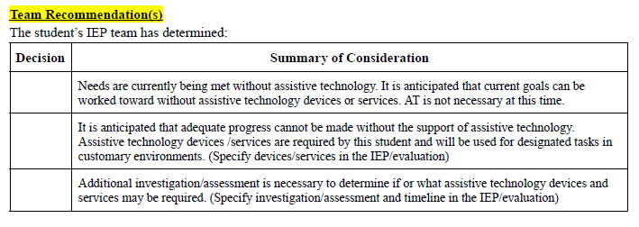
TEAM RECOMMENDATION(S)

Slide 35
REFERENCES

Slide 36
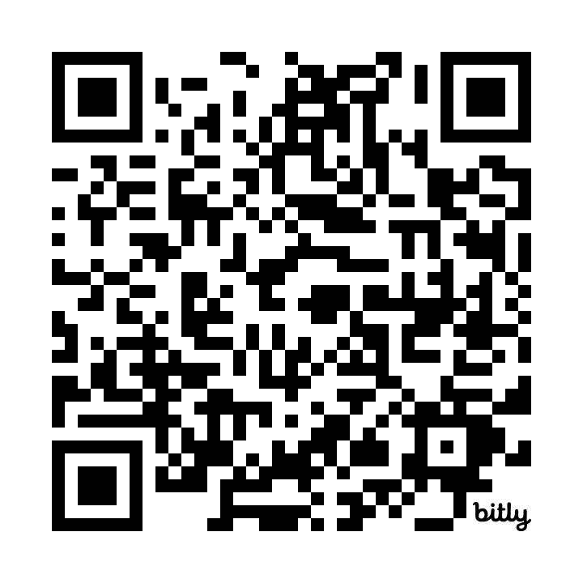
Assistive Technology Report
Locke-AT-Report
Please do not publish this document on any website or acquire any monetary profits from its use.

Slide 37
THANK YOU
Jana Locke
JLocke@MarshallOwls.com
JanaLocke.Transition@gmail.com

