Slide 1
3D Printing Learning Materials for Students with Low Vision
By:
Sommor Thornton (MSED, CTVI, COMS) and Maddie Goswick (MSED, CTVI, COMS)

Slide 2
Objectives
1. Participants will gain an understanding of available resources to help them get started with 3D printing (software, websites, existing files, etc.)
2. Participants will learn other ways 3D printing can help students with visual impairments access their core curriculum and the Expanded Core Curriculum.
(other materials that can be printed, behavior supports, recreation and leisure activities, orientation and mobility aids, tactile communication PECS, and independent living aids)
3. Participants will gain an understanding of how a 3D printer can be an asset to helping students learn the Braille Code.

Slide 3
Vocabulary 1
STL File / Model
This what the file type is called for a 3D model. When searching for an item to print, search “item name” + STL
gcode File
After an STL file has been “sliced” a gcode file is generated. The gcode file provides instructions to the printer
Filament
This is the plastic that the printer melts to print with. There are different types. PLA is the most common to print with when starting out.

Slide 4
Vocabulary 2
Hotbed
This is the flat portion of the printer that heats up. The “bed” gets hot to help the prints stick and stay in place
Nozzle
The part of the printer that extrudes the filament.
Z Offset
This is how close the nozzle that extrudes the filament is to the hotbed.

Slide 5
Vocabulary 3
Purge Line
The line the printer prints first. This is so the extruder can start running smoothly.
Supports
Extra part printed to “support” parts of the model printing in midair
Resin vs. Filament Printer
A resin printer uses resin to print. After printing, the model must be cured. A filament printer uses plastic to melt and print the model. No additional curing is needed to use the print.

Slide 6
Getting Started…
Design Software VS.
TINKERCAD
Blender
AUTODESK FUSION 360
Slicers
Cura
Prusa Slicer
Before printing something it must be designed and then sliced.

Slide 7
Design Software
Design software allows you to create your own models to 3D print. There are several free options other than the ones listed to the right.
Tinkercad has been the most user friendly to me!
Resources to learn Tinkercad…
Beginner Tutorial
10 Tinkercad Tips
Braille Labels in Tinkercad
Creating Braille in Tinkercad

Slide 8
Slicers
Any model whether you find one ready to download or design it yourself, must be sliced before it is printed.
Slicing the model… or STL… file creates a gcode file.
A gcode file tells the printer how to print your model. This includes directions for…
Printing temperature
Printing speed
What material you are printing with
How fast to make the initial layer
How thick to print the layers
Supports

Slide 9
Steps to Printing a STL
Design or download your model (STL file).
Open your slicer and “slice the print.” This will give you a gcode file.
Add the gcode file to your memory card.
Put the memory card in the printer, and heat up.
For PLA Filament, I have the nozzle at 200℃ and the hotbed at 60℃.
After the printer is heated up, start your print!
Note: Purge lines and skirt will print first (Depending on settings)

Slide 10
Tips
Increase temperature for smaller prints to help them stick
Adding a raft, brim, or skirt can help with this as well
Any oil, dust, etc. on the hotbed can cause prints to come unstuck…
Clean bed with dawn and hot, hot water once a week (helps prints stick)
Wipe down hot bed with rubbing alcohol after each print (helps print stick)
Save your failed prints and other filament scraps to melt down in the oven into silicone molds to make other manipulatives
Use acrylic paint markers and mod podge sealer to add color and protection to your prints

Slide 11
Where to download Models…
Tactiles
Perkins School for the Blind
Paths to Literacy
3D Model Databases
Youmagine
Thingiverse
Yeggi
Printables
Cults
My mini factory
Pinshape
See handouts for more.

Slide 12
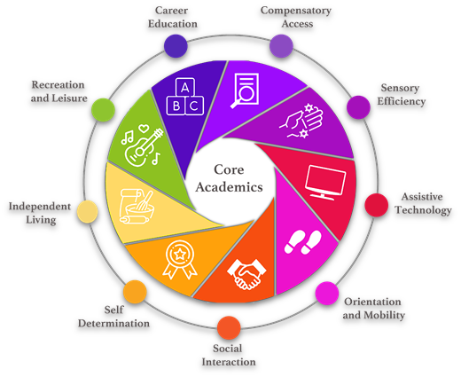
Printing the ECC

Slide 13
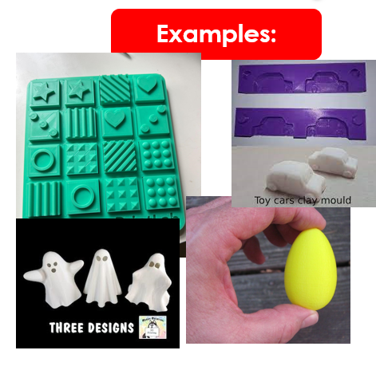
Sensory Efficiency
Ideas to Print
Textures
Matching games, Playdough toys
Rhythm Sticks
Instruments
Models of truncated domes
Manipulatives to sort by size, shape, texture, color, etc.
Sensory Bin Fillers

Slide 14
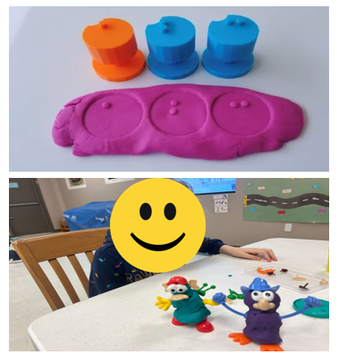
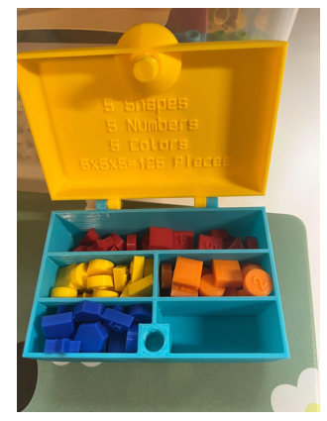
Sensory Efficiency 2

Slide 15
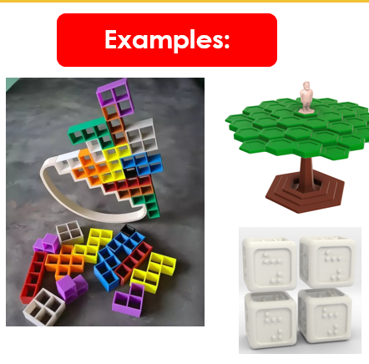
Social Interaction
Ideas to Print
Games
Turn taking skills
Appropriate language
Appropriate responses to winning and losing
Easy way to add braille
Things to show and tell
Public speaking skills
Appropriate volume
Facial Expression models
Behavior supports (rewards, token economies, etc.)

Slide 16
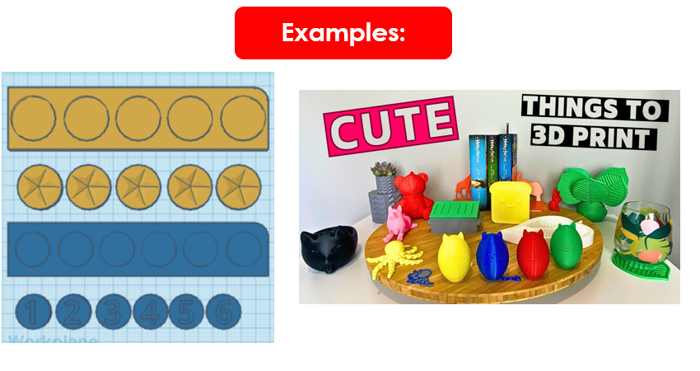
Social Interactions – More Examples

Slide 17
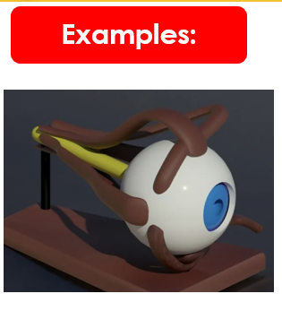
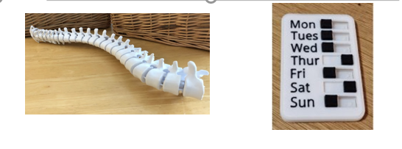
Self - Determination
Ideas to Print
Model of the eye
To help students understand their visual impairment
Models of the human body
To help students understand their physical disabilities
Goal Trackers (ex: reminder to practice a skill at home)

Slide 18
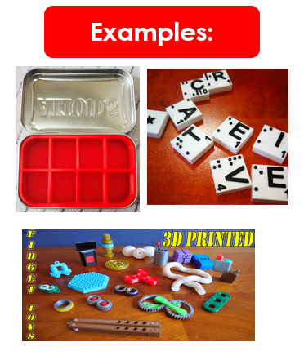
Recreation and Leisure
Ideas to Print
Games / game pieces
braille adaptations for commercially available games (Sorry, Scrabble, Boggle, deck of cards, etc.)
games students design
games to target a specific skill
Crochet markers
Organizers for hobby materials
Adaptive game materials
Clay tools
Models (cars, trains, buildings, etc.)
Fidget / sensory toys
Models of famous artwork

Slide 19
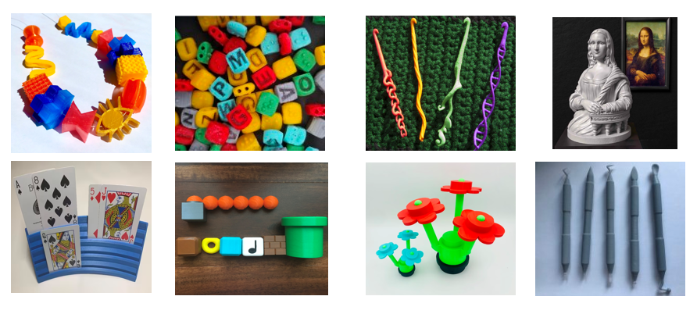
Recreation and Leisure 2

Slide 20
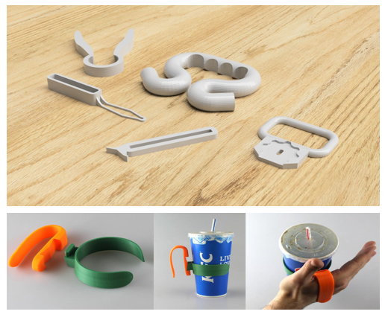
Assistive Technology
Ideas to Print
Writing aids
signature guides
pencil grips
line guides
Jar openers
Grocery bag carriers
Button loops
Universal cuffs
Bottle Openers
Nail clipper holder

Slide 21
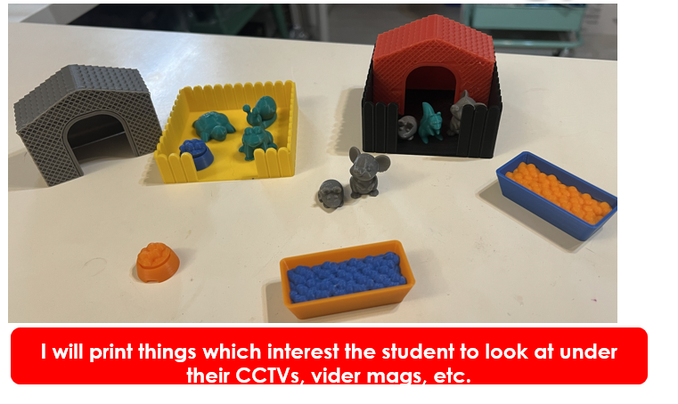
Assistive Technology 2

Slide 22
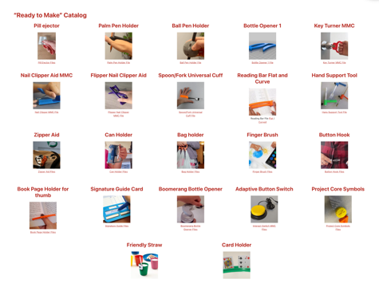
Assistive Technology 3
TechOWLPA

Slide 23
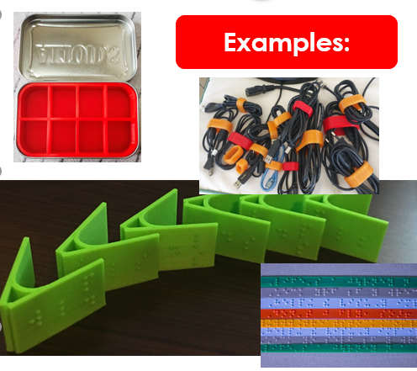
Independent Living
Ideas to Print
Braille labels for…
clothes
cabinets/drawers
cords
storage containers
organizational bins (for small items)
nail, screws, nuts, bolts
hair accessories
Cable management
Coin organizers
Assistive technology also ties into this area!
touch see me

Slide 24
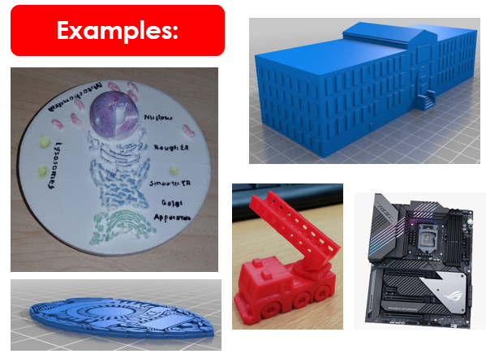
Career Education
Ideas to Print
Models of buildings the student may be going to job shadow
Equipment used within the career student is interested in
Diagrams referenced often in the career student is interested in
Materials to support community helper unit

Slide 25
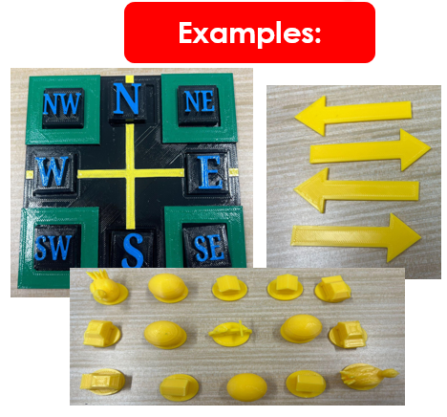
Orientation and Mobility
Ideas to Print
Models of…
Intersection Types
Compass directions at intersection
Maps
School layout
Store Layouts
Route Shapes
Town layout
Accessories for Tactile Town
touch mapper

Slide 26
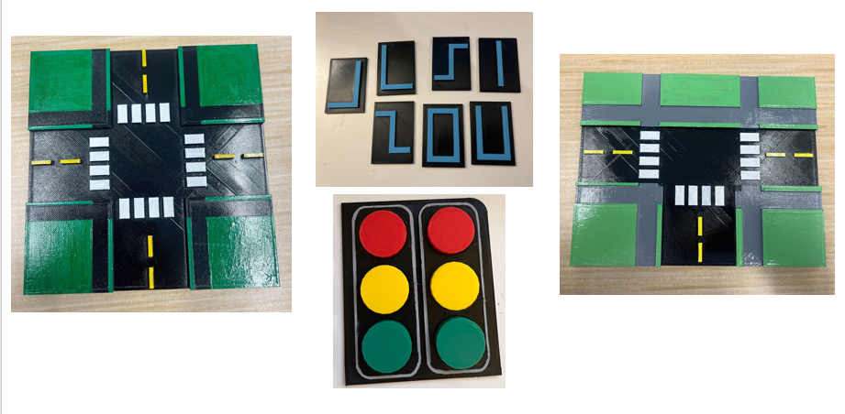
Orientation and Mobility 2

Slide 27
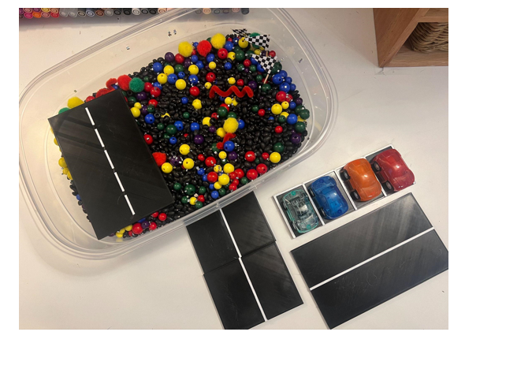
Orientation and Mobility 3

Slide 28
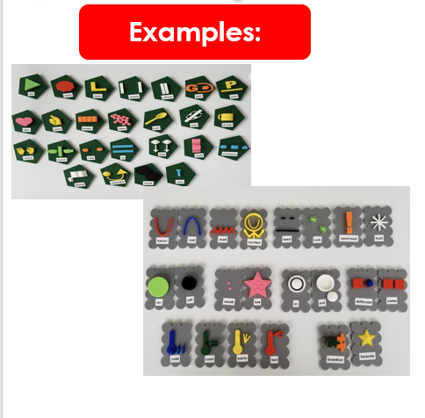
Compensatory Access
Ideas to Print
Tactile PECS: thingiverse
Sound
Behavior supports
Tactile graphics and models to support the core curriculum
Manipulatives to help support concepts like…
fractions, 2D/3D shapes, cells, 10 frames, animals, positional concepts, 1-1 correspondence, units of measurement, states, countries, continents, organs, molecules, etc.
tactiles.eu

Slide 29
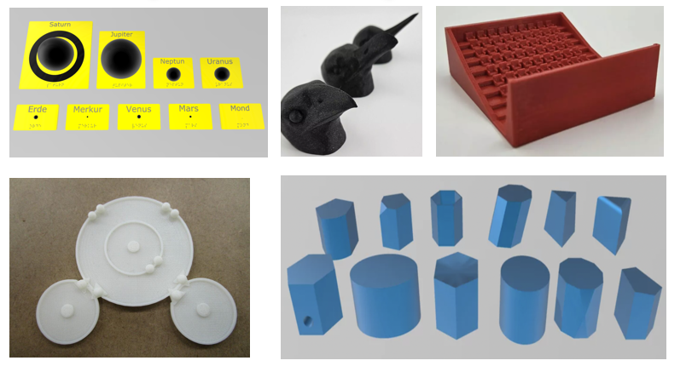
Compensatory Access 2

Slide 30
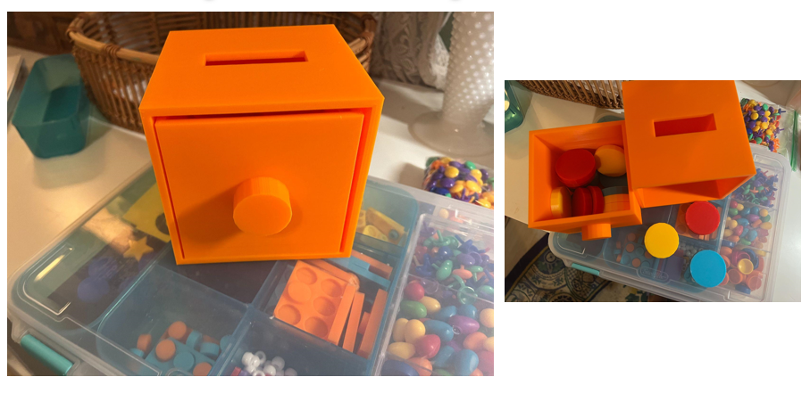
Compensatory Access 3

Slide 31
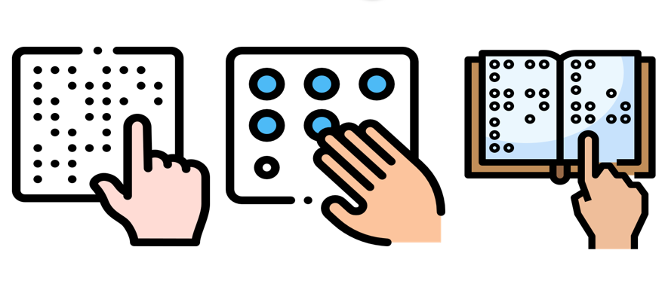
3D Printing Braille

Slide 32
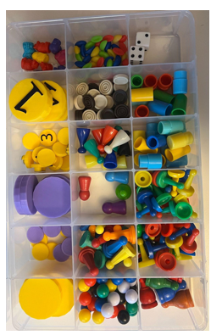
Using a 3D Printer for Braille Instructions
When I use a 3D printer to prepare materials for instruction in the Braille Code, I think about the following things…
What manipulatives do I have already which could be used to represent braille letters if I had a braille cell for them to fit in?
What is my student already interested in?
Think about colors, games the student is interested in, inexpensive things you could print for prizes, materials to send home/back to class, ways they learn best, etc.
What motivates my students to be actively involved in the lesson?
Hands on activities, moveable parts, earning tokens for a break, etc.

Slide 33
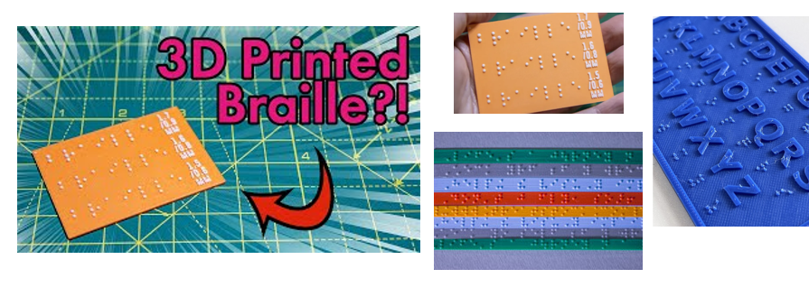
Using a 3D Printer for Braille Instruction 2
3D Printing Standard Sized Braille
Touch see me
model/109513

Slide 34
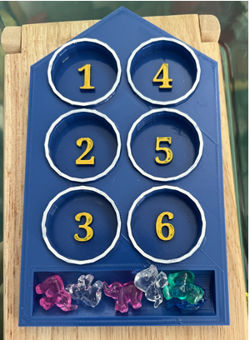
Instructional Braille Examples

Slide 35
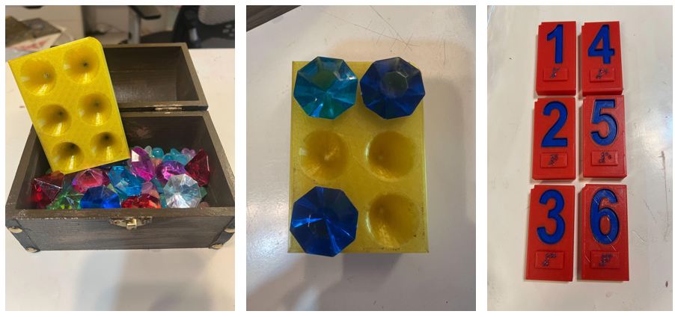
Instructional Braille Examples 2

Slide 36
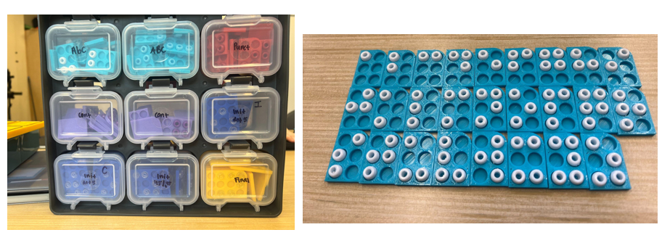
Instructional Braille Examples 3

Slide 37
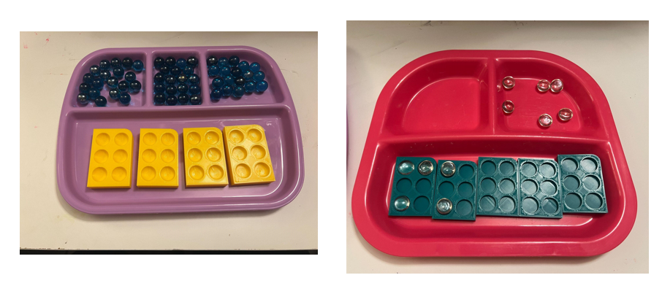
Instructional Braile Examples 4

Slide 38
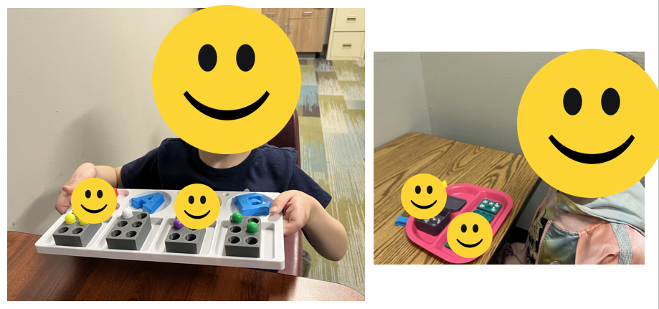
Instructional Braille Examples 5

Slide 39
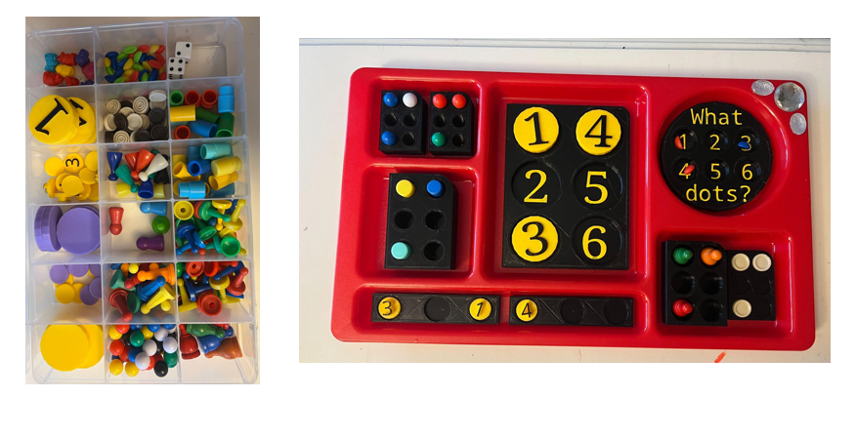
Instructional Braille Examples 6

Slide 40
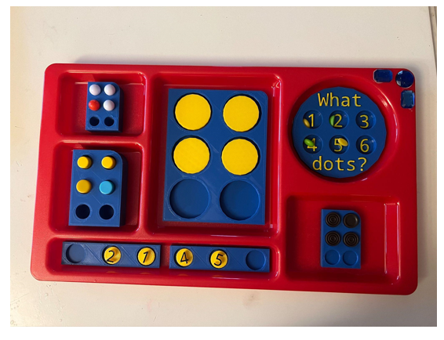
Instructional Braille Examples 7

Slide 41
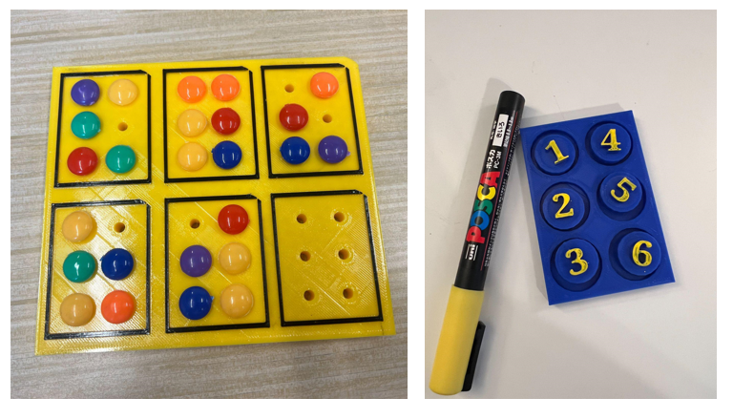
Instructional Braille Examples 8

Slide 42
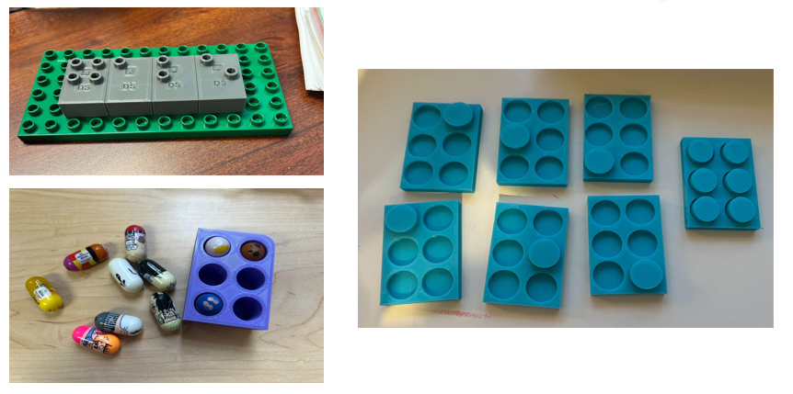
Instructional Braille Examples 9

Slide 43
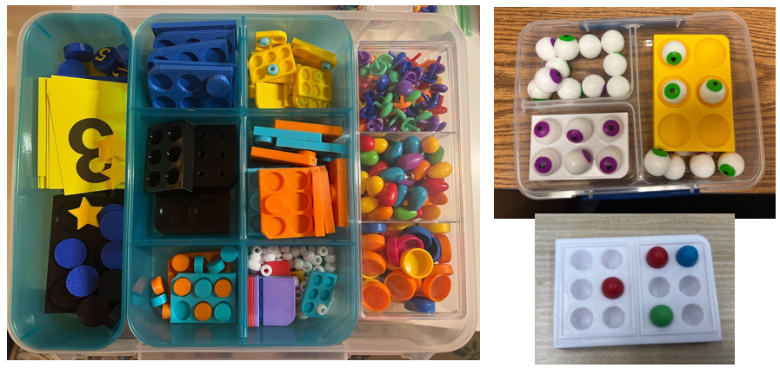
Instructional Braille Examples 10

Slide 44
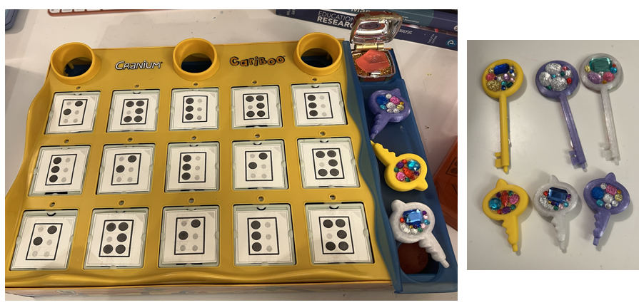
Instructional Braille Examples 11

Slide 45
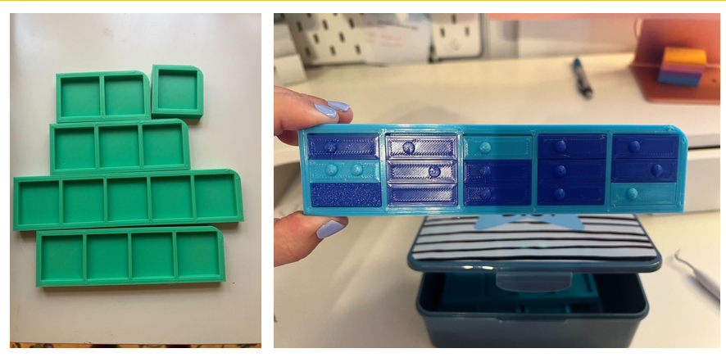
Instructional Braille Examples 12

Slide 46
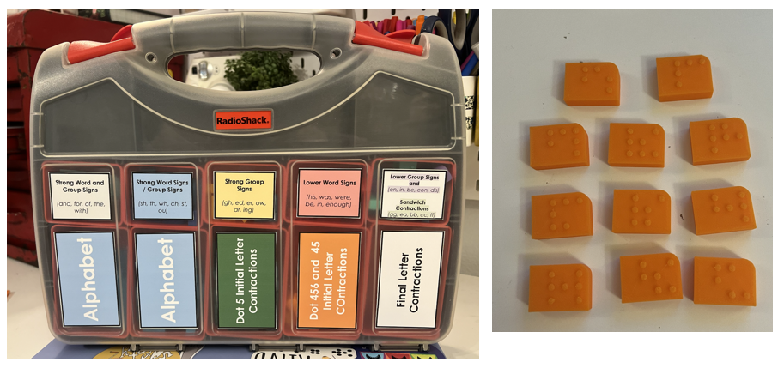
Instructional Braille Examples 13

Slide 47
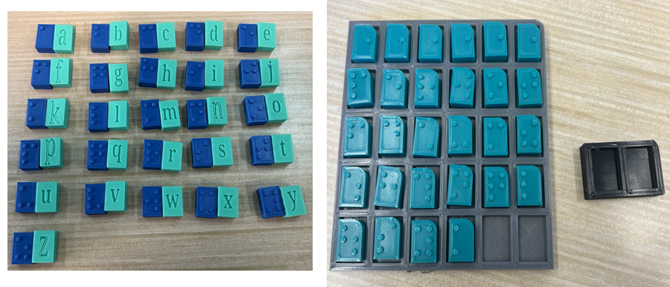
Instructional Braille Examples 14

Slide 48
Questions?

