Slide 1
Starkloff and United Way Logos

Slide 2
Why don’t people request accommodations?
And what can we do about it?
Starkloff disability institute
Notes:
For Ameren – Morgan will give to Brianne Smith to introduce me
Introductions:
Who are you?
What is your role?
What brings you hear today?
First discussion question: “Do you know of someone with a disability?”
Follow-up question: “What is the leading cause of disability in the world?” Answer: Depression.

Slide 3
Today’s objectives
What is an accommodation, and who can get one?
Why don’t people request accommodations?
How can we make requesting an accommodation comfortable?
The SDI method for asking for an accommodation.

Slide 4
Ground rules
Lean into your discomfort.
Assume positive intentions and give each other grace.
Be respectful of each other’s time.
If you wish to talk, raise your hand or say or your name and wait for the microphone.
Avoid side conversations.
If you need to leave the room, please feel free to do so.
Avoid playing the “Oppression Olympics.”

Slide 5
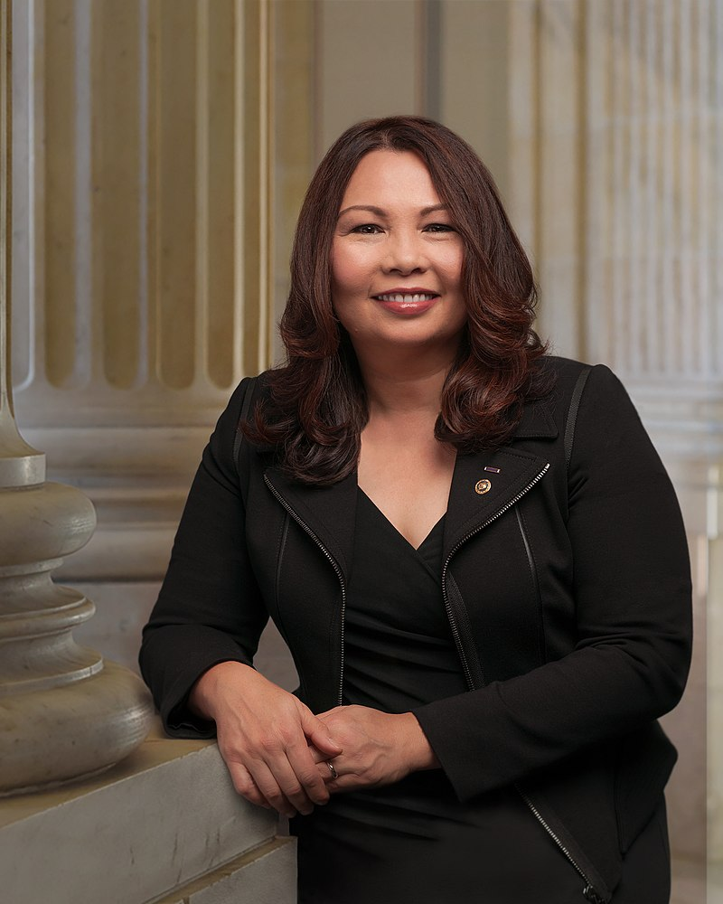
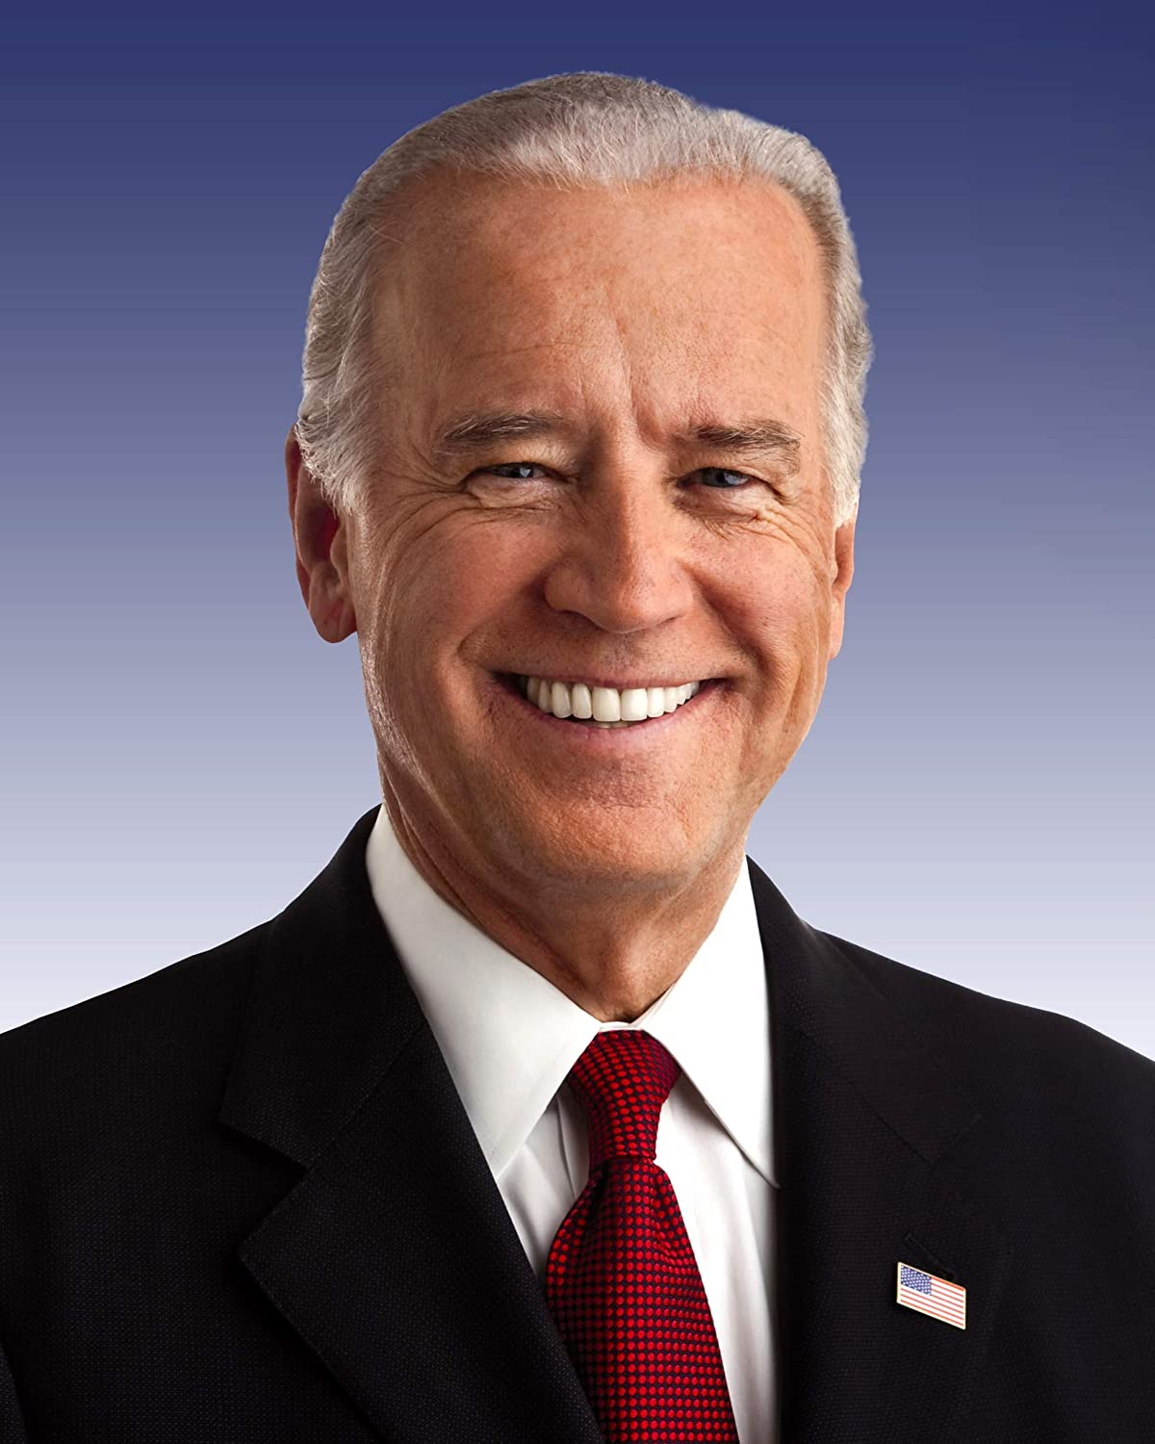
An incredibly diverse population
Tammy Duckworth
Joe Biden
27% of the U.S. population
Centers for Disease Control
2/3rds are less than 65 years old
Higher rates in impoverished and BIPOC communities
Both underdiagnosis and overdiagnosis
Many don’t realize they’re disabled
Oprah Winfrey
Simone Biles

Slide 6
Who can get an accommodation?
ADHD
Alzheimer’s
Amputation or Missing Limb
Anxiety
Arthritis
Autism Spectrum
Blindness or Low Vision
Cancer
Cerebral Palsy
Craniofacial Anomalies
Deaf or Hard of Hearing
Depression
Diabetes
Down Syndrome
Dwarfism
Dyslexia
Food or Animal Allergies
Heart Disease
Paralysis
PTSD
Sickle Cell
Stroke
Traumatic Brain Injury (TBI)
Americans with Disabilities Act
Anyone with an impairment that impacts one or more “major life activities”
Impairments can be:
Temporary or permanent
Apparent or nonapparent
Congenital (20%) or acquired (80%)
Notes:
Better definition – A disability is something about the way your body is structured that makes it more difficult for you to function in your current environment.

Slide 7
Accommodations – myth vs. reality
Accommodation Myths
Workplace accommodations are a form of favoritism or special treatment.
Everyone who has a disability needs an accommodations, and everyone who gets an accommodation is disabled.
Accommodation Reality
Workplace accommodations are a legally protected civil right every American has access to.
Accommodations are expensive.
Nearly 50% of accommodations cost nothing. The rest typically cost $300 on average.
Disability doesn’t mean accommodation, and accommodation doesn’t mean disability.
Just as with disability, there are hundreds of different types of workplace accommodations, most of which you might never notice.

Slide 8
Disconnect between employees and executives
Accenture & Disability:IN, Getting to Equal: 2020
Notes:
Briefly explain study. 2-3 minutes
Accenture – 28 international companies, 1,700 executives, 5,870 employees
Lead a discussion
What is your initial reaction?
Why? What might be behind these numbers?
What can be done? What have you heard might work? What would you like to try?

Slide 9
The experience of disability at work
Employees with disabilities are 60% more likely to feel excluded by their peers.
73% fear being fired or not hired if they tell their employer they are disabled.
72% experienced negative attitudes or behaviors in the last 5 years. 42% came from management.
GDI & Mercer
Accenture
2020
Cornell
2014
SCOPE
2022
2022
People with disabilities are possibly the least engaged with their job, manager, and company of any marginalized group.

Slide 10
Edgar Schein’s Culture Pyramid
Logos & Language
Artifacts
Visible
Social Norms
Stated Values
Patterns of Behavior
Invisible
Fundamental assumptions and values
Assumptions
Adapted from Edgar Schein, Organizational Culture and Leadership, 2004

Slide 11
What do we assume?
Moral Model
Disabilities are punishments or weaknesses to be overcome.
Social Model
Medical Model
Disabilities are illnesses and must be fixed.
Body differences are not disabilities.
“Disabled people can’t do this job safely.”
Body differences become disabilities when environments are not built with differences in mind.
The “disability con.”
“We require a doctor’s note for all accommodation requests.”
Some disabilities are “harder” than others.

Slide 12
What is your accommodations process?
Where do I learn about my rights?
Most people don’t what the ADA accommodations are.
How easy is it for me to find this information?
How many hoops do I have to jump through?
Who do I have to talk to? Are they safe?
Posters in the break room are not adequate.

Slide 13
Comparing accommodations request forms
SHRM (2021) | Job Accommodations Network (2021)
“Describe the nature, extent and duration of your disability.” | “What specific accommodations are you requesting?” “What, if any, job functions are you having trouble performing?”
“Describe the accommodations you believe are needed to enable you to perform the essential functions of this job:” | “What limitation is interfering with your ability to perform your job or access employment benefits?”
“Provide the name, address, telephone and fax numbers of your health care provider. The provider may receive a request from us for information regarding your impairment/disability and recommendations for accommodations.” | “Please provide any additional information that might be useful in processing your accommodation request.”

Slide 14
Accommodations best practices
Regular communication about accommodations
What are they?
Who can get them?
How to make a request?
How it will be processed
HR Helplines
Centralized team and budget

Slide 15
Requesting an accommodation
What do they need to know?
What are you having trouble with?
What is your request?
Come with ideas.
Visit Job Accommodations Network – askjan.org
Be prepared to have a conversation.
Document everything!
Accept that you might not get what you want, but you will get what you need.
Never apologize for exercising your rights.

Slide 16
resources
Job Accommodations Network – askjan.org
Department of Justice – ada.gov
National Center on Disability and Journalism – ncdj.org
Web Accessibility In Mind – webaim.org
Starkloff Disability Institute – starkloff.org

Slide 17
Disability inclusion writing lab
April 30th 9am to 12pm
Alberici Construction in St. Louis MO
HR, DEIA, Talent Acquisition, Hiring Managers, Marketing and Communications
Accommodations, Job Postings, Self-ID Campaigns, Diversity Statements

Slide 18
Thank you
www.starkloff.org
jhartsfield@starkloff.org
Notes:
Brianne will facilitate Q&A.

