Slide 1

From Here To There
6+++++
Moving from Where We Are to Where We’re Going
Marcia D. Davis
Senior Emergency Management Manager

Slide 2
Who Are We
Any individual with any condition of the body or mind or other circumstance that creates a barrier to understanding or the ability to act/react as requested of the general population during all phases of an emergency.

Slide 3
Where Are We
2 to 4 times more likely to die or have critical injuries
31% who cannot care for themselves were forced to evacuate
21% of blind adults forced to leave their homes
Once evacuated, most adults with disabilities never returned home

Slide 4
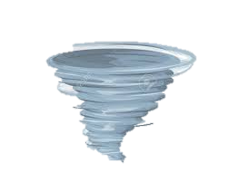
Our Goal – Personal Resilience
Hazard vs Disaster
Reduce vulnerability and exposure
Manage risk not disaster

Slide 5
The Whys
Why We Should
Why We Don’t
Disasters can strike without warning
Emergency personnel overwhelmed
Emergency resources can be limited
May be separated from loved ones
Reduces fear and anxiety
Unaware
It will never happen to me
Too expensive
Overwhelmed
Fear
Good old procrastination

Slide 6
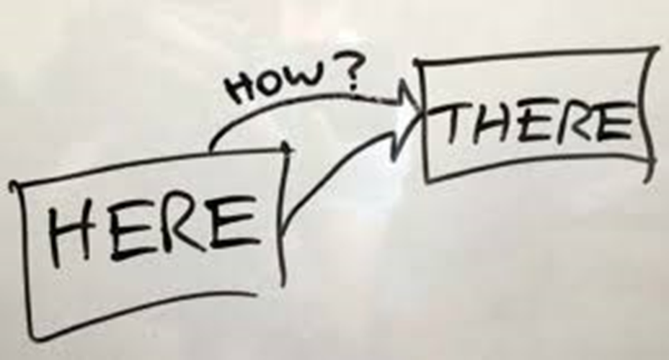
Prepare Differently
Info not set in stone
Prepare for you
Stay home if possible
Evacuate if you must

Slide 7
Stay or Go
More spacious and comfortable
Can be more secure
Your neighbors
You know your local surroundings
Can stockpile supplies
More easier found
Rising floodwaters
Severely damaged home
Official evacuation

Slide 8
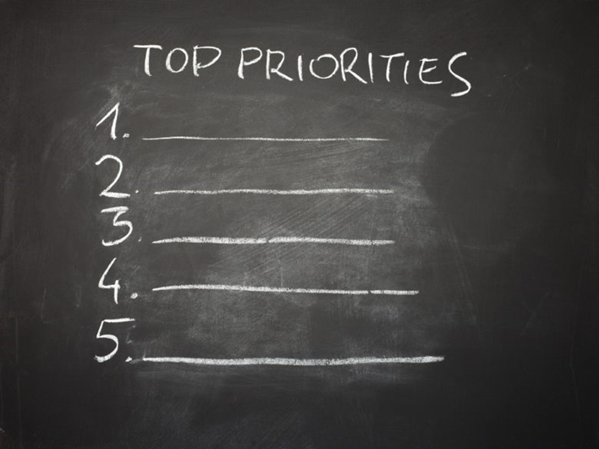
Threats and Hazards
Power outage
Flood
Winter Weather
No Elevator
No Caregiver

Slide 9
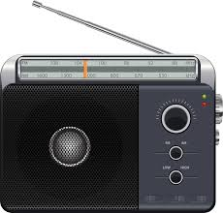

Stay Informed

Slide 10

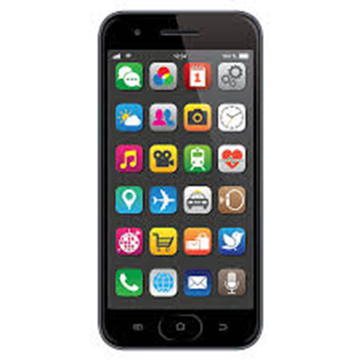
Stay Informed 2

Slide 11
Preparedness Triangle
Resources
Skills
Planning
Preparedness
Triangle

Slide 12
Personal Assessment
Planning
Level of Detail
Frequency of Practice
Coverage Area
Budget
Resources
Food
Water
Supplies
Community
Skills
First Aid
Survival
Repair
Mobility

Slide 13
Preparedness triangle - resources
Resources

Slide 14
Power Outage
Power Outage
Power
Heat
Space Heaters
Fireplace
Wood
Axe
Blade Sharpener
Blankets
Generator
Generator Cables
Electrician Work
Power Banks
Light
Candles
Lantern
Flashlights
Location
Spare Batteries
Matches or Lighter
Fire Extinguisher
Batteries
Fuel
Fuel Container
Wicks
Universal Cables
Hand Crank Radio
Fuel Rotation
Fuel Stabilizer

Slide 15


Emergency Support Group
Community
Family
Friends
Local Facilities
Coworkers

Slide 16



Planning Partners
Who can you discuss your plans with?
Are they going to be able to assist long term?
Involve them in practicing your plan.

Slide 17
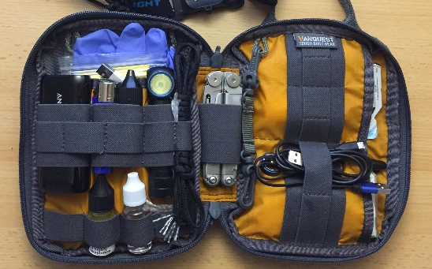
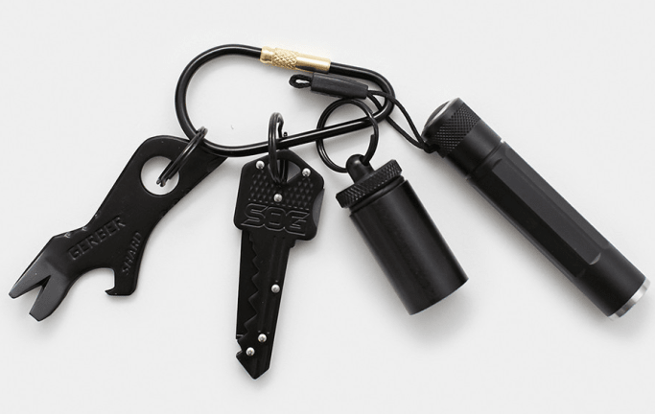
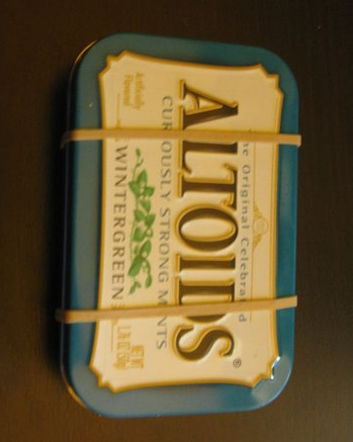
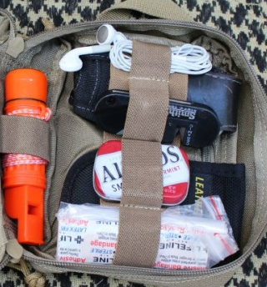
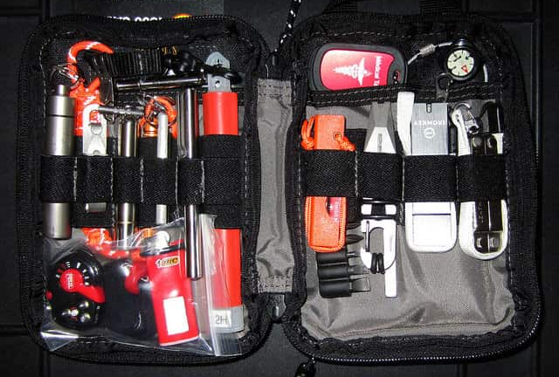
Everyday Carry Items
Flashlight
Cash
Multitool
Emergency Numbers
Pen and Paper
Seatbelt Cutter
Window Breaker
Power Bank
Charging Cable
Family Pictures

Slide 18



Essential items
Medication
Water
Food
First Aid
Communication

Slide 19

Disability Specific
Heavy Gloves
Extra Cane
Hearing Aid Batteries
Communication Aids
Service Animal Kit
Anxiety Grounding Kit
Earplugs

Slide 20
Preparedness triangle 2
Skills

Slide 21
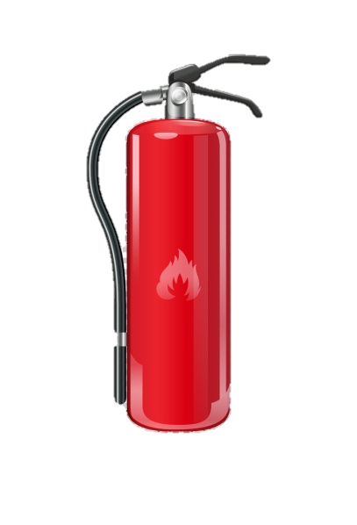
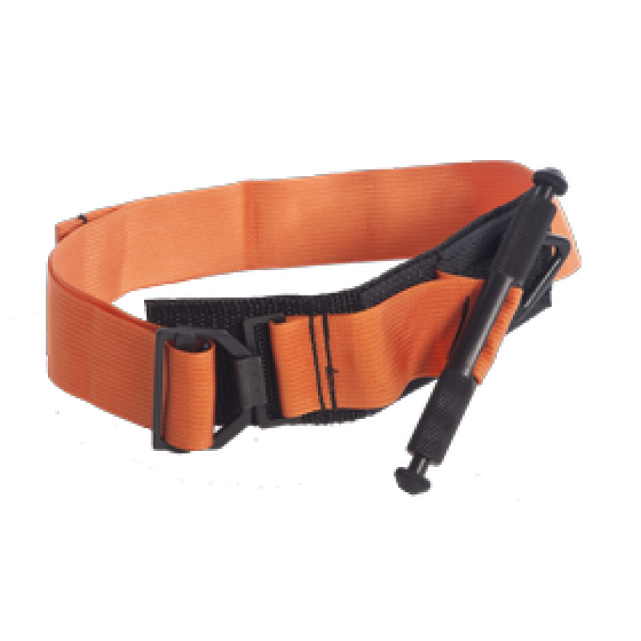
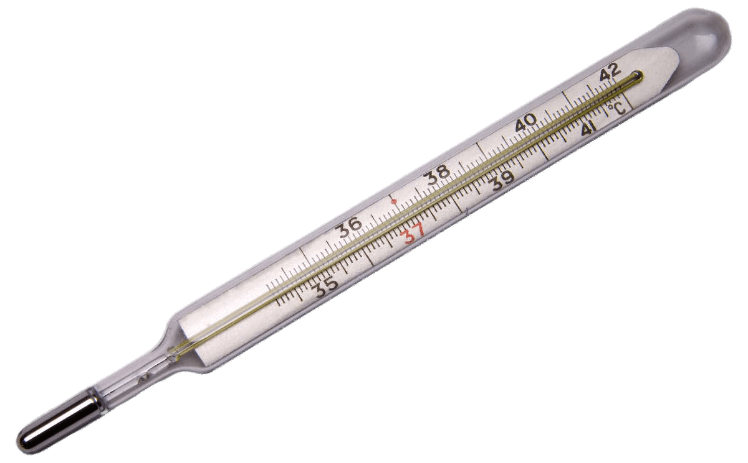
Essential Skills
Fire Suppression
First Aid
Security
Choking Aid
Evacuation
Fever reduction
Hypothermia
Hyperthermia

Slide 22
Preparedness triangle - Planning
Planning

Slide 23
Planning Pitfalls
Don’t create a novel
Stay on topic
Being too vague
No follow through
Miscommunication

Slide 24
Range of Control
Understand your limitations
Understand the areas you can be prepare for and when you need to rely on others

Slide 25
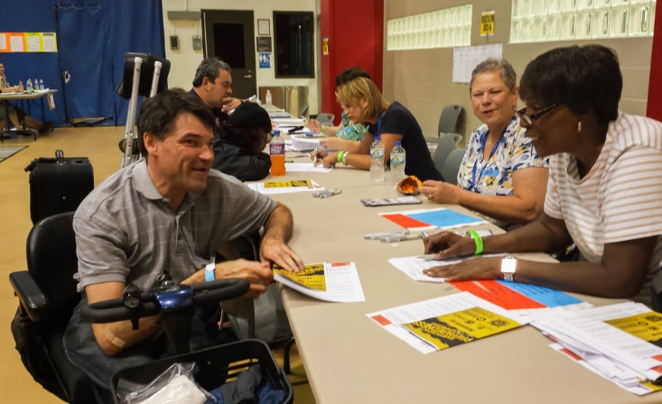
Disability Emergency Preparedness
By failing to prepare, you are preparing to fail.
–Benjamin Franklin
Challenges
Evacuations and Relocations
Support Network
No-show Aide

Slide 26
Visual Disabilities
Keep an extra mobility cane
Pre-label emergency supplies
Organize medications to be easily packed
Keep any assistive devices readily available
Transportation
Emergency Exits

Slide 27
Cognitive Disabilities
Review and practice your plan often
Pre-Printed Messages
Emergency Contacts
Comfort Items

Slide 28
Hearing Disabilities
Extra Batteries
Battery operated television (cell phone)
Emergency information
Pre-printed statements
Pen and paper

Slide 29
Chronic or Complex Conditions
Medical Condition/Medications
No-show aid or caregiver
Keep extras
Talk to your utility provider
Know locations of facilities
Notify local fire station

Slide 30
Mental Health Challenges
Maintain a brief statement of your condition and needs with you
Communicate with responders
Emergency contacts

Slide 31
Mobility Disabilities
Know evacuation routes
Arrange furniture
Keep heavy gloves handy
Have extra batteries
Keep an extra set of mobility assistance devices
Keep written instructions

Slide 32
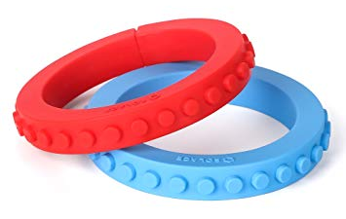
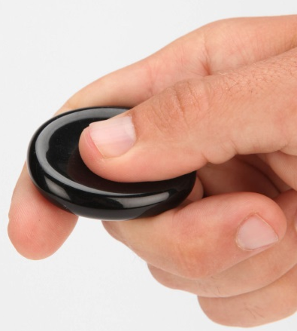

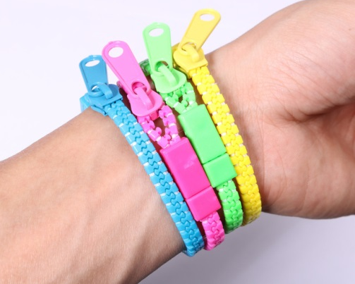



Anxiety Grounding / Sensory Kit
Smooth Stones
Fidget Device
Music
Stress Ball
Ball Bearing
Scented Oil
Activities
Rubber Bands
Earplugs
Bracelet
Pictures
Brush
Kinetic Sand
Games

Slide 33

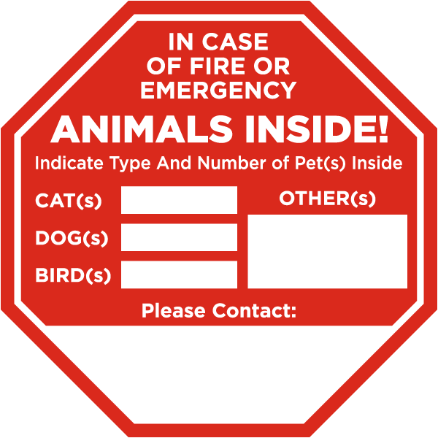
Our Pets
Take your pets
Pet inside sticker
Identification tags
Know the law
Write down instructions
Keep a photo

Slide 34
What Can We Do Today
Priority list of threats
How will I receive emergency alerts
What is my shelter plan
What are my evacuation routes
How will I communicate
Service Animals
Medications
Important documents

Slide 35
More Stuff We Can Do Today
What emergency plans are in place
Identify safe room
Life sustaining treatment
Locate water, electricity and gas shutoff valves

Slide 36
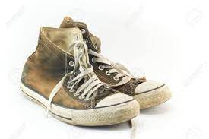
One More Thing…..

Slide 37

Start where you are, use what you have, do what you can.
Arthur Ashe

Slide 38


PROTECTING HEALTH AND
KEEPING PEOPLE SAFE
Marcia.Davis@health.mo.gov
573-526-8560

