Slide 1


Multidisciplinary approach to AAC evaluations
Laurel Duever-Collins, MS, CCC-SLP
Jessica Nicolaescu, MOT, OTR/L, ATP

Slide 2
Introduction and Disclosures

Slide 3
Presenter Disclosures
Laurel Duever-Collins, MS, CCC-SLP
  Financial Disclosure: Paid employee of University of Missouri Health Care
  Non-financial Disclosures: Member of MSHA and ASHA
Jessica Nicolaescu, MOT, OTR/L, ATP
  Financial Disclosure: Paid employee of University of Missouri Health Care
  Non-Financial Disclosure: Member of AOTA
Notes:
Both

Slide 4
Learner Outcomes
Participants will be able to:
  Identify the similarities and differences between AAC, speech-generating devices (SGDs), and the major language programs available.
  Explain the process of evaluating and obtaining AAC through various settings.
  Understand the process for determining the best access method for AAC users.
Notes:
Jessie

Slide 5
Content today
Intros/Definitions
Light-tech to High-Tech
Access
Language Navigation Styles
Insurance considerations
Eval Process
Note about Pediatrics
Notes:
Jessie

Slide 6
Definitions

Slide 7
AAC Definition
AAC – alternative and augmentative communication
  Umbrella term for a large variety of alternative means of communication for individuals who can’t effectively use verbal communication
  Unable to verbally communicate or verbally communicate unintelligibly
    Diagnoses - can be congenital or acquired, including but not limited to Autism, TBI, Cerebral Palsy, genetic syndromes, intellectual disability, stroke, hearing impairment; speech disorders including apraxia, dysarthria, aphasia
Notes:
Laurel

Slide 8
Definitions-
Unaided communication – uses no equipment
  Nonverbal means of natural communication
  Sign language (ASL or signed English), gestures, body language, pointing, blinking, facial expressions
Aided communication – uses some type of equipment/external support
    Light tech
      Writing
      Pictures
      Picture exchange communication system - PECS
      Communication board
      Light tech verbal output - Big Mac, Little Mac, Tech Talk
    High tech
      Device that produces digitized speech: speech generating device (SGD) or Augmentative Communication Device (ACD)
      Static or dynamic displays
Notes:
Jessie

Slide 9
Light to High AAC

Slide 10
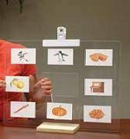
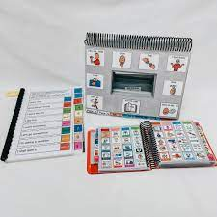
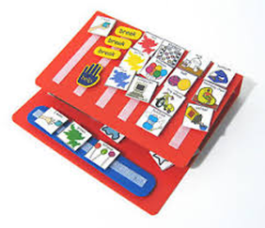
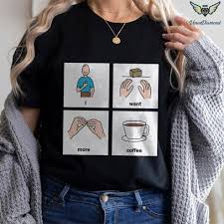
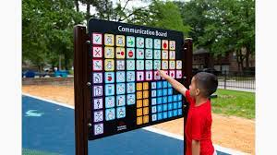
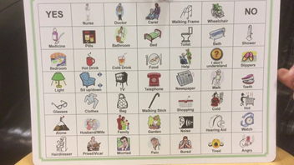
Light Tech AAC Devices
Notes:
Laurel

Slide 11
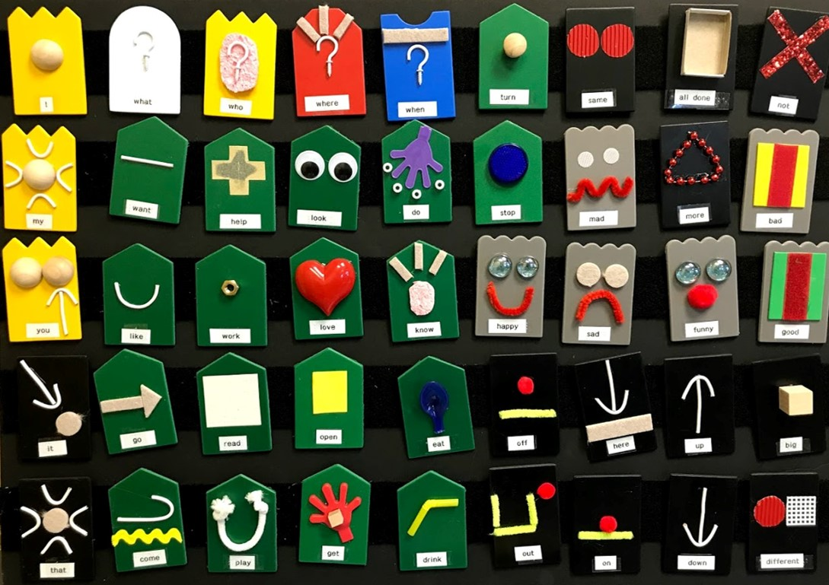
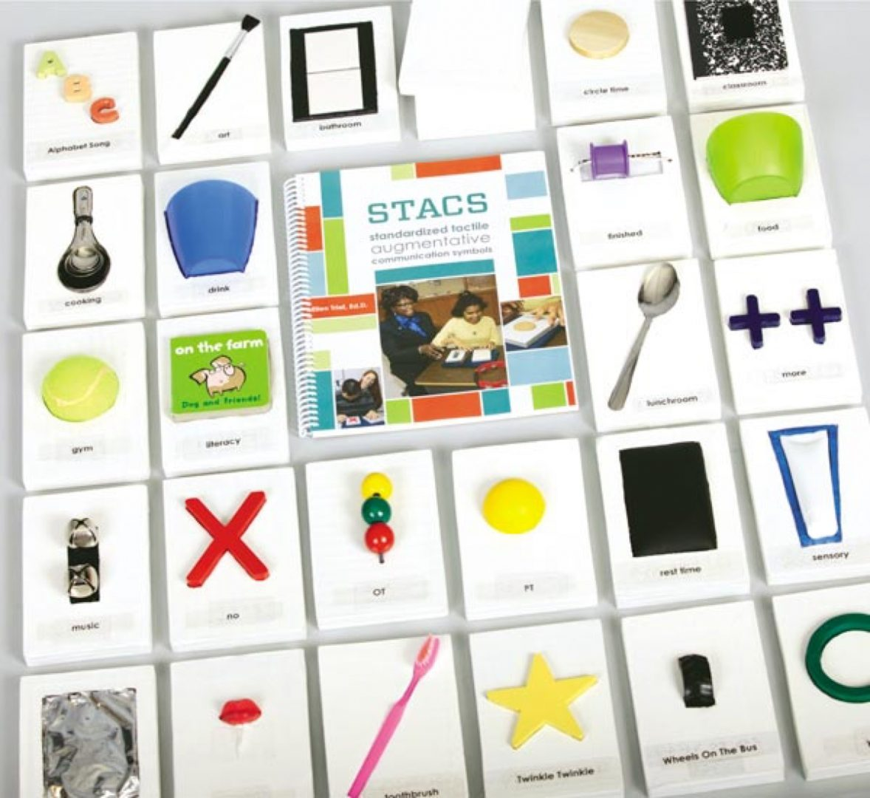
Light Tech-Tactile symbol Communication board
The Power of Communicating with Tactile Symbols – Paths to Literacy
STACS: Standardized Tactile Augmentative Communication Symbols
Kit to make your own tactile symbols:
Tactile Connections: Symbols forCommunication | American Printing House (aph.org)
STACS: Standardized Tactile Augmentative Communication Symbols Kit | American Printing House (aph.org)
Notes:
Jessie

Slide 12
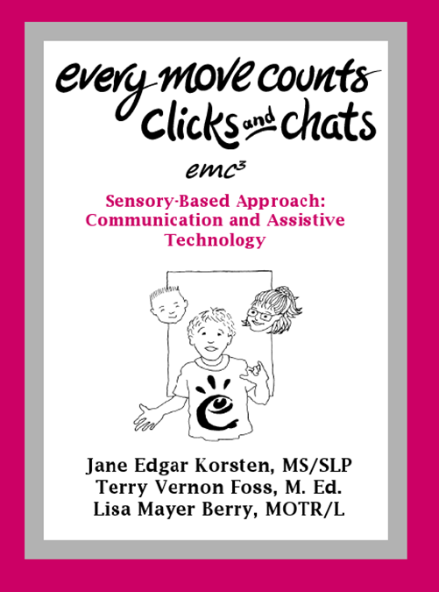
Other helpful resource: Every Move Counts
Sensory assessment-focuses on the person's response to sensory stimuli
  Helps to identify what is motivating and non-motivating
  Observe for non-verbal communication
    Use child-directed gestural response, give meaning/shape into communication
EMC, Inc. Home (everymovecounts.net)
Notes:
Jessie

Slide 13
Light TechPros and Cons
Cost Effective
Can be slowly developed
Less intimidating for communication partners
Multiple access modalities (direct, eye gaze, manipulative, partner assisted)
Customizable vocabulary
Use in multiple locations due to ease of printing
Can be as big or small as needed
Easily replaceable
No voice output (additional sensory input lost)
Cannot “save” and “store
May be cumbersome to remake or add vocabulary
May be cumbersome to carry
Vocabulary often limited
Mid to high tech
Notes:
Jessie

Slide 14
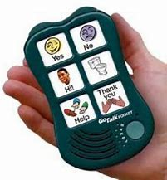
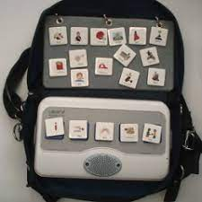
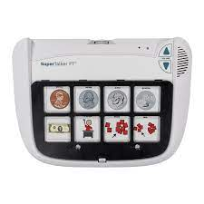
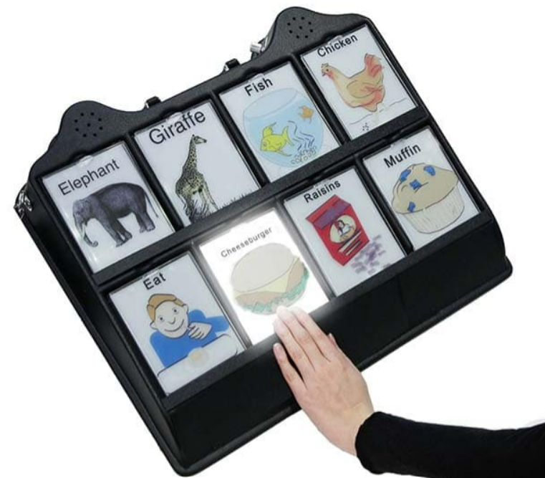
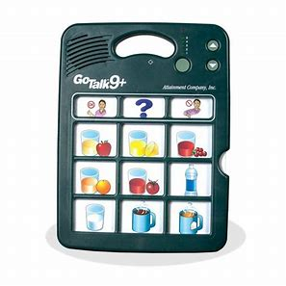
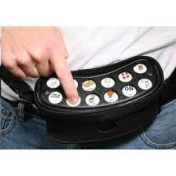
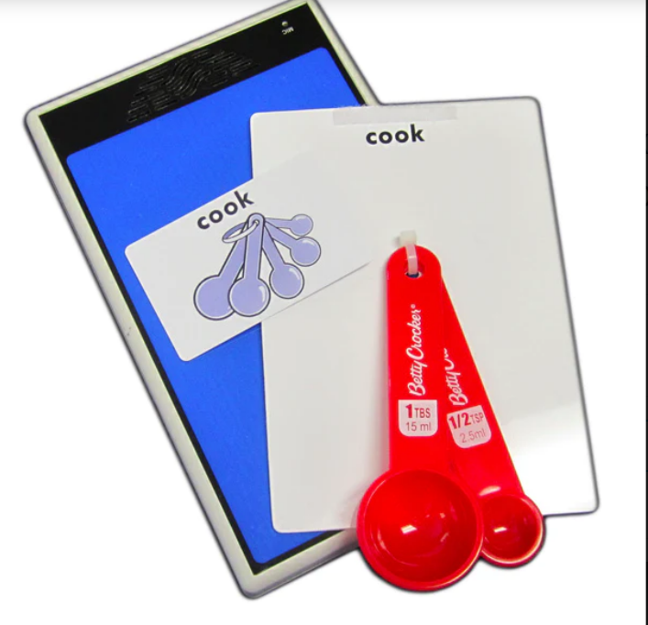
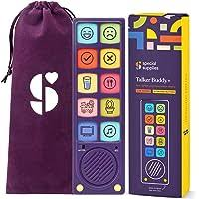
Mid Tech AAC Devices
Notes:
Laurel

Slide 15
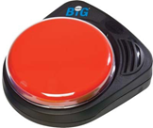
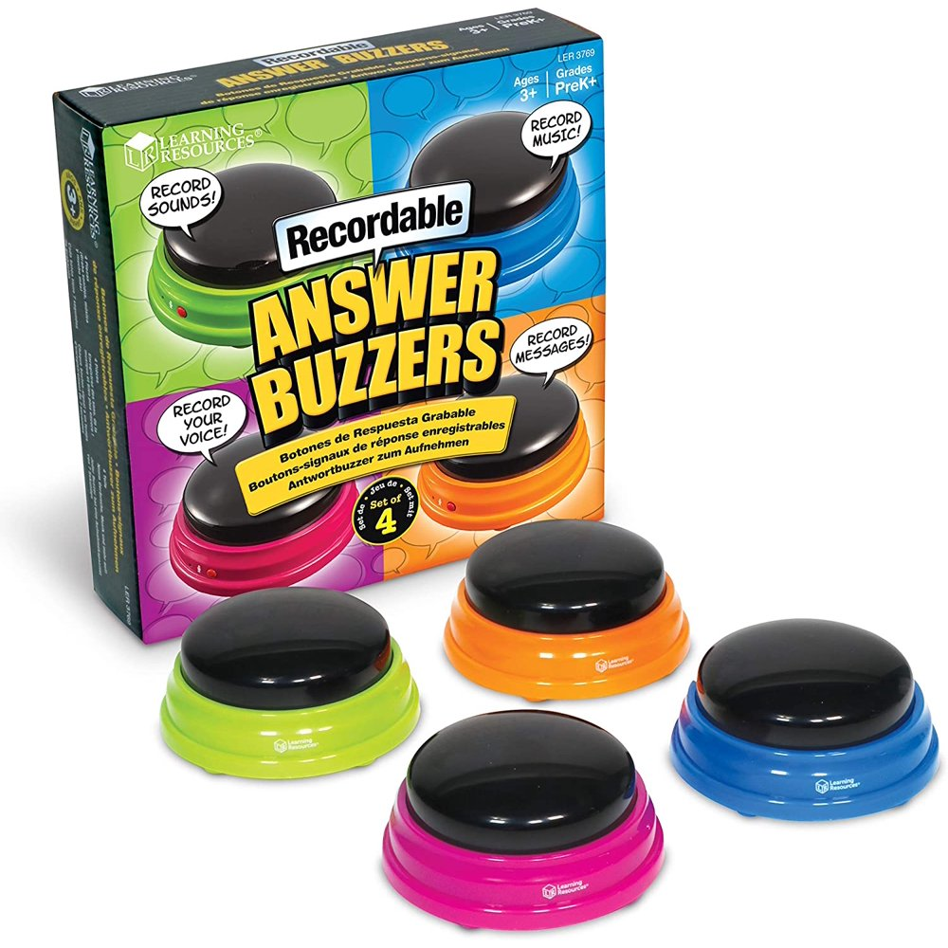
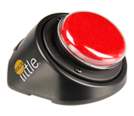

Mid Tech AAC Devices -
Amazon Voice Answer Buttons (consider searching for pet voice output buttons
Big Mac
Little Mac
Talking Brix
Notes:
Jessie

Slide 16
Mid Tech Pros and Cons
Voice output
Can gain attention
Great for initial teaching of call and response
Less fine motor skills are generally needed
Predictable
Often easily re-recordable
Words must be pre-recorded before an activity
No opportunities for novel, generative utterances
Batteries must be replaced
Can be broken
Expensive (although less expensive than high-tech)
Often easily re-recordable
Light Mid and High Tech AAC
Notes:
Laurel

Slide 17
High Tech AAC Pros and Cons
Robust Communication systems
Synthesized speech allows for any word in the language to be spoken at a variety of volume levels
Digital storage for thousands of words
Word prediction based on grammar, spelling, or category
Predictive text, combination of spelling and picture access
Ability to create novel utterances of any length and complexity
Easy integration of texting, social media, or household assistance
Cost
Short life expectancy (~5-7 years)
Devices will break and need repairs/upgrades
Devices must be charged regularly and cannot be used when uncharged
Training users and communication partners to use and program the device can be time-consuming
The weight of devices is prohibitive for some small users to carry
Fatigue-specifically with alternative access
Same But Different
Notes:
NovaChat ranges from 5-10"
Accent ranges from 8-14"
Via (Apple based) comes on ipad mini or pro
Megan

Slide 18


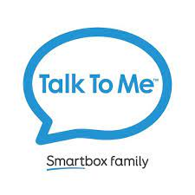


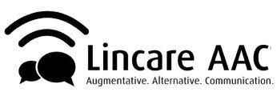

High Tech Companies
Notes:
Not all of the companies, but some of the ones we use frequently
These companies are DME providers that have their own hardware AAC devices, many, many others provide AAC apps

Slide 19
What's the difference?
Apple vs Andriod OS
Case
Carrying case
Mounting options
keyguard connections
customer service
Medicaid approved
independence of the company in getting information
Timelines
warranty coverage
alternative access options
Notes:
Why so many companies? Whats the different between them?
Laurel

Slide 20
Vision Considerations
What symbols do they show awareness of? Consider 3d, 2d, 1d images/objects.
Simple Environment! -what is behind the device?
Consider size of symbols and placement
Lighting: if using a tablet may benefit from dimming lights, watch for glare on screen
Present the device to the learner's preferred visual field
Settings on devices:
  Adjust fonts and backgrounds to have high contrast (red, yellow, black and white)
  Visual cue: color changes when key is activated, button is enlarged when selected
  Some devices have specific vocab files setup for high contrast pictures
Consult with Teacher for Visually Impaired if patient has one!
May need to be creative here, with symbols used.
Monitor for visual fatigue (build in breaks!)

Slide 21
Motor Considerations
Direct Access
  Touch (touching the screen with a body part)
  Eye gaze
  Mouse
  Head pointing
Indirect Access
  Scanning
    One switch
    2 switches
    Partner assisted
Notes:
Jessie

Slide 22
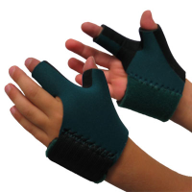
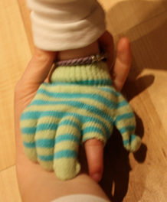
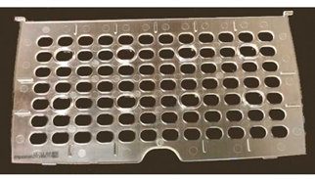
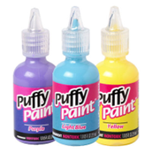
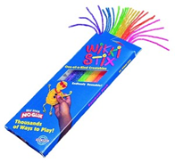
Direct Access- Touch
Think outside the box! Not isolated to just a finger!
Settings to consider:
  Activation on contact-button activates on initial contact
  Activation on release-button does not activate until released
  Acceptance time-hold button for x amount of time before activation
  Audio feedback
  Visual feedback: change color when activated, enlarge button when activated
  Adjusting time between button activations: can be used to prevent accidental selections
  Adjust rate at which button can repeat itself
Additional equipment :
  Key guards or touch guides (some are thicker than others depending on the brand)
  Glove
  Splints
  Coban
  Stylus
  Head or chin pointer
  Wikki sticks or puff paint-help bring more attention to a button (use over keyguard)

Slide 23
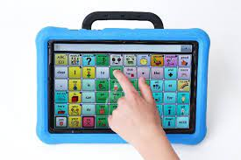
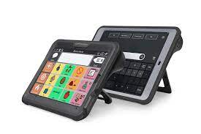
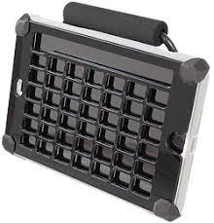
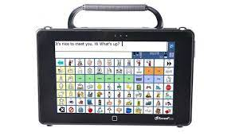
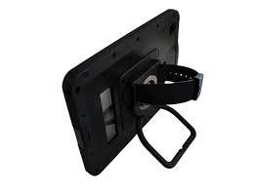
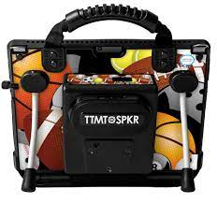
Direct Access- Device Examples

Slide 24
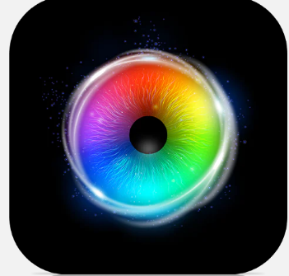


Direct Access- Eye gaze
Calibrate device to patient (at least attempt), if can't calibrate try a simple cause effect game then revisit the calibration.
Considerations:
  What positions will the patient be in during the day
  Do they have a preferred field of vision
  Monitor for visual fatigue, may need to take breaks
  Do they need a free area on the screen to rest eyes
  Any specific areas on the screen that are easier than others
Take note of any quadrants that are easier or harder for patient to access. Take this into consideration when setting up language.
Making a selection can be done with dwelling on a button (this can be customized) or using a switch to select.
Sensory Eye Fx 2-by Tobii Dynavox
On Accent devices, PRC-Saltillo
By Smartbox. Also have Look to Read. Runs on Grid 3 platform

Slide 25
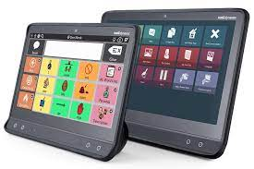
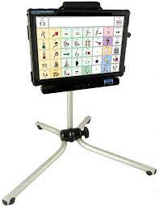
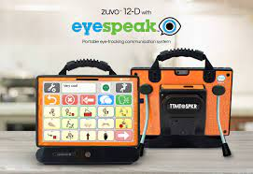
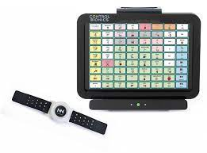
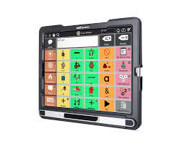
Direct Access- Device Examples-

Slide 26
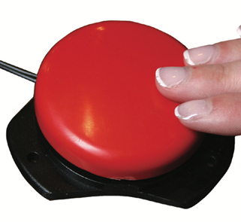
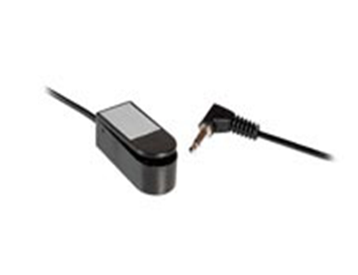
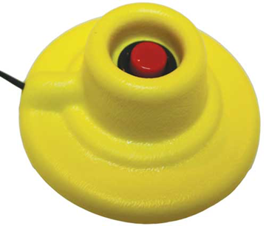
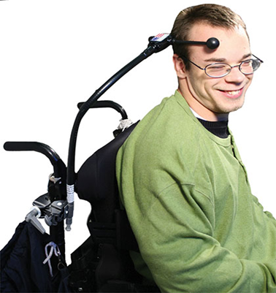
High Tech-Indirect Access
Find your consistent access points
  Want this movement to be easy for patient and purposeful
Be creative with finding access points (hands, head, lower extremities, elbow, etc.).
Considerations:
  What positions is the patient in throughout the day (how will they access the switches in these positions?)
  Do they use a power wheelchair, walker, etc.
    If a power wheelchair user-will you use a similar access method or different?
      Adaptive Switch Labs-has some equipment to utilize the same head array for driving and use of a device.
Micro light
Jelly Bean Switch
Finger isolation
Ultimate Switch
Enabling Devices
AbleNet

Slide 27
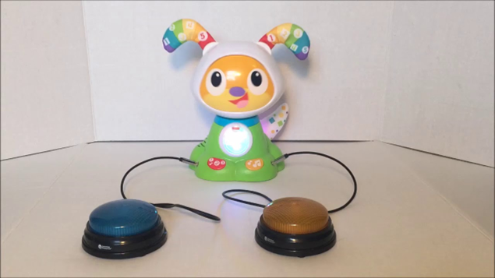

Switch Adaptive Toys
Switch toys can provide a great starting point for helping determine access to switches in preparation for communication devices and power mobility.
Pascale's Pals Switched Adapted Toys
    Find them on Facebook
    Switched Toys
    Toy giveaway every year in December
    Website has some tutorials for modifying toys

Slide 28
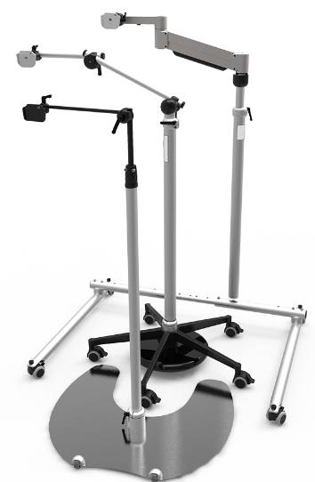
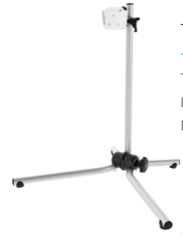
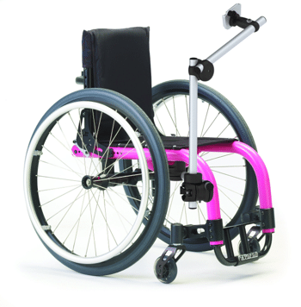
Mounting
Rehadapt
Mount'n Mover
Table Mount
Wheelchair Mounts
Floor Mount

Slide 29
Language Navigation Styles
Notes:
Laurel

Slide 30
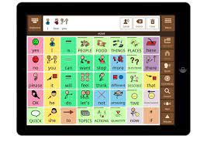
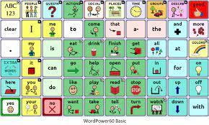
Linguistic Basic Navigation
Organizes words into noun categories (animals, clothing, food) and syntactical categories (people, actions, describing words)
Very easy for majority of people with functional receptive language skills
Generally, the best understood by verbal communication partners who are assisting AAC users
Wordpower (NovaChat and TouchChat) and Avaz are good examples of this type of organization
Finding My Words
Notes:
Laurel

Slide 31
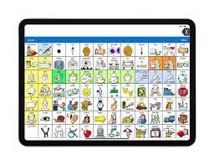
Operational Based
AKA Motor Planning
Location of the words is determined by motor access instead of organizing semantically
Most often kids love or hate it
Generally very easy for kids with good sequential motor recall ("they use the iPad better than I do")
Communication partners often find it complex and difficult. <- Often the largest barrier
LAMP and Unity
Finding My Words
Notes:
Laurel
“Motor automaticity is achieved through practice when a consistent motor movement produces a consistent result. In order to achieve automaticity with AAC, each word should be accessed using a unique and consistent motor pattern regardless of the activity” (Halloran and Halloran, 2006, p. 17).
After the placement and motor movement of a word has been established, it should not be changed, as this would negatively affect communication fluency.
Halloran and Halloran (2006) found that individuals on the autism spectrum might experience difficulties with motor planning of an icon on a device, which however is found to be easier than the motor plan to articulate that word.

Slide 32


Environmentally Based Navigation
Words are organized based on context or environment
Often associated with older light-tech activity boards that were limiting
Reduced cognitive load for navigation as many communicative functions are in the same place
TD Snap
Finding my Words
Notes:
Laurel

Slide 33

Pragmatic Based Navigation
Words are organized based on function
Best when kids learn to articulation feels and purpose behind what they say
Rooted in typical language development
PODD (pragmatically organized dynamic display)
Personalized eye gaze systems
Most programs have pages that include this (social, quick fires, chat)
Finding My Words
Notes:
Laurel

Slide 34
Insurance

Slide 35
Insurance-
Medicaid
  Needs to be completed by a Medicaid-licensed facility
  Have to have a medical diagnosis and a speech/language diagnosis
  Three signatures-SLP, OT and PT or second SLP
  Rarely, if ever, is there a co-pay or deductible
Tricare
  Some plans go through quickly, others take an incredibly long time
  National plan, so it's okay if families move
Commercial insurances
  BCBS-Some plans have DME as exclusionary pieces, will not cover for any reason. When they are covered, it is usually at 14-30% only
  UHC-Often requires a 3-month trial and extensive paperwork documentation of device success. Device tends to be mostly covered after deductible is met, warranty is generally not
  Commercial insurances as far as approval and coverage
Notes:
Laurel

Slide 36
Other funding sources
Lilly's Voice
UHC Children's Grant
SB 40 funding from counties
MoAT
  AT Reimbursement for schools
  Kids Assistive Technology
MO Better- https://www.mobetter.org/
Notes:
Jessie
Lilly's voice – nonprofit organization that covers device and language program 100% (does not have income requirements)
UHC Children's grant – 16 or younger, income requirements
SB 40 – BCFR, other equivalents
MoAT – must have AT listed in IEP and AT cost between $350 and $5000
MO Better – no income requirements

Slide 37
Eval Process
Notes:
10:10

Slide 38

Meet Calvin
18yo w/ Cerebral Palsy GMFCS V
Mix tone w/ spasticity and dystonia in extremities. Has Baclofen pump.
Attended CTC since 8 yo- for OT, PT, ST
Primarily uses power chair(R hand joystick) has manual chair backup
Gen ed classes needs help for access, getting ready for college
Used Winslate w/ 2-switch scanning previously
Notes:
Jessie

Slide 39
Before the Eval
ATEC Script
Background Survey-Case manager
Schedule Face-to-Face Doctor's appointment
Schedule 2-hour Eval spot
Week before-Call and confirm, check for updates
Notes:
Laurel
What does he like to play with? Is he using anything at school? Any medical changes we need to consider?

Slide 40
Motivators!
Find out what is motivating to patient! Use caregiver report and observation.
  Explore sensory input if difficulty finding what is motivating
    Vestibular: front to back, side to side, rotary, up/down movement of head/body
      Rocking, swinging, spinning, being pushed in stroller, bouncing on ball
    Proprioception: can be active or passive input
      Push/pull, chewing, vibration, applying deep pressure
    Tactile
    Auditory: music, instruments, sound board,
    Visual:
      Pin wheel, mylar material, cd, ipad with sound off, light up toys etc
    Olfactory
    Gustatory
The Patient will need to be motivated to participate to show their communication! Make note of preferences as well as things that the patient may dislike.
Notes:
Jessie
Add specifics about "calvin"

Slide 41
During the Eval
Collect background info
OT-explore access
SLP-explore language systems
Parent/school preferences?
Pros and cons of different companies for this patient
Series vs Trial vs Purchase
Notes:
Laurel

Slide 42
Calvin's Eval
OT access
  Targeting
  Vision (no concerns reported from family)
  Portability
  Concerns for use with power wheelchair and manual wheelchair
Notes:
Jessie

Slide 43
Calvin's Eval-Expressive Language
Functional expressive language skills
  speaks in simple sentences with a good variety.
  spelling and overall syntax is below average.
Prefers to speak verbally, but limited to close friends and family d/t intelligibility and is still often not understood
  intelligibility decreases with fatigue
  A lot of communication breakdown and frustration recently.
Notes:
Laurel

Slide 44
Calvin's Eval-Receptive Language
Receptive language skills WNL
Followed a variety of simple commands.
  ask and answer a variety of questions via verbal communication and AAC device.
Independently used two-step scan using AAC device.
Becomes fatigued when using AAC device currently
Can IND add phrases to his device, however he does not do so in an organized manner
Often prefers to type out responses.
Needed integration for social media, graphing calculator, and phone access
Notes:
Laurel

Slide 45
Calvin's Eval-What we tried
Natural Speech
ProSlate w TouchChat with and without touchguide
TobiiDynavox I13+ w/ eye gaze interaction 0.8 sec dwell
Winslate w/ switches. Presented 2 switch scanning at head on text based software.
Notes:
Laurel
Natural Speech - Family can understand him most of the time, especially when he goes slow and produces short phrases.
slurred, imprecise articulation, limited breath support and inconsistent volume.
60% intelligible
ProSlate w TouchChat.
Pt with limited interest
direct hand access resulted in gross swiping motion, which activated numerous targets at a time. Unable to determine intent, as no single button access achieved.
When touchguide added, pt with significant difficulty grading movements and accessing small finger hole for target selection
TobiiDynavox I13+ w/ eye gaze interaction 0.8 sec dwell
Pt able to access and activate targets with eyes. Completed successful calibration. However, pt had difficulty accessing keyboard.
He fatigued quicker than with switches.
Pt reported limited interest or desire to utilize his eyes for communication. Dwell .8 sec
Winslate w/ switches. Presented 2 switch scanning at head on text based software.
Pt IND'ly navigated and typed to answer questions.
He utilized predictive text when he spelt items correctly, along with followed directions to navigate towards preprogrammed messages.
Pt able to control whole device and toggle between programs.
For instance, between communication app and text message app to alert grandma to his immediate medical needs. Pt reports preference to switch access at head, over other direct access methods.

Slide 46
After the Eval
Series – if we are undecided on which program and/or device is the best fit, we would see Calvin for 4-6 weekly visits to trial at the clinic
Trial – Calvin would receive a device for ~4 weeks (dependent on company) to take everywhere with him including home, school, therapy, community to see if this device would be a good fit. We may follow up with family during the trail, or if he is receiving services elsewhere, we would follow up with those therapists to determine if we should trial another device or push to purchase.
Purchase – we would ask insurance to buy a specific device for Calvin because it seems to be the most appropriate fit. We would have a conversation with family to ensure they are on board and feel the same.
Notes:
Megan

Slide 47
Calvin's Decision
In-house series to explore more access between switches and eye gaze, and to best determine the language program and software
Following the series, made request for Uno Touch from Control Bionics for Grid-3
Notes:
Laurel

Slide 48
Report Writing
Current level of functioning with
  Articulation
  Receptive Language
  Expressive Language
  Cognition
Gross/Fine motor considerations
Vision/Hearing considerations
Speech therapy has been attempted without success
Medical diagnosis
Behavior considerations
Low tech considered and why unsuccessful
Notes:
Laurel

Slide 49
Trial of devices
Need a trial, formal or informal
3 different systems, 3 different programs
Why is the one being selected the most appropriate and least expensive
Why will an iPad not work?
Notes:
Jessie
Why not ipad:
Not locked down, kid may get out of it
Not supported by vendor
Not under warranty

Slide 50
Goals
At least 3, focused on the language development and use and care of the devices
  Pt will explore a variety of access methods and communication systems to determine most appropriate means of communication to increase overall expressive skills.
  Pt will access and utilize ACD for a variety of communicative functions, including but not limited to greetings, requests, directives, commenting, or protesting, on 7/10 attempts to increase effective communication skills.
  Pt's caregiver will verbalize understanding regarding ACD evaluation, treatment, and overall POC, along with implementation of HEP strategies and recommendations.
Notes:
Jessie

Slide 51
When to refer to an AAC site
When the child has Medicaid
When you don't feel comfortable completing the evaluation (may be complexity of case or access)
When insurance requires something specific that is out of your ability level
Feel free to reach out to our team if you have questions and are unsure of what to do!
Notes:
Laurel

Slide 52
Report Templates and assistance
PRC-Saltillo
FORBES
Tobii Dynavox
AbleNet: Whole process starts w/ a benefits check
TalkToMeTechnologies
Lincare AAC
Notes:
Laurel

Slide 53
Questions?
Laurel: lmdrvb@umsystem.edu
Jessie: NicolaescuJ@umsystem.edu
Notes:
10:30

