Slide 1
AEM and IEP Discussions
A Pilot Project

Slide 2
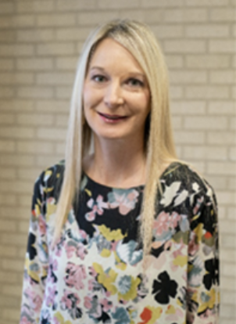
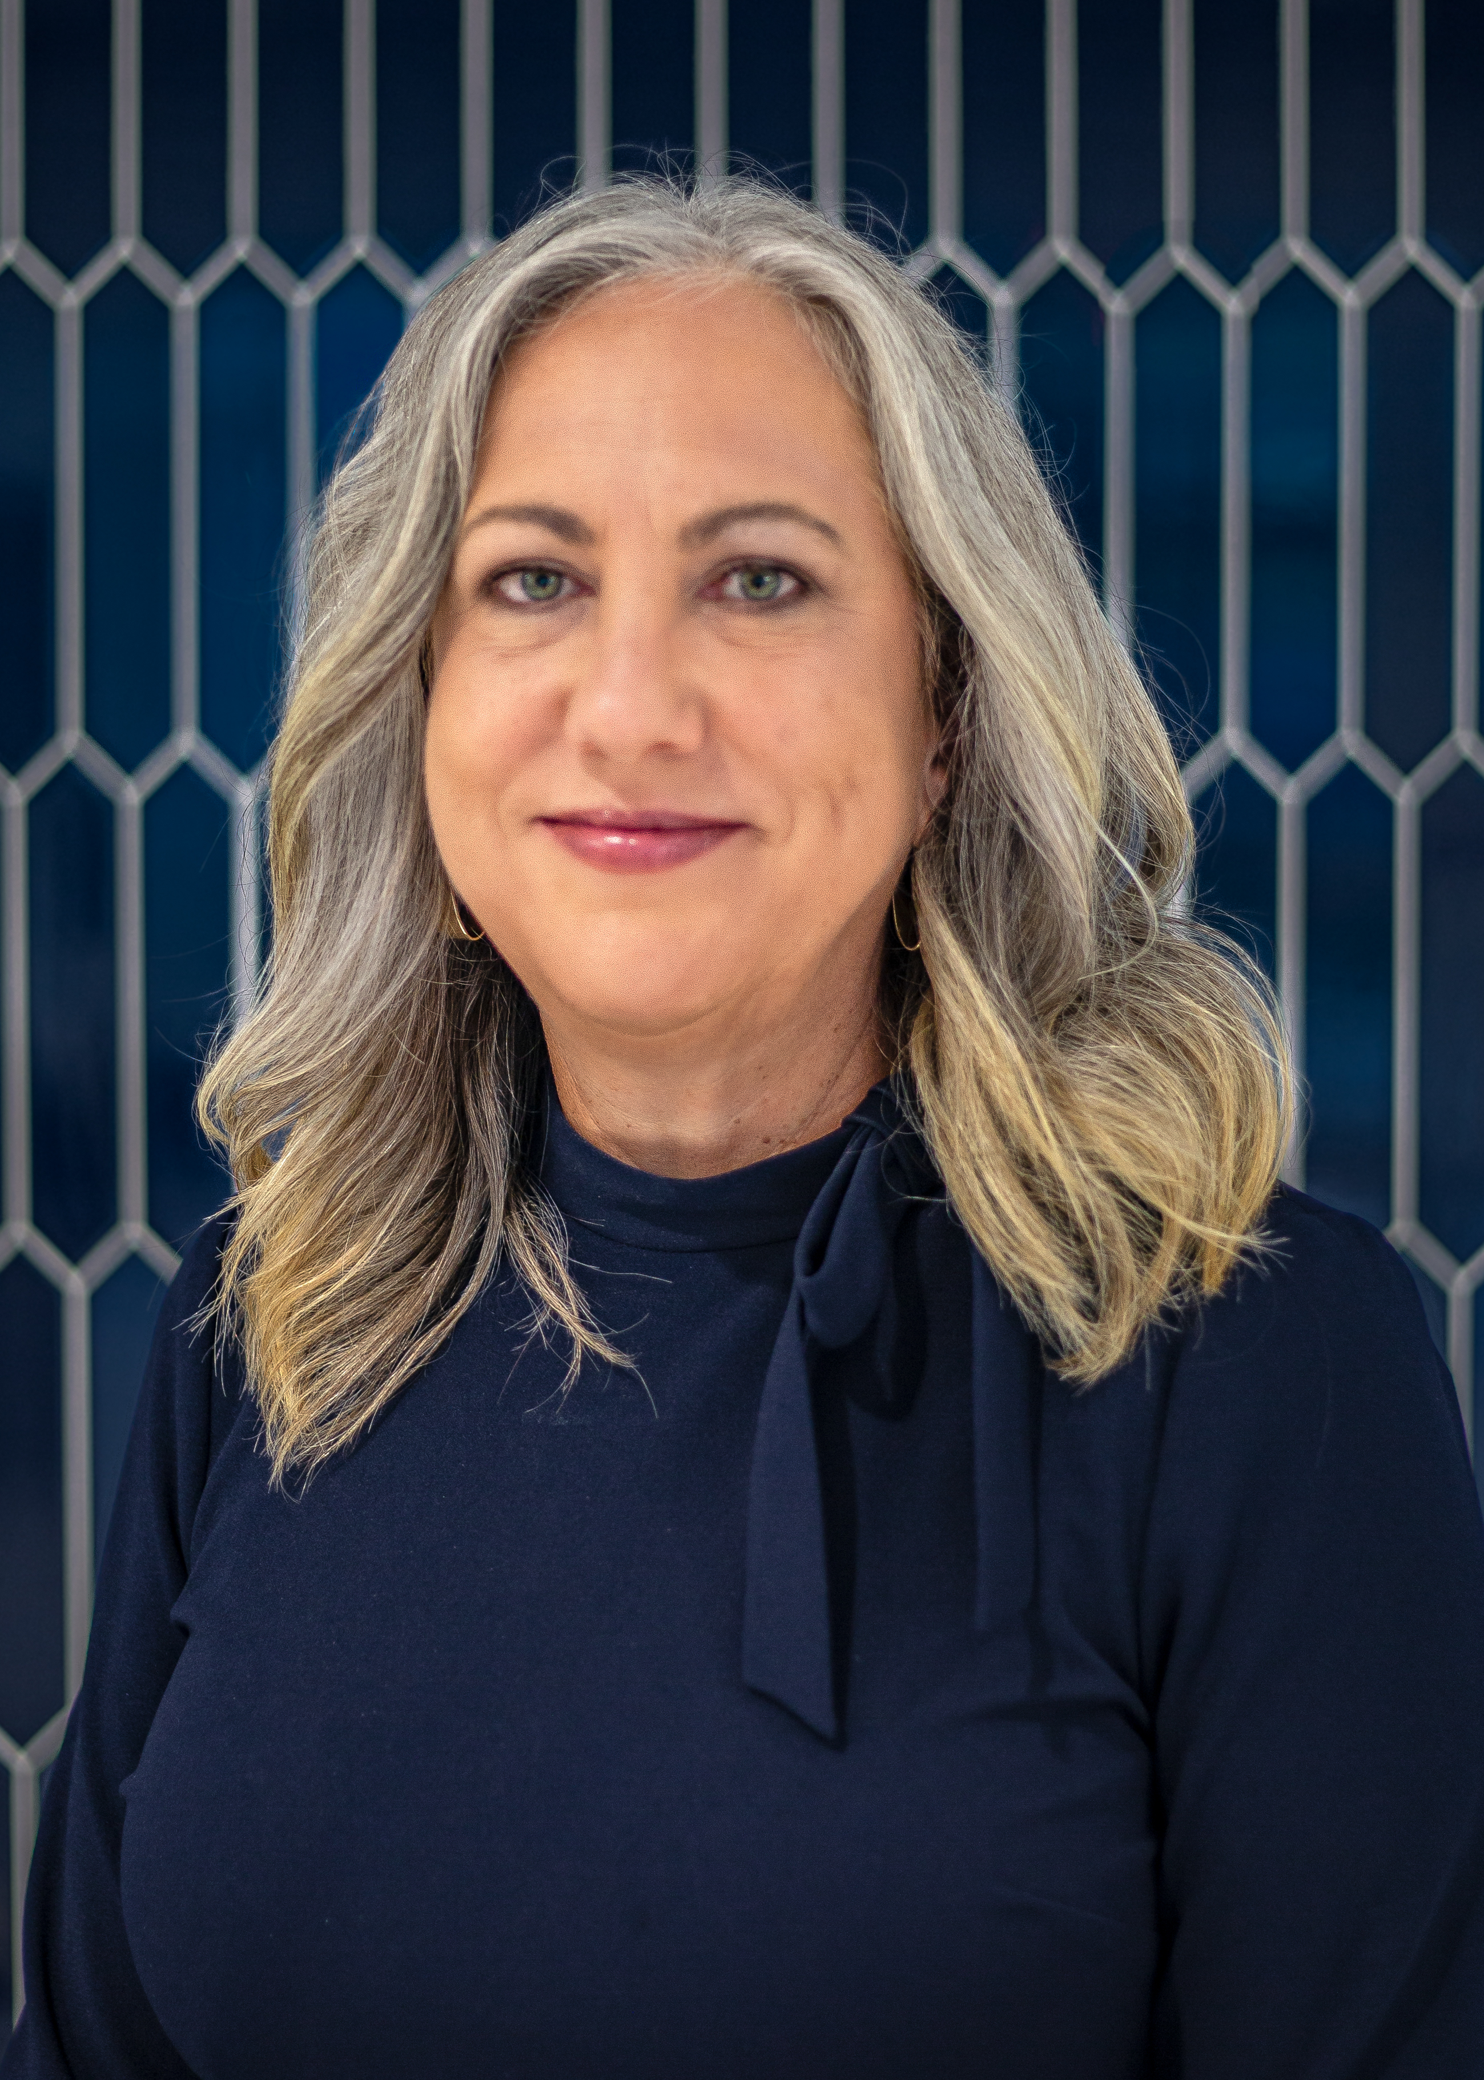
Welcome & Introductions
Kara Winnike
Assistive Technology Specialist
North Kansas City Schools
Email Contact Information
kara.winnike@nkcschools.org
Phone Contact Information
(816) 321-6457
Lisa Meyer
Instructional Coordinator for Technology
North Kansas City Schools
Email Contact Information
lisa.meyer@nkcschools.org
Phone Contact Information
(816) 321-5731

Slide 3
Getting to Know Each Other
Who’s in the room?
This Photo by Unknown Author is licensed under CC BY

Slide 4
Learning Objectives Participants will...
Increase knowledge of what AEM is and the vital role it plays in student success.
Learn about NKC Schools journey in ensuring AEM is part of IEP discussions.
Discuss and share next steps for increasing AEM awareness and growth opportunities.

Slide 5
(AEM) Accessible Educational Materials

Slide 6
Accessibility Occurs when…
A person with a disability can…
Acquire the same information
Engage in the same interactions
Enjoy the same services
In an equally effective, equally integrated manner, with substantially equivalent ease of use
…as a person without a disability
Source: Cast-National Center on Accessible Educational Materials, /What is Accessibility?, 2/29/24

Slide 7
ACCESSIBILITY
Assistive Technology
Accessible Educational Materials

Slide 8
Assistive Technology (AT)
Is any item, piece of equipment, or product system, whether acquired commercially off the shelf, modified, or customized, that is used to increase, maintain, or improve functional capabilities of a child with a disability.
Source: IDEA/ Section 1401, 2/29/24

Slide 9
(AEM) Accessible Education Materials
Are print and technology-based educational materials, including print and electronic textbooks and related core materials and technologies that are designed or enhanced in a way that makes them usable across the widest range of learner variability, regardless of format (e.g. print, digital, graphic, audio, video) or features. People with disabilities may experience barriers to the use of printed materials, digital materials, and technologies. Examples where barriers might occur include textbooks, digital documents, websites, apps, learning delivery systems, and electronic devices.
Source: dese.mo.gov.-Missouri Department of Elementary & Secondary Education, /Assistive Technology, 2/29/24

Slide 10
ACCESSIBILITY
Assistive Technology
Accessible Educational Materials

Slide 11
NKC AEM Journey
Focused on Special Education/AT.
Focused on General Education/Accessibility.
Joined AEM State Leadership Team.
AEM was reactive vs proactive for IEP students.
Gathered AEM and IEP discussion resources.
Created AEM Consideration Guide.
Identified targeted group to begin conversations about AEM.
Collected information from targeted group about growth opportunities for AEM and IEP discussions.
Began developing plan for creating and sharing AEM training resources.

Slide 12
NKC Next Steps in our AEM Journey
Continue developing training materials.
Integrate and implement collected resources.
Share current pilot data with administration to determine next steps.
Identify and expand targeted groups based on data from pilot project.
Share AEM and IEP discussion pilot project information with AEM State Leadership Team.
Focus on AEM outside of IEP and move towards MTSS and 504.

Slide 13
Discussion and Sharing

Slide 14
Resources
National Center on Accessible Educational Materials
Missouri Department of Elementary & Secondary Education
Missouri Assistive Technology
NKC Instructional Technology YouTube Channel-AEM Playlist
Accessible Education Materials and Accessible Formats
NKC AEM Consideration Guide
Georgia Department of Education "Take A Minute"
Wisconsin Department of Public Instruction Decision Tree

