Slide 1
Why Does “Matter Compatible” Matter?
Chris Helmick
Asst. Director of Assistive Technology
St. Louis Arc

Slide 2
Learning Objectives
Discuss what Matter Compatibility is.
Identify who is behind the Matter protocol and a brief history.
Outline the importance and the benefits.
Give examples of Matter Compatible devices.
Navigate the setup of Matter Compatible devices on Alexa, Google Home, and Apple Home.
Recognize the direction of future developments.

Slide 3
What is Matter?
Matter is an open-source standard aimed at uniting the smart home world by enabling smooth communication among internet-connected devices from various manufacturers.
This standard not only ensures secure and reliable interactions but also enhances the overall security of smart homes.
Built upon the Internet Protocol (IP), Matter simplifies the development process for manufacturers, enabling them to create devices that seamlessly integrate with popular smart home ecosystems such as Amazon Alexa, Apple Siri, and Google Assistant.

Slide 4
Who is behind Matter?
Matter is an important collaboration between competing companies working towards a common goal: to advance the smart home and make it more consumer-friendly. It was created by Amazon, Apple, Google, and other companies through the Connectivity Standards Alliance (CSA).
The CSA maintains the official list of Matter certified products and restricts the use of the Matter logo to certified devices.

Slide 5
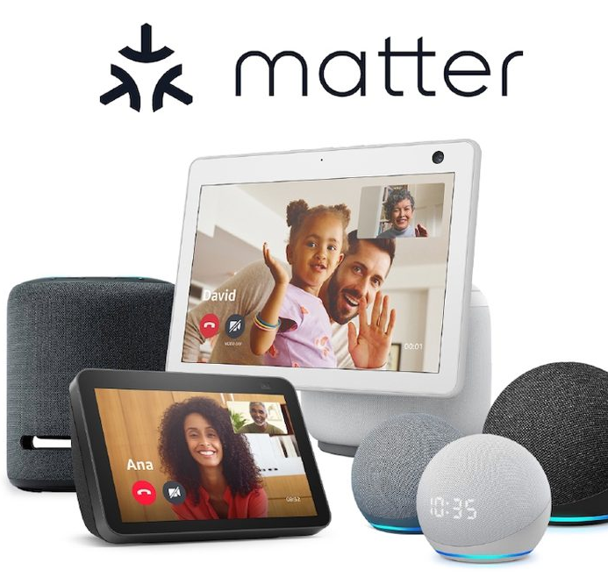
Background of Matter.
In December of 2019, Amazon, Apple, Google, Samsung, and the Connectivity Standards Alliance (formerly Zigbee Alliance) announced the collaboration.
Matter 1.0 was launched on October 4, 2022. It introduced support for lighting products, door locks, thermostats, motion sensors, and televisions.
The latest version, 1.2, was launched on October 23, 2023, which added new device types such as refrigerators, robotic vacuum cleaners, smoke detectors, and air purifiers.

Slide 6
Why does "Matter" matter?
The goal of Matter is to make all smart home devices compatible. That means if you buy a product with the Matter logo, you can use it with Amazon Alexa, Apple Home, Google Home, Samsung SmartThings, or any other ecosystem that meets the standard. This allows consumers to choose models based on features and price rather than compatibility with a specific system.

Slide 7
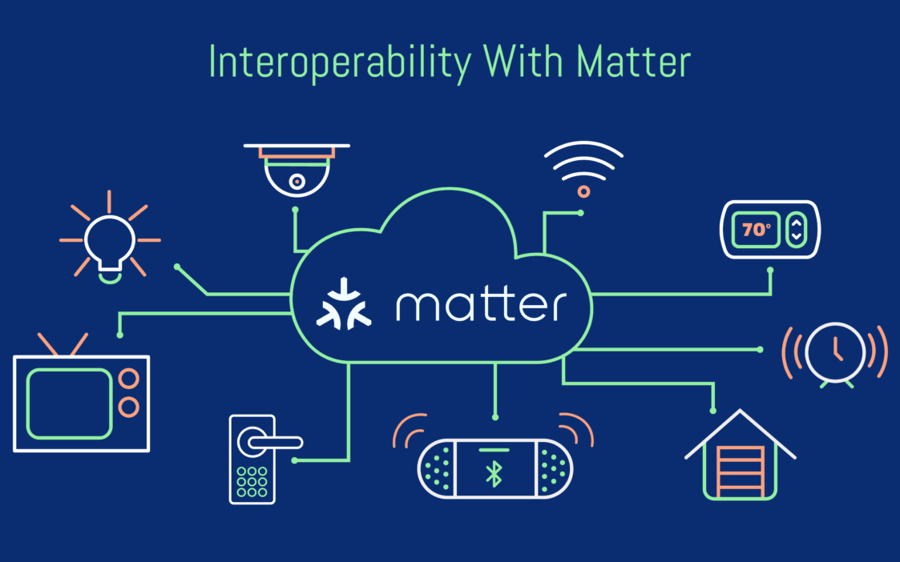
Benefits of Matter
Simplified setup: No more struggling with compatibility issues.
Ease of use: Reduces the need for multiple apps.
Increased flexibility: Mix and match devices from different brands.
Improved security: Enhanced security features for your smart home.
Wider choice: More Matter-compatible devices to choose from in the future.
Future-proof: Matter is designed to be scalable and adaptable for future innovations.

Slide 8
Considerations
Bugs: New standard that still needs updates. Remember it is a work in progress.
Availability: Matter Compatible devices are still being developed and may not be as available as older smart home devices.
Change: This may require slowly switching over to Matter Compatible devices.
Best to use one assistant. (i.e., Apple, Google, Alexa.) The logistics of naming systems can still be different on each platform.
A Smart Home hub is needed to add Matter Devices.

Slide 9
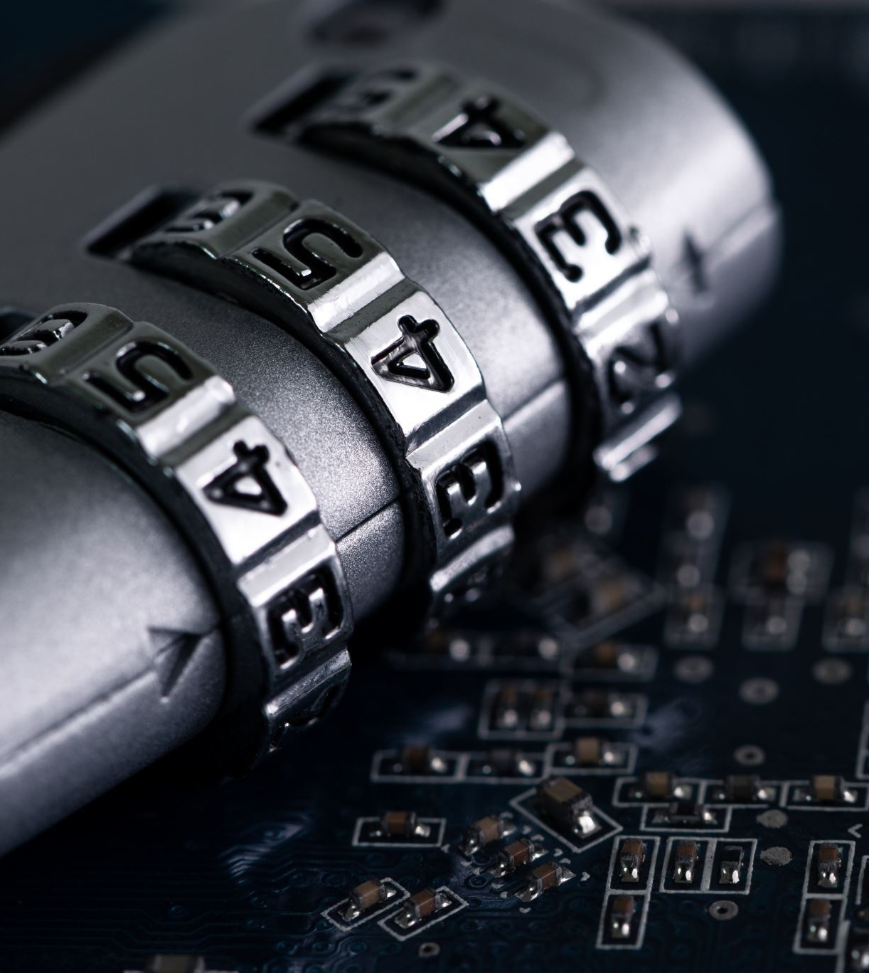
Matter Security and Privacy
Matter takes security and privacy seriously, employing various methods:
Robust Encryption: Matter uses strong encryption methods making it difficult for unauthorized individuals to access it.
Secure Communication: It emphasizes secure communication protocols and standardized public key infrastructure (PKI) to authenticate devices and encrypt data, protecting privacy and preventing unauthorized access to information.
Data Privacy Principles: Matter embeds data privacy principles into all device interactions, safeguarding personal information.
Direct Device Communication: By operating on the Internet Protocol (IP), Matter allows devices to communicate directly without relying on third-party services.
Industry Support: This broad industry support indicates a commitment to maintaining high security and privacy standards.
While Matter provides these security and privacy features, it's still important for users to take basic security measures like using strong passwords and keeping devices updated.

Slide 10
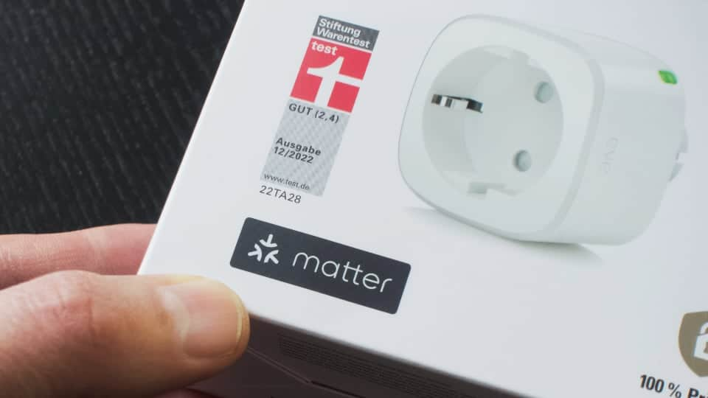
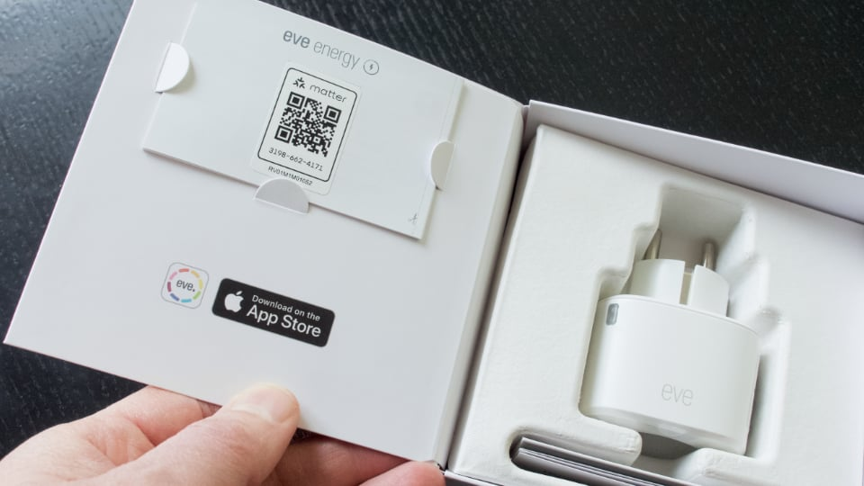
Examples of Matter Compatible devices.
Appliances
Lighting
Smart Plugs
Door Locks
Thermostats and HVAC Controllers
Window Coverings and Shades
Motion and Contact Sensors
Smart TVs and Streaming Devices
Smart Speakers & Displays

Slide 11
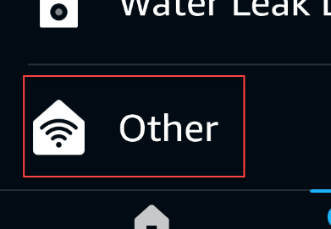
Setting Up Matter with Alexa
STEP 1
Open the Alexa app.
STEP 2
Select Devices.
STEP 3
Select the Plus Icon.
STEP 4
Select Add Device.
STEP 5
Select Other from the bottom of the list.
STEP 6
Select Matter.
STEP 7
To confirm that you have a Matter device, select Yes.
STEP 8
Scan your Matter QR Code or enter the numeric code and follow the on-screen instructions.

Slide 12
Setting Up Matter with Google Home
STEP 1
Open Google Home App
STEP 2
Select Devices.
STEP 3
Select the Add button.
STEP 4
Select Matter-enabled device.
STEP 5
Scan your Matter QR Code or enter the numeric code.

Slide 13
Setting Up Matter with Apple Home
STEP 1
Open the Home app.
STEP 2
Select the Add button.
STEP 3
Select Add Accessory *.
STEP 4
Scan QR Code or select "More Options", "My Accessory isn't Shown Here", "Enter Code".
STEP 5
Follow the onscreen instructions to finish setup.
* If your Matter accessory was previously paired to another app, select "More options" then select your Matter accessory.

Slide 14
The Future of Smart Homes with Matter
Matter is revolutionizing the smart home industry.
It simplifies setup, increases compatibility, and enhances security.
As Matter adoption grows, expect a wider range of devices and functionalities.
Matter paves the way for a more seamless and unified smart home experience.

Slide 15
Questions?

Slide 16
Contact Info
Chris Helmick
chelmick@slarc.org

Slide 17
Reference Links
What Is Matter? The Smart Home Standard, Explained
Matter smart home standard explained: Here's why Google, Apple and Amazon are backing it
The Matter Smart Home Standard Is Finally Available: Here's What It Means for Your Home
Devices that Matter: these products work with the new smart home connectivity standard
The top Matter-compatible devices announced at CES 2024
Matter Explained: A Brand New Smart Home Standard
Best Matter Devices for Your Smart Home
How to Connect Matter Smart Home Devices with Alexa
Set up and manage Matter-enabled devices in the Google Home app
Apple: Pair and manage your Matter accessories
Samsung: SmartThings x Matter Integration

