Slide 1
Assistive Technology:
A School Team Approach

Slide 2
Introductions
Kara Winnike
Assistive Technology Specialist for the North Kansas City School District
Email Contact Information​ kara.winnike@nkcschools.org​
Phone Contact Information​ (816) 321-6457​

Slide 3
Learning Objectives
Participants will….
learn how the North Kansas City School District is working to enhance assistive technology services by developing school teams
will review resources used to assist in developing and improving assistive technology services
will reflect and share experiences from their district, including actions which have positively impacted assistive technology services

Slide 4
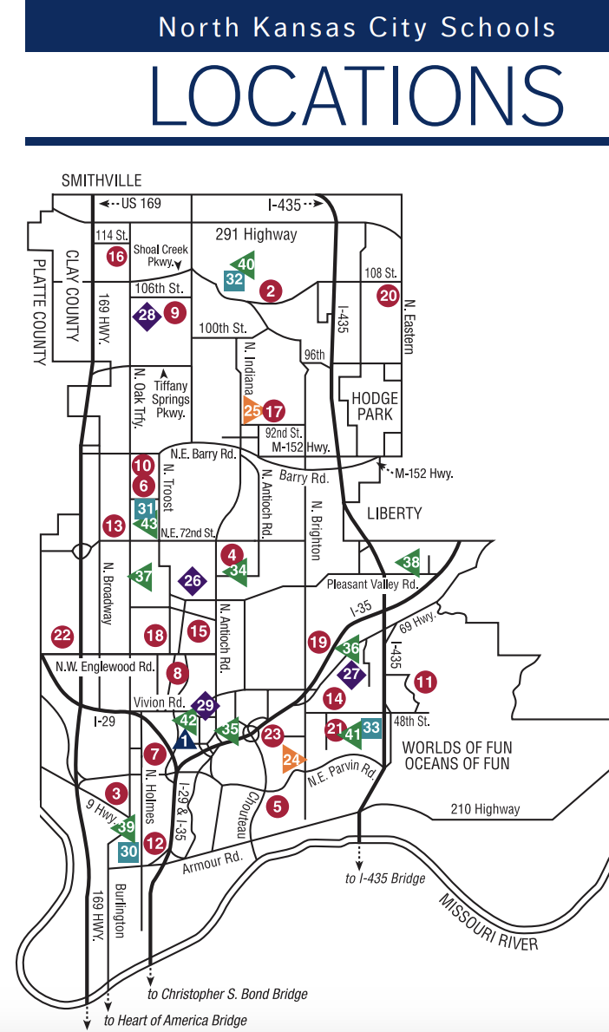
Snapshot of NKC Schools
2nd largest district in Missouri
Student population 21,500+
Among the most diverse
82 square miles
35 school sites

Slide 5
Relentless Champions for All Students
NKC Mission
Develop self-aware, authentically empowered, future-ready learners through a rich array of purposeful learning opportunities in collaborative communities of belonging that are: culturally affirming, academically challenging, experiential and exploratory for each student.
Special Education Department Mission
Ensure equal access to a free and appropriate public education (FAPE) for every student, enabling them to meet their unique potential. We will accomplish this through extraordinary educational experiences, exceptional educators, community partnerships and student-centered implementation of IDEA.

Slide 6
Historical Snapshot of AT in NKC
Beginning
1 teacher; dual roles
Processes & determining student needs
Developing
2 special educators
AT island & IT island
Transitioning
Created bridge between AT & IT
District 1:1 Technology

Slide 7
A Plan for Change
Focus on the team function
What is your role in: supplying equipment, building district capacity, obtaining funding, training
2. Administrative support
What knowledge & support is needed
3. Aligning to district goals
How could students use of AT help meet these goals
Reference; A Capacity Building Approach to Assistive Technology Service Design

Slide 8
Building Capacity in NKC
Develop consistent & sustainable AT services and procedures
Build administrative support for delivering & documenting AT devices and services
Provide professional development and on-demand resources to increase knowledge about AT

Slide 9
AT Mission
Provide the necessary support for students in Special Education to access the curriculum, through the use of appropriate assistive technology equipment and services. The use of assistive technology will enable students to meet individual educational goals and exceed expectations.

Slide 10
Expanding AT in NKC
Beginning
1 teacher; dual roles
Processes & determining needs
Developing
2 special educators
AT island & IT island
Transitioning
Expanding
Cohort of related services staff
Preschool through Graduation
District 1:1 Technology
Created bridge between AT & IT

Slide 11
Evaluating & Aligning to District Goals
Source: QIAT-Quality Indicators for Assistive Technology Services/Matrix 5:Evaluation of Effectiveness of AT, 2/29/24

Slide 12
Defining AT
any item, piece of equipment, or product system, whether acquired commercially off the shelf, modified, or customized, that is used to increase, maintain, or improve functional capabilities of a child with a disability.​
Source: Assistive Technology/Assistive Technology for Deaf/Hard of Hearing Children, 2/29/24

Slide 13
Universal Design for Learning (UDL)
is a framework for all people based on scientific insights into how humans learn
is an approach to teaching and learning that gives all students an equal opportunity to succeed
offers flexibility in the ways students access material, engage with it and show what they know
Source: Understood.org/What is Universal Design for Learning (UDL), 2/29/24

Slide 14
SETT Framework
Source: Council for Exceptional Children/SETT Framework, 2/29/24

Slide 15
Transforming AT in NKC
Beginning
Processes & needs
Developing
AT island & IT island
Transitioning
Expanding
Transforming
Cohort of related services staff
District 1:1 Technology
1 teacher; dual roles
2 special educators
Interprofessional practices
School based teams
Created bridge between AT & IT
Preschool through Graduation

Slide 16
Special Education Professional Development High Leverage Practices #19
Teachers select and implement assistive and instructional technologies to support the needs of students with disabilities.
Teachers use the universal design for learning (UDL) framework to select, design, implement, and evaluate important student outcomes.
Source: High Leverage Practices for Students with Disabilities/HLP #19 Use Assistive and Instructional Technologies,2/29/24

Slide 17
Missouri Statewide IEP Special Considerations

Slide 18
AT Consideration an ongoing process
Source: QIAT-Quality Indicators for Assistive Technology Services/Assistive Technology Consideration Guide, 2/29/24

Slide 19
Discussion & Sharing

Slide 20
Resources
Quality Indicators for Assistive Technology Services
SETT Framework
High Leverage Practices #19
A Capacity Building Approach to Assistive Technology Service Design
NKC AT 3 Year Plan
NKC Instructional Technology
MacBook Accessibility
iPad Accessibility

