Slide 1
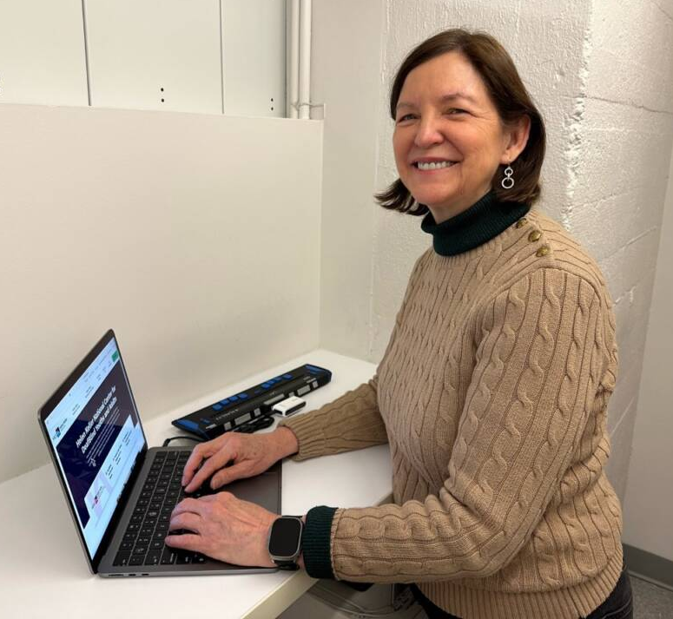
DeafBlind and Employed
Beth Jordan
Helen Keller National Center
Brenda Whitlock
Missouri Assistive Technology
And a panel of DeafBlind Missourians
for MO Power Up 2024

Slide 2
Panelists
Al Alvord, Archdiocese of St. Louis
Eric Edmonds, Alphapointe
Dennis Miller, NE Christian High School
Faith Pulliam, Target
Erica Walz, Spectrum/Equifax
Brett Wilhelm, Vancro

Slide 3
Working in Missouri
Now is a great time to work in Missouri
There are numerous resources for people who have both hearing and vision loss
We want you to hear from people who are working every day!
Notes:
The Unemployment Rate in the US is 3.9%
The Unemployment Rate in Missouri is 3.3%
That said, companies are looking for employees, people who will advance their business
There are “now hiring” signs everywhere.
There are so many ways to work even part-time and maintain benefits or work full-time and earn benefits through the company

Slide 4
Questions?

Slide 5
For More Information
Brenda Whitlock MO Assistive Technology
BWhitlock@mo-at.org
816-655-6700 voice
816-490-6510 text
Beth Jordan Helen Keller National Center
Bjordan@helenkeller.org
913-677-4562 voice
913-227-4282 videophone

