Slide 1
Accessible Color Palette
Lainie strange State of MO-ITSD

Slide 2
GAAD Study

Slide 3
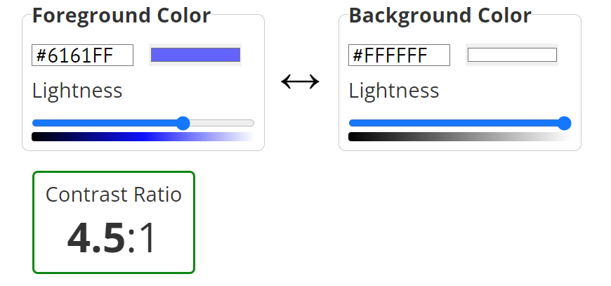
WCAG Color Success Criterion 1.4.3: Contrast
Level AA
4.5:1 text vs. background
Large text 3:1 (at least 18 point or 14 point bold )
Exceptions:
Incidental
Logotypes
Level AAA
7:1 text vs. background
Large text 4.5:1

Slide 4
Where is Color Contrast Criteria Applied?
Electronic Documents : PDFs, PowerPoint including charts
Websites, Apps
Social Media
Email and Email Newsletters
Notes:
Colors are used in social media posts, printed material, banners, website images and design and more.
This site demonstrated color blindness and what can be seen by the user: https://www.theverge.com/23650428/colorblindness-design-ui-accessibility-wordle?fbclid=IwAR0ub3qhtZzvUh0SIIZgZS_Me6QVsVxLgJu6kxsoejVRxeTLxUVirpGSODo

Slide 5
How are colors chosen?
Premade templates
Brand colors
Team Decisions
Contracted illustrator
Just happens!
Introduce Contrast standards

Slide 6
Tools You can Use!

Slide 7
Resources
Accessible Color Palette
Color contrast checker with color grabber option
Helpful premade color palettes
WCAG Standard on color contrast
WebAIM – Understanding Color standards and contrast ratios
Venngage Color Palette generator
Photo Color Analyser

