Slide 1
Connecting the Dots:
AT and Employment
Mary Ross and Scout Merry
Notes:
Mary

Slide 2
Thanks for Joining Us!
Scout Merry
Program Coordinator
MO Assistive Technology
I used to think I was passionate about assistive technology (but) this is not about the technology, this is about people’s lives. Joy Zabala
Mary Ross
Assistant Director of Rehabilitation Technology
Vocational Rehabilitation
Notes:
Mary intro
Scout intro set framework and outline what’s going to happen

Slide 3
AT is…
…any device, no matter where or how you get it, that is used to increase, maintain, or improve the functional capabilities of people with disabilities
…any service that helps with selecting, acquiring, or using an assistive technology device.
Notes:
Scout

Slide 4
The Continuum
Accommodations:
Simple modifications,
ready to use affordable tools
Low or Light Tech:
Less sophisticated, easy to learn, readily available, affordable tools
Medium Tech:
May cost more, requires some training, relatively complicated mechanical devices
High Tech:
Advanced,often expensive electronic/digital devices that may require specific training and ongoing support
Notes:
Mary

Slide 5
Three Step Process for Getting Started with AT-Consideration
Consideration
Exploration
Implementation
Notes:
Scout

Slide 6
Is Assistive Technology for Everyone in Every Case?
How often should we consider AT for employment or education?
Whose job is it to figure out when to consider AT?
Notes:
Scout

Slide 7
Consideration
Is there a barrier to your individual performing any of the tasks needed to be successful in their job or educational setting?
Getting ready
Transportation
Essential functions
Peripheral functions (staying on task, using the bathroom etc)
Let’s consider AT!
Notes:
Mary
Where is the Barrier? Let’s consider AT to address the barriers identified

Slide 8
Three Step Process for Getting Started with AT-Exploration
Consideration
Exploration
Implementation
Notes:
Mary

Slide 9
The Journey of Exploration
Exploration sounds like a long journey, how do we start?
How are we supposed to know what is unfamiliar to us?
Notes:
Mary- sounds huge, how do we begin this part of process, we want to break this down.
How do we know what to explore

Slide 10
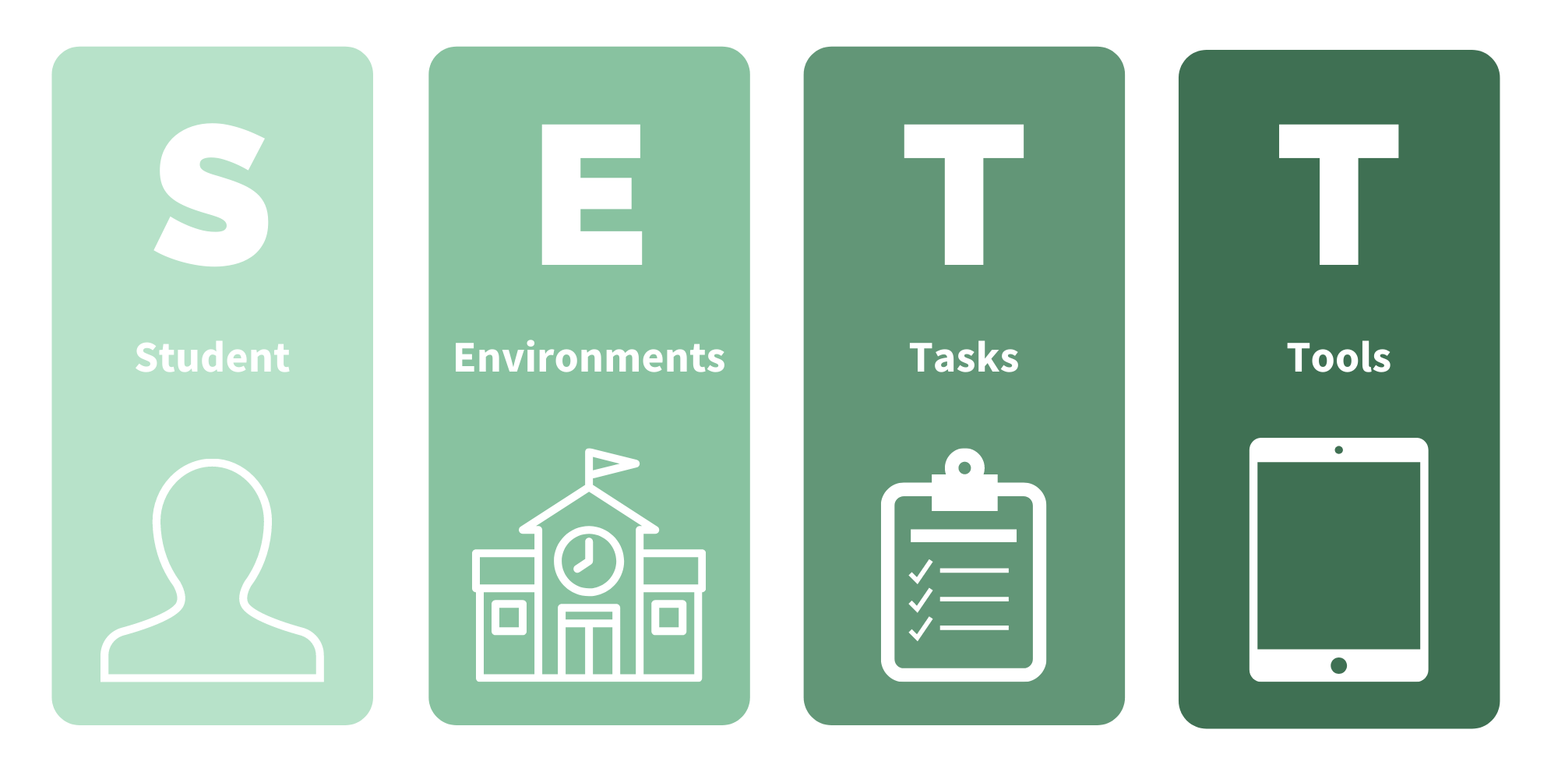
SETT Framework
Notes:
Scout -Joy Zabala, one model of many available

Slide 11
The Person
Individual or Person
What are their strengths
What are their limitations
Can also include likes and dislikes
Notes:
Scout use example of red rollator??

Slide 12
The Environment
Environment
What is the work or school environment like?
What particular barriers or supports does this environment provide
Notes:
Mary
If a person is working in a warehouse, more concrete examples. Physical space

Slide 13
The Tasks
Tasks
What tasks must our person perform to be successful?
This can be everything from getting ready (ADL’s) to clocking out or doing homework
Notes:
Mary

Slide 14
And finally, the Tools
Tools
Now we can look at specific supports that may assist with the limitations for the tasks
Each previous piece has helped us narrow the scope of possible tools.
Identifying supports does not mean they will be successful. Our individual must trial the device and be willing and able to use it
Notes:
scout

Slide 15
Three Step Process for Getting Started with AT-Implementation
Consideration
Exploration
Implementation
Notes:
Scout

Slide 16
Implementation?!
I just learned about this device and now I have to train someone!?!
If the person is unsuccessful will it be my fault?
I can barely use my smartphone!
Notes:
Scout

Slide 17
Implementation - Who is responsible for what?
Let’s define the pieces before we start doing our puzzle
Notes:
Mary

Slide 18
The (possible) pieces…are there others?
Training-define and assign
Charging
Updating
Follow up-what does this look like?
Replacement
Supervising usage
Keeping track of device
Notes:
Mary
Training: long process, only youtube videos? High tech device, is there a course?
Scout follow

Slide 19
Framework for Success
Consideration
Exploration
Implementation
Notes:
Explain this is a reminder/handout slide and explain what is coming next
Pass devices to a neighbor??

Slide 20
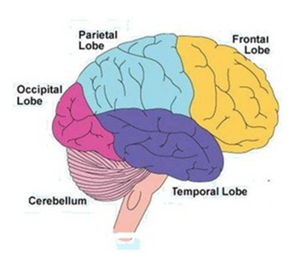
Brain Injury/Executive Function
Definition: “Executive function and self-regulation skills are the mental processes that enable us to plan, focus attention, remember instructions, and juggle multiple tasks successfully.” Executive Function and Self-Regulation
What might be a struggle for people living with BI or EF?
Frontal Lobe is responsible for much of the executive functioning of the brain
These functions include
Attention
Working Memory
Planning, organizing
Forethought
Impulse Control
Notes:
Mary: Introduce and define
What we are going to do?, how we are going to do it.

Slide 21
Brain Injury/Executive Function Lists
Notes:
Scout talking, and then tools and pass it down
Mary typing and we do have chocolate…

Slide 22
Hearing Loss
Notes:
Scout talk
Mary type

Slide 23
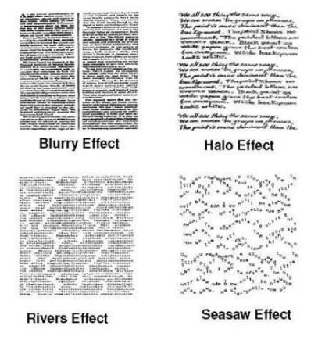
What Dyslexia can look like
Definition: Dyslexia is a language-based learning disability. Dyslexia refers to a cluster of symptoms, which result in people having difficulties with specific language skills, particularly reading.
dyslexia basics
dyslexia guide
Notes:
Scout: define dyslexia/scren

Slide 24
Dyslexia
Notes:
Scout talk
Mary type

Slide 25
Arthritis Fine Motor Grip Strength

Slide 26
Learn options for enhancing personal and professional growth of AT knowledge
No Wrong Door series No Wrong Door Playlist access
Demo Centers add our page link MO Demonstration Centers
You Tube videos
Manufacturer videos
Closing the Gap resources CTG Resource Directory
Ask Samie info - “On Demand Assessment” Ask Samie
Email or Zoom meetings with MO AT staff
Notes:
Scout

Slide 27
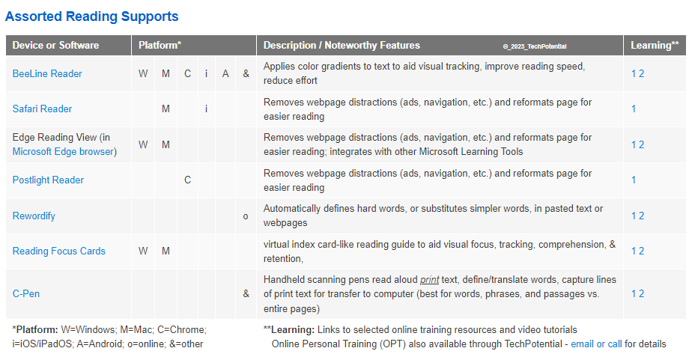
Tools for Learning Differences, ADHD, and Executive Functioning Challenges
Notes:
Mary

Slide 28
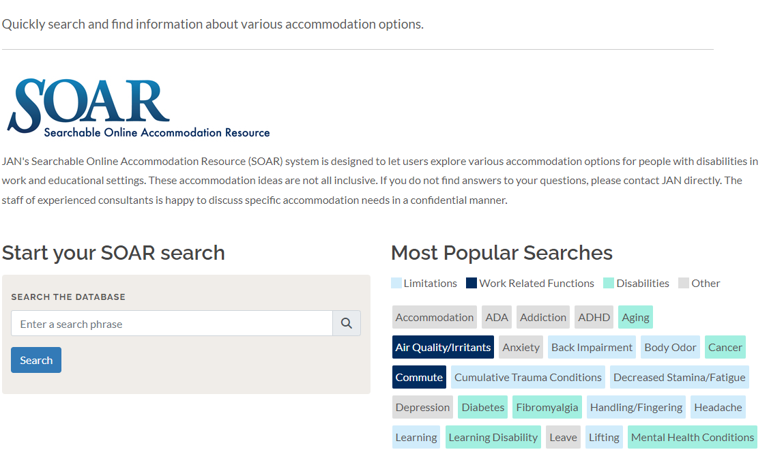
Ask Jan - SOAR.. Searchable Online Accommodation Resource
Notes:
Mary

Slide 29
Vendor Resources
Vendor Website |  | General offering
Diglo |  | Hearing
LS&S |  | Vision and hearing
Maxiaids |  | General
Independent Living Aids |  | General
Rehab Mart |  | Physical access
Performance Health |  | Physical access
Teltex |  | Hearing and more
Notes:
Scout

Slide 30
Before Getting Help
Remember to:
have some discussions with your client/consumer
Use the frameworks
Ask what worked or did not work in the past
Brainstorm together on what might be a good solution
Then reach out for more support!
Notes:
Mary
Review Sett, reach out to our supports to more supports

Slide 31
Questions or Comments?
How to contact us!
Scout Merry, MO AT smerry@mo-at.org
Mary Ross, MO VR mary.ross@vr.dese.mo.gov

