Slide 1
Exploring Apple Built-In Accessibility Features

Slide 2
Welcome!
Lisa Meyer-Instructional Coordinator for Technology
North Kansas City Schools
Email Contact Information
lisa.meyer@nkcschools.org
Phone Contact Information
(816) 321-5731

Slide 3
Getting to Know Each Other
Who’s in the room?
This Photo by Unknown Author is licensed under CC BY-NC

Slide 4
Benefits of Apple Accessibility Features
Built into Apple devices
Minimizes need for additional software or equipment.
Exceptions…
Works with many Assistive Technology apps and equipment.
Promotes (UDL) Universal Design for Learning approach
Accommodates needs and abilities for all students.
Breaks down barriers in learning process.
Provides flexibility and student voice and choice in learning process.
Enhances teaching and learning
Allows for differentiation (content, process, product and environment).

Slide 5
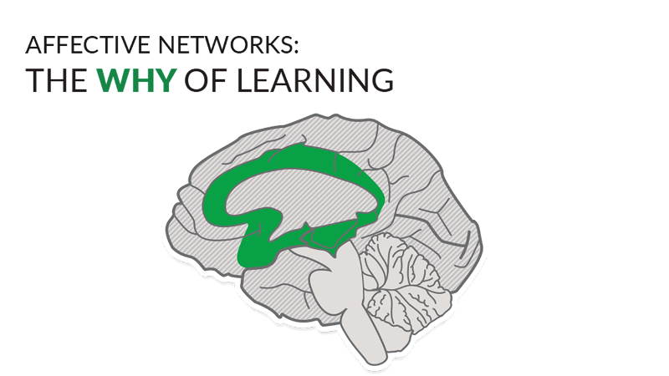
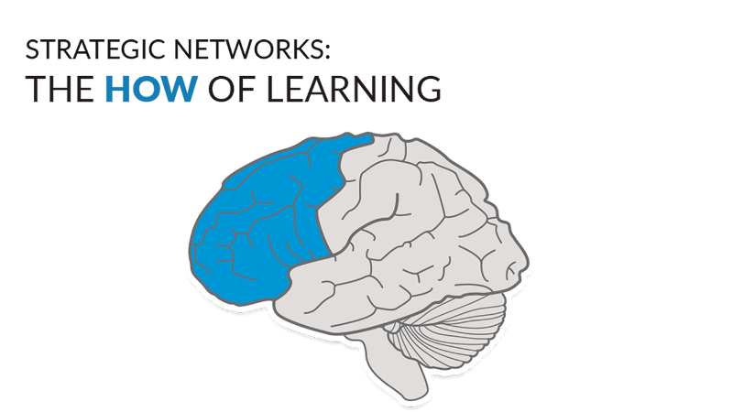
Universal Design for Learning
Source: Cast /About Universal Design for Learning, 2/27/2024

Slide 6
Getting Started with Accessibility Features on Mac
Vision
Hearing
Motor
Speech
General
Source: Apple Support, 2/27/2024

Slide 7
Getting Started with Accessibility Features on iPad
Vision
Mobility
Hearing
Speech
Cognitive
Source: Apple Support, 2/27/2024

Slide 8
Apple Native Apps that Support Accessibility
Safari on all Apple devices
Reader View
Removes distractions and assists with focus.
Customizes background and font.
Shortcuts on all Apple devices
Accessibility Assistant
Creates a summary of accessibility features and resources based on needs.
Files on iPad
Autofill
Fill out and add signatures to documents.
Magnifier on iPad
Zoom in on objects near you.
Detection Mode and customization.

Slide 9
Let’s Explore and Share…

Slide 10
Resources
Apple Accessibility
CAST
Apple Support YouTube Accessibility Videos
NKC Instructional Technology YouTube Channel
Accessibility Features for the iPad
Accessibility Features for the Mac

