Slide 1
Empowering Inclusive Learning: Harness Your LMS*
for Accessibility
*Learning Management System
Power Up 2024
Notes:
Alternate Title: AEM in LMS for UDL & AT Compatibility

Slide 2
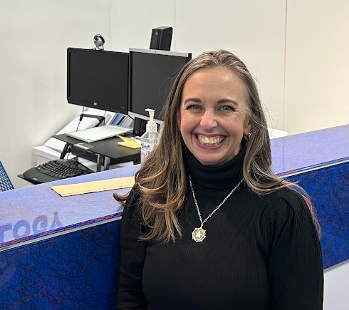
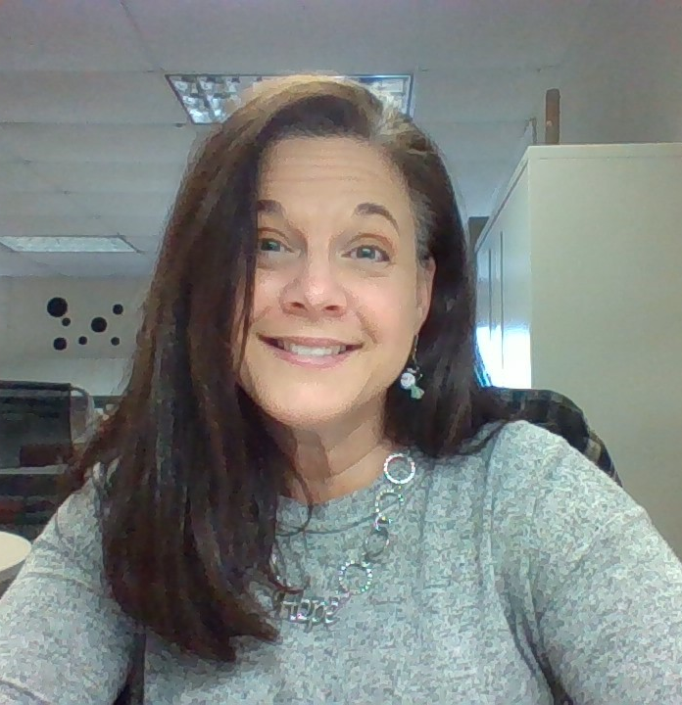
Who We Are
April Burton:
Instructional Tech
Content Leader
Cathy Fortney:
Coordinator
AT, ADA, OT/PT

Slide 3
Some Acronyms
LMS: Learning Management System
AEM: Accessible Educational Materials
AEM Center: National Center on Accessible Educational Materials
CAST: Center for Applied Special Technology
UDL: Universal Design for Learning
CITES: Center on Inclusive Technology and Education Systems

Slide 4
Welcome to Our Journey
2018 Collaboration but in different departments, different meetings
2019-2020 Learning Management System procurement
Asked about accessibility
Sought input from Great Plains ADA
Chose product that “checked the boxes”
2020 Rollout of Canvas Learning Management System
2020-2021 District investment in some universal tools pushed out to all
2022 Became members of Accessibility Educational Materials (AEM) Cohort (late entry in 1/2022 to cohort established in~ 2019)
2022+ Learned about AEM and related resources: AEM Center
2023+ Application of new AEM learning across areas/platforms
Current: Focus on full accessibility and Universal Design for Learning (UDL)
Notes:
Cathy

Slide 5
Learning Management Systems (LMS)
Common Learning Management Systems
Blackboard
Canvas
Schoology (Accessibility Checker and Immersive Reader)
Moodle
[Google Classroom]
We will focus is on what we use in our District (Canvas), but know that there are accessibility features in all if you look for them.
Always make “the ask” with vendors re: demonstrating accessibility and contact information for their accessibility rep/team
Notes:
April

Slide 6
Some of the Issues
Quick Rollout (ours happened over closure so involved virtual training):
Limited training for teachers (in higher stress/new learning situation)
Limited training for students (in higher stress/new learning situation)
Inaccessible practices that can become routine
Inconsistent expectation for use: things “stored” many places; students had to learn different methods of accessing/submitting assignments
Inconsistent formatting across classes (high cognitive load)
Links to external sites that may not be accessible
Inaccessible Attachments
Often a bad scan of a page in a textbook
No awareness of how to create an accessible document
Interfered with assistive technologies working
Notes:
There was a note in here about an Embedded Google Slide (not sure what this was pertaining to)

Slide 7
Realizations:
Accessibility tools only enhance accessibility if you use them
Assurance of AEM very much impacts usability of assistive technology
Inaccessible documents uploaded to an “accessible” system= inaccessibility
People didn’t understand the expectations and the importance
New learning is hard, especially when under high stress with little time

Slide 8
Take Aways
We learned…
We had more work to do…
Awareness
Support
Expectations
So we…
Sought out resources around accessible design
AEM Center
Canvas Example: AEM Center: Online Learning Series on Accessible Materials & Technologies
AEM Center: Designing for Accessibility (P.O.U.R.)
About Universal Design for Learning
Developed learning opportunities
Meaningful (but “bite-sized”)
On demand
Have the conversation re: expectation

Slide 9
Canvas Accessibility Tools
Canvas Accessibility Page
Things we will cover: for us to highlight:
Rich Content Editor (formatting with Styles, etc)
Immersive Reader
Embedded Documents
Captioning using Canvas Studio (Add-On)
Tech-Enhanced Assessments (Add-On)

Slide 10
Canvas Tool 1: Rich Content Editor (Style Tool, etc)
AEM Center Creating Accessible Documents using SLIDE
Styles (some auto formatting, but need to add)
Links (not automatically formatted correctly)
Images (not automatically prompted to add alt text)
Design (need to use outside tool like WebAim Color Checker)
Evaluation (end user checking)
Note about tables, navigation and some other tidbits…

Slide 11
Canvas Tool 2: Immersive Reader
Tool that is interactive with content that is within Canvas
Does not work on attachments or pages the redirect outside of Canvas
Features:
Translation
Dyslexia Font
Changing Colors/Contrast
Text to Speech
Notes:
Cathy? Check to see if this needs to be turned on at the institution level

Slide 12
Canvas Tool 3: Embedded Documents or Media
Examples:
Videos
Documents
Scanned documents must be use Optical Character Recognition
Ensuring use of SLIDE for document accessibility
Slide Decks

Slide 13
Canvas Tool 4: Captioning in Canvas Studio (Add-On)
Note that Canvas Studio is a paid add-on
Other options for creating captioning
YouTube Captioning
Screencastify

Slide 14
Canvas Tool 5: Tech-Enhanced Assessments (Add-On)
MasteryConnect is an “add-on” used for assessment within Canvas
Includes embedded accessibility tools
Canvas Quizzes does not have this feature
What to do when we need to have a quiz read-aloud?
3rd party tools
Embedded audio file
Tools inherent to operating systems

Slide 15
Canvas Tool 6: Accessibility Checker in Canvas
Within Canvas Platform itself
Detects common accessibility errors within the Rich Content Editor
Link errors
Headings
Alt Text
Text Contrast
Lists
Table formatting

Slide 16
Other Accessibility Checkers
3rd Party Accessibility Checkers that interface directly within LMS
Blackboard Ally
Cidi Lab UDOIT Advantage
Other Accessibility Checkers (e.g. Blackboard Ally, UDoIt, )
What they Check
Things that may not be checked:
Attached documents
Accessibility of linked sites
A note about Web Accessibility Overlays https://overlayfactsheet.com/

Slide 17
Attached Documents or Media
Training is required to ensure accessible document creation
AEM Center Creating Accessible Documents using SLIDE
SLIDE challenge
Styles
Links
Images
Design
Evaluation

Slide 18
Thoughts About Formatting for Cognitive Load
Keep the course navigation links cleaned up (can hide in “settings”)
Using the redirect tool to provide additional resources
The magic of a template!
FHSD Highschool Template
Pro Tip: Create a “sample” page, discussion, assignment and duplicate
Consistency in use of tools like calendar/due dates that allow different “views”

Slide 19
Using Canvas as a Training Tool
Current presentation
Training platform
National Center on AEM at CAST Example

Slide 20
Video

Slide 21
Other Things to Keep in Mind(learn from our mistakes)
Vetting for Accessibility of curriculum resources (anything you link to from Canvas)
Interactivity with 3rd Party Tools
Screen Readers
Learning Tools (e.g. Text to Speech)
Avoid scanning when possible, but if you have to scan use
Copy Machines with Optical Character Recognition (OCR)
Online OCR
Phone OCR

Slide 22
Canvas Accessibility Resources
April Burton’s Canvas Accessibility Course
Meeting Accessibility in Your Canvas Course
Canvas Accessibility Page
What are the Canvas accessibility standards? - Instructure Community - 1564
Canvas Accessibility Considerations | UO Accessible Education Center
5 principles for creating accessible Canvas pages

Slide 23
Other LMS Accessibility
Blackboard
Schoology
Accessibility Checker
Immersive Reader
Moodle
Google Classroom

Slide 24
Other Resources
A Family’s Guide to AEM
US Dept of Education Press Release about NETP
Guidance Document for AT
National Ed Tech Plan
Dear Colleague Letter
Myths and Facts about AT Document
Federal Policy to Practice
Assistive Technology and IDEA: New Resources for Schools, Practitioners, and Parents (ATIA video)
Rules for the Accessibility Checker - Microsoft Support

Slide 25
Our Contact Information
April Burton april.burton@fhsdschools.org
Cathy Fortney cathy.fortney@fhsdschools.org

