Slide 1
WORKPLACE ACCOMMODATIONS
IN ACTION!
POWER UP 2024

Slide 2
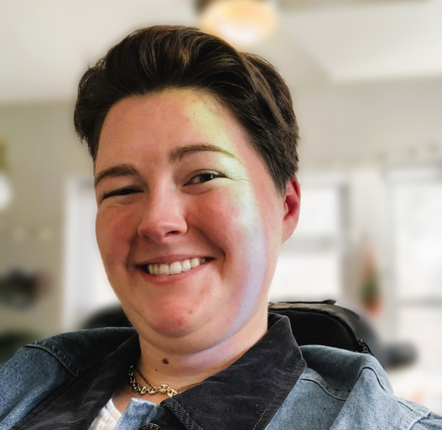
INTRODUCTIONS: SPEAKERS
ANN MARIE GORTMAKER
Accommodations Specialist for the University of Missouri – Columbia
ELLIE STITZER
Accessibility and ADA Manager for the University of Missouri – Columbia

Slide 3
INTRODUCTIONS: AUDIENCE
Are you looking for a job, looking for an employee, or trying to connect the two?

Slide 4
The Basic question
SKILLS NEEDED
SKILLS YOU HAVE
TO DO THE JOB
Can this be a match with or without accommodations?

Slide 5
HOW DO YOU KNOW WHAT SKILLS A JOB REQUIRES?

Slide 6
- PURPOSE: Fundamental to the job. The reason the position exists. - SPECIALIZATION: Position-specific, not person-specific. Would cause harm to the business if left unperformed. - EXCLUSIVITY: Only a few employees have the specific expertise to perform these functions. - NOT OPTIONAL: Ability to perform with or without accommodations determines whether an individual is qualified for the job.
KEY TERM: “Essential job functions”

Slide 7
- PURPOSE: The reason the position exists is to make coffee. - SPECIALIZATION: The coffee shop would suffer without someone to make coffee. - EXCLUSIVITY: Only a few employees have been trained on how to make coffee to the coffee shop’s specifications, using the shop’s equipment, etc. - NOT OPTIONAL: The ability to make coffee with or without accommodations determines whether an individual is qualified to be a barista.
EXAMPLE: A BARISTA MAKES COFFEE AT A COFFEE SHOP.

Slide 8
Essential VS. NON-ESSENTIAL job functions
Essential
NON-ESSENTIAL
Purpose
Specialization
Exclusivity
Not optional for the role
Less frequent
Less specialized
Less defined
Optional for the role

Slide 9
Building on the same example…
EXAMPLE: A BARISTA MAKES COFFEE AT A COFFEE SHOP. EVERY MONTH THE COFFEE SHOP GETS A SHIPMENT OF COFFEE BEANS. TYPICALLY, THE BARISTA IS RESPONSIBLE FOR GETTING THE SHIPMENT OF BEANS OFF THE TRUCK AND STORING THEM IN BACK OF HOUSE.

Slide 10
LESS DEFINED, LESS FREQUENT, LESS SPECIALIZED, NON-EXCLUSIVE TO THE ROLE OF BARISTA.
EXAMPLE: A BARISTA MAKES COFFEE AT A COFFEE SHOP. EVERY MONTH THE COFFEE SHOP GETS A SHIPMENT OF COFFEE BEANS. TYPICALLY, THE BARISTA IS RESPONSIBLE FOR GETTING THE SHIPMENT OF BEANS OFF THE TRUCK AND STORING THEM IN BACK OF HOUSE.

Slide 11
IDENTIFYING THE ESSENTIAL JOB FUNCTIONS IN A job posting
Look for information regarding…
The job title
The job’s “purpose”
Job duties and responsibilities
Any required qualifications, certifications, etc.
Typical working conditions for the job

Slide 12
NOW YOU TRY!
Identify the essential job functions in 2 real job postings from Indeed.

Slide 13
Example 1: DENTAL RECEPTIONIST
JOB RESPONSIBILITIES:
Answer incoming phone calls.
Schedule patient appointments.
Contact referring doctors’ offices for
referrals and x-rays
Scan in ID cards and insurance cards
Create patient charts
File charts

Slide 14
Example 2: HOTEL FRONT DESK AGENT
THIS JOB IS:
A good job for someone just entering the workforce or returning to the workforce with limited experience and education.
A job for which all ages, including older job seekers, are encouraged to apply.

Slide 15
WHAT DO YOU DO IF YOU RUN INTO A JOB POSTING LIKE EXAMPLE 2?

Slide 16
Route 1: contact the employer directly to ASK clarifying QUESTIONS.
“I saw your job posting on Indeed. Can you tell me a little more about what a typical day looks like for someone in this role?”

Slide 17
Route 2: send in resume and apply!
Come prepared to ask clarifying questions during the interview.

Slide 18
MATCHING SKILLS TO the job through accommodations
What does the accommodations process look like?

Slide 19
THE ACCOMMODATION PROCESS Step 1
STEP 1:
CONTACT HR TO LET THEM KNOW YOU WANT TO DISCUSS WORKPLACE ACCOMMODATIONS.
Notes:
Clarify on the employee to make the first move (make a request).

Slide 20
THE ACCOMMODATION PROCESS step 2
STEP 2:
1-ON-1 MEETING WITH HR TO DISCUSS WORKPLACE BARRIERS AND BRAINSTORM SOLUTIONS.

Slide 21
THE ACCOMMODATION PROCESS step 3
STEP 3:
PROVIDE MEDICAL DOCUMENTATION CONFIRMING THAT YOU ARE A PERSON WITH A DISABILITY.

Slide 22
THE ACCOMMODATION PROCESS step 4
STEP 4:
IMPLEMENT ACCOMMODATIONS AND FOLLOW UP AS NEEDED.

Slide 23
TYPES OF ACCOMMODATIONS
Assistive Technology
Devices
Changes to the workspace
Changes in the job schedule or location

Slide 24
COMMON accommodation Examples…

Slide 25
NOISE CANCELING HEADSETS

Slide 26
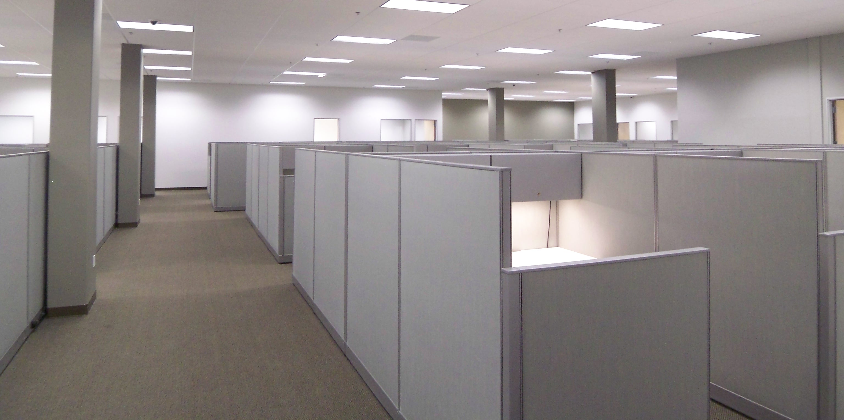
LIGHTING CHANGES

Slide 27
ERGONOMIC KEYBOARDS AND MICE

Slide 28
BUILT-IN SPEECH-TO-TEXT and TEXT-TO-SPEECH FEAUTURES

Slide 29
CAPTIONING

Slide 30
Screen readers

Slide 31
Fusion: jaws and zoom text

Slide 32
magnifiers

Slide 33
Accommodation Resources

Slide 34
Job accommodation network
JAN is an office under the US Department of Labor working with employers and their workers to provide accommodation solutions, strategies, and guidance on the ADA.
Webinars
Contact by phone or email

Slide 35
Missouri assistive technology device loan program (etc)
Free program that offers various assistive technology devices for trial.
Website: ETC Program
Phone Number:
1-816-655-6700

Slide 36
Independent living centers
ILCs are connection points for the MO AT ETC Loan Program
Located throughout the state.
Contact your ILC for items they may have on site

Slide 37
Questions?

Slide 38
CONTACT INFORMATION
ELLIE STITZER
University of Missouri Office of Accessibility and ADA
Email:
stitzere@missouri.edu
ANN MARIE GORTMAKER
University of Missouri Office of Accessibility and ADA
Email: gortmakera@missouri.edu

