Slide 1

Captioning and Visual Accessibility
David S. Kingsbury, MA
Director of Deaf Services

Slide 2

DMH Office of Deaf Services

Slide 3
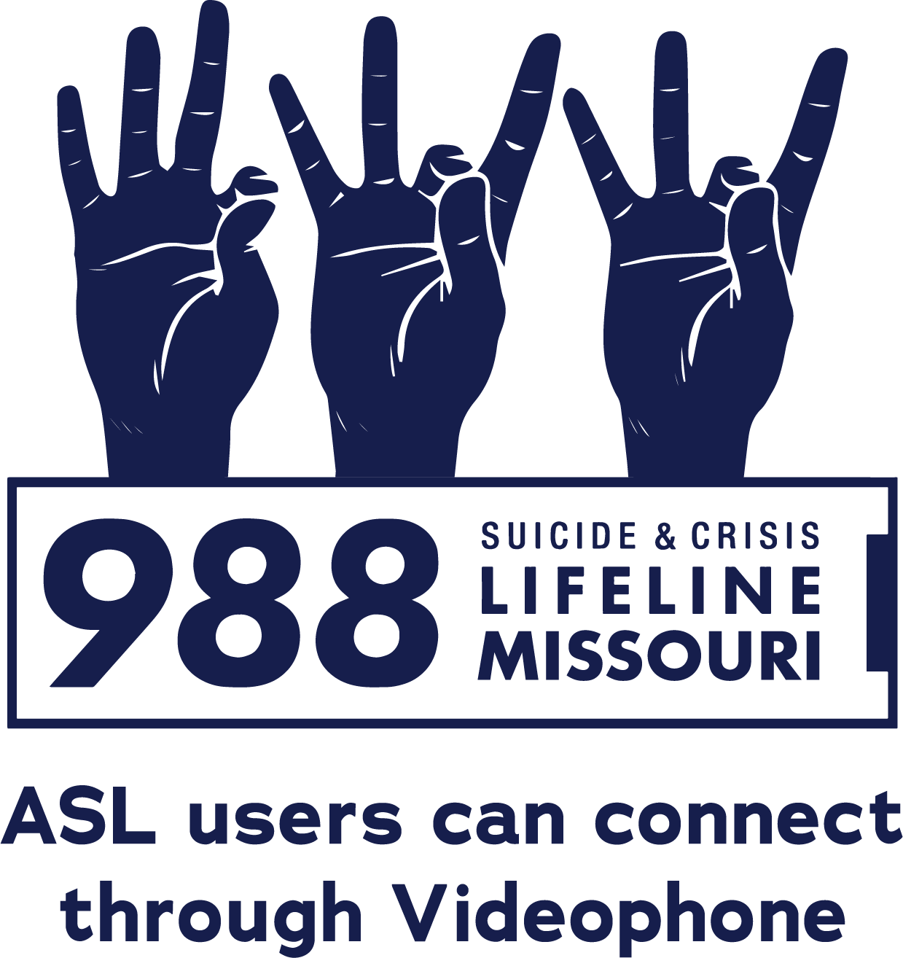
988 Suicide & Crisis Lifeline Missouri
If you or someone you know is in a mental health, suicide, or alcohol or drug use crisis, help is available. The 988 Suicide & Crisis Lifeline has options for Videophone (VP), Chat, Text, and Voice calls.
Crisis specialists fluent in ASL answer videophone calls. Crisis specialists trained in the needs of Deaf and Hard of Hearing people answer most texts and chats in Missouri.
The 988 Suicide & Crisis Lifeline is a free and confidential service available to everyone.
Reach a 988 crisis specialist now:
VP 988 | Text 988 | Chat 988 | Dial 988 by phone
To call by TTY relay, first dial 711 and then 988
For more information, visit:
dmh.mo.gov/988vp | missouri988.org | 988lifeline.org

Slide 4
Overview
Legal and Technical Standards for Visual Accessibility
Captioning
ASL Interpreting
Transcripts
Resources
Notes:
Legal/technical standards vs practical application.
Conflict between principles of highly engaging presentations and highly accessible presentations.
Where these are in conflict, I prioritize accessibility.
Some slides are wordy. This improves visual accessibility and allows you to use the slides as a better reference later.
I will follow the slides closely. Some include quotes or near-quotes of legal or technical standards. This also improves auditory accessibility.

Slide 5
A Note on Preferred Terms
deaf vs. Deaf vs. D/deaf
Hard of hearing
Best practice is to avoid using person-first language unless a person requests it.
Best practice is to avoid using “hearing impaired” unless a person self-identifies with the term.

Slide 6

Visual Accessibility:
Legal & technical Standards

Slide 7
Legal & Technical Standards Overview
MO Revised Statutes, Ch. 161 – Disabilities Assistance
State ICT Standards
Americans with Disabilities Act
  Title I – Employment – 29 CFR Part 1630
  Title II – Public entities – 28 CFR Part 35
  Title III – Public accommodations – 28 CFR Part 36
Rehabilitation Act, Section 504 – regulations per funding agency
Affordable Care Act, Section 1557 – 45 CFR Part 92
Web Content Accessibility Guidelines (WCAG)
Notes:
Each federal agency has their own Section 504 regulations that apply to that agency’s recipients of federal funding. DOE, HHS, etc.
If your agency or organization receives federal funding from more than one agency, then more than one set of Section 504 regulations apply.

Slide 8
Missouri Statutes
RSMo 161.935
Requires State departments and agencies to ensure that uses of information communication technologies (ICT) are accessible to people with disabilities.
Requires the Information Technology Services Division (ITSD) and MO Assistive Technology Council to adopt accessibility standards for State departments and agencies in line with the Section 508 requirements for federal agencies.

Slide 9
State ICT Standard
Requires State agencies to ensure that uses of ICT are accessible to individuals with disabilities.
Requires compliance with the Web Content Accessibility Guidelines (WCAG), version 2.1, levels A and AA.
WCAG level AAA compliance is optional.

Slide 10
Americans with Disabilities Act
ADA Title I
Applies to employers with 15 or more employees.
Requires reasonable accommodations for qualified individuals (applicants and employees) with disabilities.
Appropriate reasonable accommodations are determined individually based on an interactive process with the person with a disability.
Notes:
Title I does not expressly require specific types of accommodations.
Required accommodations are highly person- and context- specific.

Slide 11
Americans with Disabilities Act
Title II
Title III
Applies to all services, programs, and activities provided or made available by public entities.
Public entity means any State or local government, including any agencies, departments, districts, or other instrumentalities of government.
Applies to all public accommodations with respect to the operations of a place of public accommodation.
Public accommodation means a business or nonprofit that serve the public.
Notes:
START
Both Titles require web accessibility, but who is required to comply is different, and the standards are different.

Slide 12
Americans with Disabilities Act
Title II
Title III
Requires equal access to all programs, services, or activities provided directly or made available through contractual, licensing, or other arrangements, including those offered on the web.
Requires equal opportunity to participate or benefit.
Requires equally effective communication.
Must give primary consideration to how the person with the disability requests.
Requires equal access to all goods, services, facilities, privileges, advantages or accommodations offered, including those offered on the web.
Requires equal opportunity to participate or benefit.
Requires equally effective communication.
Business decides how to communicate, as long as it is equally effective.
Notes:
START
Each title contains similar overarching requirements:
Equal access, equal opportunity, and equally effective communication.
Title II has an additional primary consideration requirement.

Slide 13
ADA Web and Mobile App Rule
Title II
Title III
Equal access requirement applies to all programs, services, or activities offered on the web.
New web & mobile app accessibility rule requires compliance with technical standards.
Equal access requirement applies to all goods, services, facilities, privileges, advantages or accommodations offered on the web.
Allows flexible implementation but must ensure web accessibility.
Several lawsuits have enforced this requirement, including the requirement for captioning (e.g. National Association of the Deaf v. Harvard University and Massachusetts Institute of Technology, 2020).
Notes:
Websites are a form of communication.
Title III lawsuits and settlements have generally required WCAG compliance.

Slide 14
Americans with Disabilities Act
Titles II & III
Auxiliary Aids and Services (AAS) required when necessary for effective communication.
Examples include:
  Qualified interpreters (in-person or Video Remote Interpreting);
  Open and closed captioning, including real-time captioning;
  Accessible electronic and information technology; or
  Other effective methods of making aurally delivered information available to individuals who are deaf or hard of hearing.
Notes:
These are also examples of potential reasonable accommodations under ADA Title I.

Slide 15
Americans with Disabilities Act
Titles II & III
Video Remote Interpreting (VRI) Service must provide:
  (1) Real-time, full-motion video and audio over a dedicated high-speed, wide-bandwidth video connection or wireless connection that delivers high-quality video images that do not produce lags, choppy, blurry, or grainy images, or irregular pauses in communication;
  (2) A sharply delineated image that is large enough to display the interpreter's face, arms, hands, and fingers, and the participating individual's face, arms, hands, and fingers, regardless of his or her body position;
  (3) A clear, audible transmission of voices.
Notes:
Meeting the technical standard is a necessary condition for effective communication, but it is not a sufficient condition for effective communication.

Slide 16
Americans with Disabilities Act
Titles II & III
The ADA prohibits:
  Requiring or requesting that a person provide their own AAS.
  Charging a person for providing them with an AAS.
  Denying service because the person needs an AAS.

Slide 17
Rehabilitation Act, Section 504
Applies to recipients of federal financial assistance.
Prohibits discrimination on the basis of disability.
Compliance with the ADA generally results in compliance with Section 504.
Certain settings such as education and healthcare may have additional requirements under Section 504.

Slide 18
Section 504 Web and Mobile App Rule
Each Federal Executive Branch agency publishes their own Section 504 regulations for their recipients.
Currently, only the US Department of Health and Human Services’ Section 504 regulations includes the web and mobile app rule.
If DOJ adopts the rule, all other agencies would be required to adopt it, as well.
HHS’s Section 504 rule is the same as the Title II rule except that it also covers kiosks.
Notes:
If a school district bills Medicaid for physical therapy, occupational therapy, speech therapy, or other services, it is a recipient of federal funds from HHS and is required to comply with the HHS rule.

Slide 19

When is Compliance Required?
ADA Title II
HHS’s RA Section 504
Public entity’s total population is:
  > 50,000 = April 24, 2026 April 26, 2027
  ≤ 50,000 = April 26, 2027 April 26, 2028
Special District Governments:
  April 26, 2027 April 26, 2028
Independent school districts are not special district governments.
Recipients with 15 or more employees:
  May 11, 2026
Recipients with fewer than 15 employees:
  May 10, 2027
Effective Communication requirements, including general
web accessibility, are currently in effect and enforceable.
Notes:
START
Population is total US Census population – not persons served or persons eligible or likely to be served.
E.g. State University has 40,000 students. State population is 6 million. Deadline is based on 6 million.
MID 1
Special district governments are government entities established for a limited single purpose or set of related purposes.
MID 2
An entity may be covered by both rules.
A Title II entity with a population less than 50,000 would need to comply by May 11, 2026 if it is also a recipient of Federal funds from HHS and has at least 15 employees.
END
It is merely the technical standard in the new rule that is not enforceable until the compliance date.
If not meeting the standard results in a discriminatory effect, that is currently a cause of action.

Slide 20
Affordable Care Act, Section 1557
Applies to health programs or activities, any part of which receives Federal financial assistance from the US Department of Health and Human Services: Missouri DHSS, DMH, DSS, etc.
Requires that health programs or activities provided through ICT are accessible to individuals with disabilities.
Notes:
Does not expressly require compliance with a specific technical standard.

Slide 21
Web Content Accessibility Guidelines (WCAG)
Version 2.1
Conformance to levels A and is AA expressly required under:
  ADA Title II regulations
  HHS’s Section 504 regulations
  Missouri State ICT Standards
Conformance to level AAA is voluntary.

Slide 22
WCAG Technical Standards
1.2.1 Audio-only, prerecorded content (Level A)
An alternative is provided that presents equivalent information.
Sufficient technique: provide a transcript that:
  Provides a verbatim account of everything that is said;
  Identifies who is speaking; and
  Describes meaningful non-speech sounds.

Slide 23
WCAG Technical Standards
1.2.2 Captions for prerecorded audio in synchronized media (Level A)
An alternative is provided that presents equivalent information.
Sufficient technique: open or closed captions that:
  Provide a verbatim account of everything that is said;
  Identify who is speaking;
  Describe meaningful non-speech sounds; and
  Are synchronized to the audio.

Slide 24
WCAG Technical Standards
1.2.4 Captions for live audio in synchronized media (Level AA)
An alternative is provided that presents equivalent information.
Sufficient technique: open or closed captions that:
  Provide an accurate account of everything that is said;
  Identify who is speaking;
  Describe meaningful non-speech sounds; and
  Are provided in real-time.

Slide 25
WCAG Technical Standards
1.2.6 Sign language interpretation for prerecorded audio in synchronized media (Level AAA)
An alternative is provided that presents equivalent information.
Sufficient technique: a sign language interpreter is:
  Included in the video stream;
  Displayed in a different viewport; or
  Overlaid on the image by the player.

Slide 26

Captioning

Slide 27
Types of Captions
Live/Real-Time Captions
Pre-Produced Captions
Produced concurrently with a live event/stream.
Produced for pre-recorded video.

Slide 28
Types of Captions
Open Captions
Closed Captions
“Burned in” to the original video file.
Permanently visible to all viewers.
Maintains accessibility regardless of file-sharing or player’s support for captioning.
Not indexed by search engines.
Contained in a separate “sidecar” file.
Individual users can turn the caption display on or off.
Player must support captioning and the specific format of the sidecar file.
Indexed by search engines.

Slide 29
Types of Captions
Automated Captioning
Human Captioning
AKA auto-captions or automatic speech recognition (ASR).
Produced by computer software or artificial intelligence (AI) without human editing.
Produced by humans with or without the aid of software/AI.

Slide 30
Captioning Accuracy
Word accuracy – words correct, words incorrect: substitutions, insertions, and deletions.
Formatting accuracy – punctuation, capitalization, grammar, speaker identification, non-speech elements, etc.
Overall accuracy depends on both word accuracy and formatting accuracy. Can be estimated by multiplying word accuracy by formatting accuracy.
Advertised accuracy is usually word accuracy based on ideal speech samples and not real-world conditions.
Notes:
Who do you think has the most accurate auto-captioning?
Google, Microsoft, OpenAI, other?

Slide 31
Captioning Accuracy 2022
Auto-Caption Engines | Word Accuracy | Formatting Accuracy | Overall Accuracy
Speechmatics + 3Play | 92.0% | 82.8% | 76.2%
Speechmatics | 91.3% | 82.1% | 75.0%
Microsoft | 89.4% | 77.6% | 69.4%
Rev AI V2 | 86.2% | 75.1% | 64.7%
Google Video | 87.2% | 73.0% | 63.7%
(Research conducted by 3Play Media [2022] using real-world samples from a range of industries)
Notes:
3Play Media is a company that provides human captioning services. They don’t have their own auto-caption engine. Rather, they research other companies’ engines to see which is the best for their captioners to use.
+3Play is automated post-processing.

Slide 32
Captioning Accuracy 2025
Auto-Caption Engines | Word Accuracy | Formatting Accuracy | Overall Accuracy
AssemblyAI Universal-2 | 92.7% | 84.4% | 78.2%
Whisper X | 91.5% | 85.2% | 78.0%
Speechmatics | 91.7% | 83.2% | 76.3%
Microsoft | 91.3% | 82.2% | 75.0%
OpenAI Whisper Large V2 | 89.9% | 82.8% | 74.4%
Rev AI V2 | 88.9% | 79.3% | 70.5%
Google Chirp 2 | 87.0% | 79.4% | 69.1%
Google Gemini 2.0 Flash LLM | Marginally better than Chirp 2 but often failed to complete transcriptions.
(Research conducted by 3Play Media [2025] using real-world samples from a range of industries)
Notes:
2022 to 2025 = 2% improvement. Most of the gain was in formatting accuracy.
This is about half the rate of improvement seen from 2020 to 2022.
Rev AI V 3 = 90.7% Word, 82.5% Formatting, and 74.8% overall. This is based on Rev’s internal testing with similar methods but different sample content.

Slide 33
Captioning Accuracy
According to the Worldwide Web Consortium (W3C):
  “Automatically-generated captions do not meet user needs or accessibility requirements, unless they are confirmed to be fully accurate. Usually they need significant editing. There are tools that use speech recognition technology to turn a soundtrack into a timed caption file. For example, some common video websites provide automatic captions. However, often the automatic caption text is wrong and does not match the spoken audio — sometimes in ways that change the meaning (or are embarrassing). For example, missing just one word such as ‘not’ can make the captions contradict the actual audio content.”
Notes:
W3C develops and publishes the WCAG standards.

Slide 34
Word + Formatting Accuracy
≠ Meaning Accuracy
Word + Formatting Accuracy measures accuracy against original wording and proper formatting. It does not weight errors by impact on meaning.
Meaning Accuracy measures whether the captioning accurately preserves the intended message (communicative intent).

Slide 35
Word + Formatting Accuracy
≠ Meaning Accuracy
A caption can score high on word + formatting accuracy while still failing meaning accuracy if small errors distort the message, e.g.:
  “can” instead of “can’t” or missing “not”
  Wrong names or technical terms
  Wrong numbers, alphanumerics, or website URL’s
  Incorrect speaker attribution or not distinguishing between speakers
  Punctuation errors that change meaning
Meaning accuracy is the stronger test because it asks whether the viewer received the same information (effective communication), not just whether most of the words were correct.

Slide 36
Captioning Use Cases
Live (Level AA, AAS)
Prerecorded (Level A, AAS)
Internal or advance-registration required vs. open access
Live with recording posted afterward
Notes:
WCAG does not define a statistical accuracy standard, but courts and settlements have generally required 99+% accuracy for prerecorded content.
~95% accuracy is generally achievable in live captioning.
The output from live captioning is generally not accurate enough to be reused with a recording posted afterward.

Slide 37

ASL Interpreting

Slide 38
Using Interpreters
Interpreters must be qualified.
  (1) Adhere to ethics and confidentiality standards;
  (2) Proficient in both languages; and
  (3) Able to interpret effectively, accurately, and impartially, using any necessary specialized words and phrases.
In Missouri, interpreters must be licensed by the Division of Professional Registration.
In Missouri, interpreters must be certified at the skill level required for the assignment per 5 CSR 100-200.170 .
Requirements apply to both VRI and on-site interpreters.

Slide 39
ASL Interpreting Use Cases
In-person (AAS)
Telehealth (AAS)
Virtual meeting or webinar (AAS)
Livestream (AAS)
Pre-recorded video (Level AAA, AAS)

Slide 40

Transcripts

Slide 41
Transcripts
The raw transcription is usually a document containing text and minimal formatting.
You may need to:
  Review text and correct any errors.
  Add identification of speakers.
  Adjust paragraph breaks.
The final transcript document should meet WCAG standards for electronic document accessibility.

Slide 42
Transcript Use Cases
Podcast (Level A)
Other pre-recorded audio (Level A)
Pre-recorded video (Level AAA)
Notes:
For pre-recorded video, even though providing a transcript is optional, if provided, the transcript must meet WCAG standards.

Slide 43

resources

Slide 44
Resources
Live/Real-Time Captions
Relay Missouri’s Relay Conference Captioning Service (RCC) – free (FCC-funded) service for eligible virtual meetings and events: relaymissouri.com/rcc.
CCC Services – on-site and remote real-time captions: cccaptioning.com.
Quality Transcription Specialists – on-site and remote real-time captions: qtskc.com.

Slide 45
Resources
Pre-Produced Captions and Transcripts
YouTube auto-captions with manual corrections.
Rev – open and closed captions, audio & video transcription: rev.com.
Request a transcript from your real-time caption provider.
Upload an accurate transcript or script to YouTube for auto-synchronization.

Slide 46
Resources
ASL Interpreting and Translation
Missouri Statewide Contract Vendors:
  Go to: archive.oa.mo.gov/purch/contracts.
  Search by keyword for “interpret”.

Slide 47
Questions?
Office of Deaf Services
David S. Kingsbury, MA, Director
david.kingsbury@dmh.mo.gov
573-526-1857
dmh.mo.gov/deafservices

