Slide 1



Developing an Accessibility Roadmap
for State or Local Government:
The Road to Successful Inclusion
Lainie Strange – ITSD/Web Team
April 29, 2026

Slide 2
Agenda
Audience
A Note on the Title II Extension and Section 504
What is an Accessibility Roadmap?
The Steps
Communication Plan
Accessibility Roadmap and Plan Templates

Slide 3
Who is the Audience for this presentation?
Those at the beginning stages of their accessibility assessment and planning.
Those who are in process or who have completed accessibility assessment and planning, to make sure there are no gaps.
Any organization wanting to conduct an accessibility assessment and establish an accessibility plan, not limited to government organizations.
Notes:
Organizaitons at the

Slide 4
A Quick Note on the ADA Title II Extension Before We Begin
All State and most Local Governments were already working towards the original April 2026 and 2027 deadlines before the ADA extension was announced 4/20/26.
What does this extension mean for you?
Don’t stop! Keep that momentum going with your current efforts.
Don’t wait for the deadline. Use this window to strengthen sustainable accessibility processes.
State and local government size | Compliance date
0 to 49,999 persons | 4/26/28
Special district governments | 4/26/28
50,000 or more persons | 4/26/27

Slide 5
HHS OCR Section 504
HHS requires all entities receiving federal financial assistance from the Department of Health and Human Services to make their websites, web content, and mobile apps WCAG conformant
May 11, 2026: Deadline for organizations with 15 or more employees.
May 10, 2027: Deadline for organizations with fewer than 15 employees.
Keep an eye out for a possible extension
Notes:
Also,, a quick note on Federal Section 504

Slide 6
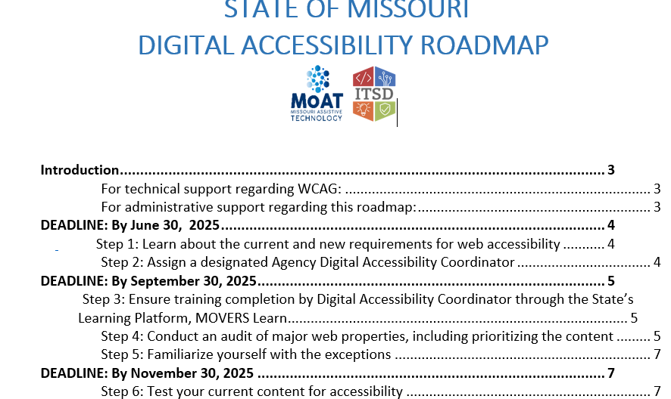
What is an Accessibility Roadmap?
A step-by-step template for how to audit and assess accessibility as well as integrate an accessibility program.
The state’s roadmap has eleven steps, with an additional step addressing internal content. In this state example, a span of 18 months.
Define your deadline date and then map out your steps to get you there.
Notes:
Shoutout to the State of Oklahoma for being the inspiration behind our state Roadmap.

Slide 7
Roadmap Project Team
Depending on organization size, these might be combined roles or consult with staff as needed:
Project Manager
Legal
Representation from your IT Website/Applications Team
Communications Director or Organization Director
IT Fiscal/Procurement
Notes:
Before we dive into the Roadmap steps, let’s talk about what a roadmap project team looks like.

Slide 8
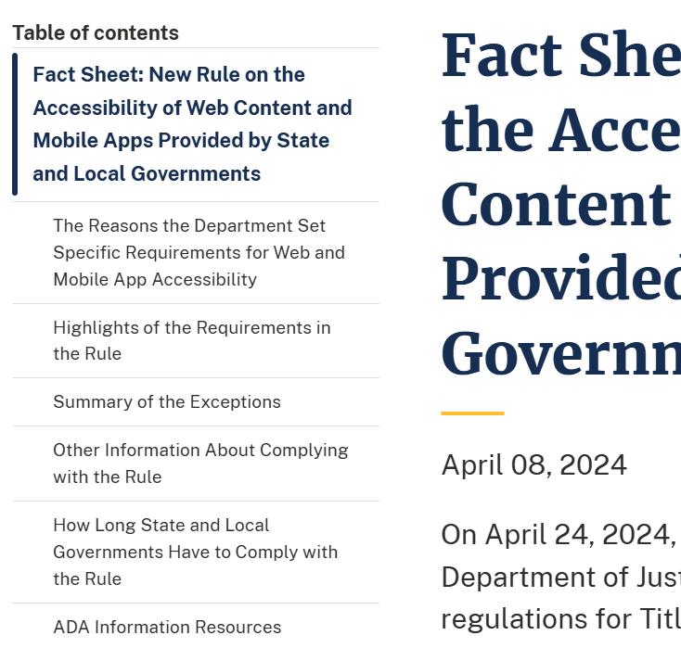
Step 1: Learn About Current & New Requirements for Web Accessibility
Fact Sheet: New Rule on the Accessibility of Web Content and Mobile Apps Provided by State and Local Governments (WCAG 2.1)
State Government Only: Missouri State Accessibility Law and Standard
WCAG 2.2 as well as specific non-public (internal) content per Federal Section 508

Slide 9
Step 2: Identify a Digital Accessibility Coordinator, identify others involved in accessibility decisions
Of those involved in your organization’s accessibility efforts, which person:
Has the expertise in web accessibility (or ability to gain such expertise) to serve as your organization's digital accessibility coordinator.
Is a full-time employee.
Can exercise appropriate control to enforce accessibility requirements. This does not necessarily mean the individual must be the Executive Director (or other high-level administrator), but the individual must be authorized to direct other agency personnel in what must be done before web content is approved to be posted or accessibility processes in place for web application development.

Slide 10
Step 2: Identify a Digital Accessibility Coordinator, identify others involved in accessibility decisions
Examples of roles that took on this responsibility
Public Information Officers, Communications Directors
Senior Website and Web Application Developers or Analysts
Legal staff who work closely with the organization’s content developers.
In a few cases, agencies secured funding for a Digital Accessibility Coordinator position in their organization.
Notes:
At the state level, this is primarily: Public Information Officers/Communications Coordinators. We also assigned Accessibility coordinators on

Slide 11
Step 3: Ensure training completion by Digital Accessibility Coordinator
Training recommendations included in the organization’s accessibility plan template
Recommended topics for Coordinators working in the public communications space:
Accessibility Awareness
Accessible Images
Accessible Office and PDF Documents
Accessible Social Media
Accessible Multimedia
Accessible Meetings (In-Person and Virtual)
Notes:
We also provide a role-based training reference at the end of the presentation that focuses on different role types.

Slide 12
Step 4: Conduct an audit of major web properties (Audit spreadsheet)
Example web properties include:
Public website content and digital documents
Secure login web applications
Social media content
3rd party contracted or licensed website content, web applications and digital documents
Mobile applications
Sample audit spreadsheet
Includes information on how to determine priority order of accessibility remediation work

Slide 13
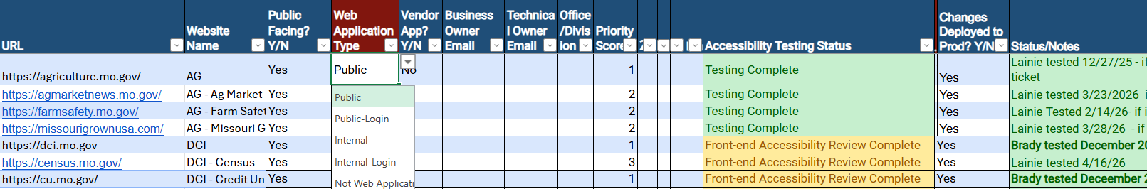
Step 4: Conduct an audit of major web properties (Audit spreadsheet)
Examples of spreadsheet data:
URL/Website name
Business Owner
Technical Owner
Priority Level: 1/2/3
Accessibility Testing Status
Moved to Production: Y/N
Status/Notes
Notes:
The audit will document detail for each web property type. Some organizations may already have a listing of their websites and systems for their starting point.
You may find that you want to create tabs for different web property, Websites, Social Media, Web Applications, Vendor-hosted applications and so on.

Slide 14
Step 5: Familiarize yourself with the Title II exceptions
Archived web content
Preexisting conventional electronic documents
Content posted by a third party where the third party is not posting due to contractual, licensing, or other arrangements with a public entity
Individualized documents that are password-protected
Preexisting social media posts
Notes:
Before we dive each web properties’ content in Step 6, we need to better understand the Title II update. If you haven’t done so, dive into the details of the five content exceptions. These are:
A link is provided at the end to the Title II exceptions.

Slide 15
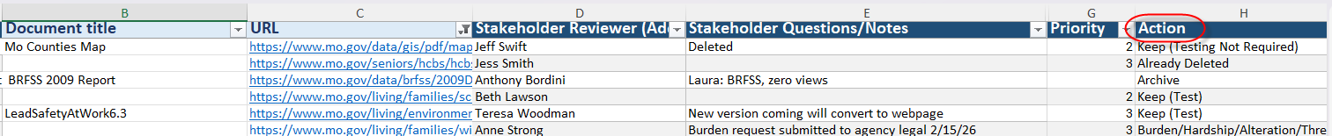
Step 6: Create and Evaluate Content Inventories
Create content inventories from the audit spreadsheet for each web property
Evaluate and Mark Content to Determine What Needs to Be Tested:
Bucket 1: Remove (Redundant, Obsolete, Trivial Content - ROT Analysis)
Bucket 2: Ignore (Exceptions 2-5)
Bucket 3: Archive (Exception 1)
Bucket 4: Update
Notes:
Now we are at the step of evaluating the content from each web property.
Create page and document inventories of websites, web applications, etc. We’ll provide a template you can use to record your content inventories.
You can create site page inventories from sitemap.xml files, Google Analytics inventories or other tools you can pull inventories. In the state’s case, we have 100+ websites in our Siteimprove cloud tool for example.
For example, a website will have webpages and documents. You could create a page tab and a documents tab.
In the screenshot here you can see examples of the data you will identify.
Note here the “Action” field This represents the buckets we talked about.

Slide 16
As you complete your web property audits or inventories…
Consider that you may need to purchase additional tools, subscriptions or contracted help to complete your initial remediation efforts
Notes:
Like additional copies of Adobe Acrobat Professional,

Slide 17
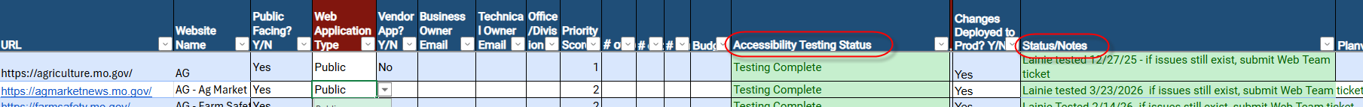
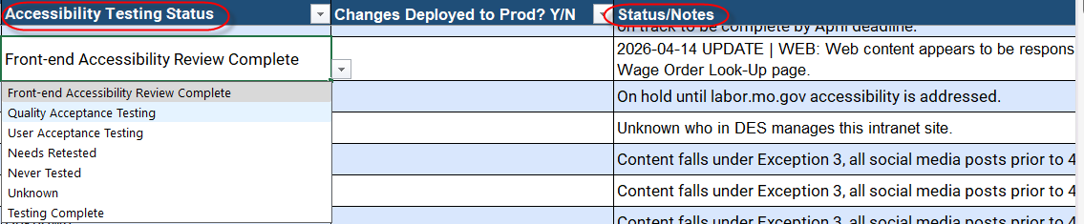
Step 7: Continue to Update Accessibility Testing Status in Audit Spreadsheet
Notes:
In particular, continue to update testing status and status/notes areas. Include dates in the status area as information changes.
Here are couple of spreadsheet screenshots, showing examples of some website, web applications and social media platforms examples. The second screenshot shows the dropdown for accessibility testing status.

Slide 18
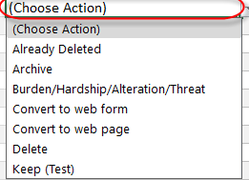
Step 8: Work Through Your Inventory Spreadsheets
Now that you’ve identified what to do with your content, it’s time to take action.
Bucket 1 : Remove ROT content
Bucket 2: Ignore, nothing to do (exceptions)
Bucket 3: Mark archive content on websites, no remediation needed UNLESS content is updated for any reason.
Bucket 4: Remediate content, working in priority order
Notes:
Now that you have created inventory spreadsheets for each web property., it’s time to take action on each item referring to the “Actions” dropdown.

Slide 19
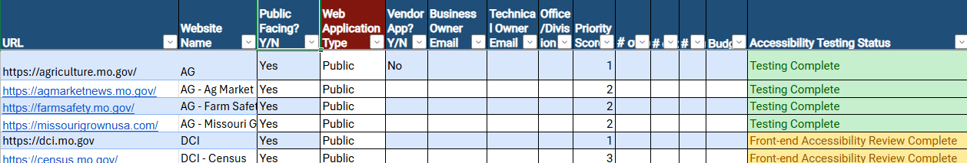
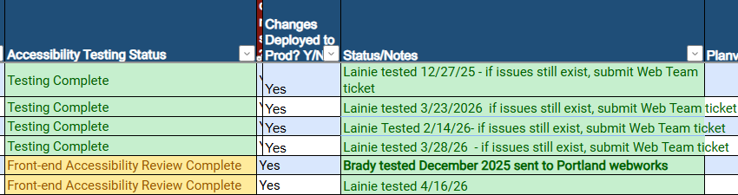
Step 9: Continue to Update Accessibility Remediation Progress in Audit Spreadsheet
Keep leadership/stakeholders/legal informed of progress through status reports

Slide 20
Step 10: Develop and Publish the Organization’s Web Accessibility Plan
Accessibility is not a project with a defined end; it is a continuous process.
Moving from the Roadmap “project” phase to the accessibility “program” phase.
Notes:
The Roadmap begins with content audit and comprehensive remediation steps This is what we might call the “project” portion of the roadmap. Now we move on to the step that creates a sustainable accessibility program. The organization’s ongoing accessibility plan.

Slide 21
Step 10: Develop and Publish the Organization’s Web Accessibility Plan
Examples of topics within your plan
Accessibility laws and guidelines within scope
Accessibility Principles
Organization Accessibility Statement
Digital Accessibility Issue Resolution Process
Accessible Procurement Process and Accessibility Language
Accessibility Roles and Responsibilities
Accessibility Training Plan
Testing Tools and Techniques
PDF Remediation Workflow
Core Accessibility Skills – Web Content
Contractor to help with remediation efforts?

Slide 22
Step 11: Maintain and Monitor Accessibility Through the Accessibility Plan
Integrate the plan into your agency personnel policies, procedures, employee onboarding process and general communication.
Establish a digital accessibility presence on your intranet, including accessible templates and accessible brand color combinations. Don’t forget to post your accessibility plan.
Identify employee roles which impact the accessibility of your content and target training. Schedule training refreshers and expand accessibility training.
Establish patterns for testing content.
Periodically review and update your plan.
Notes:
See the components of the

Slide 23
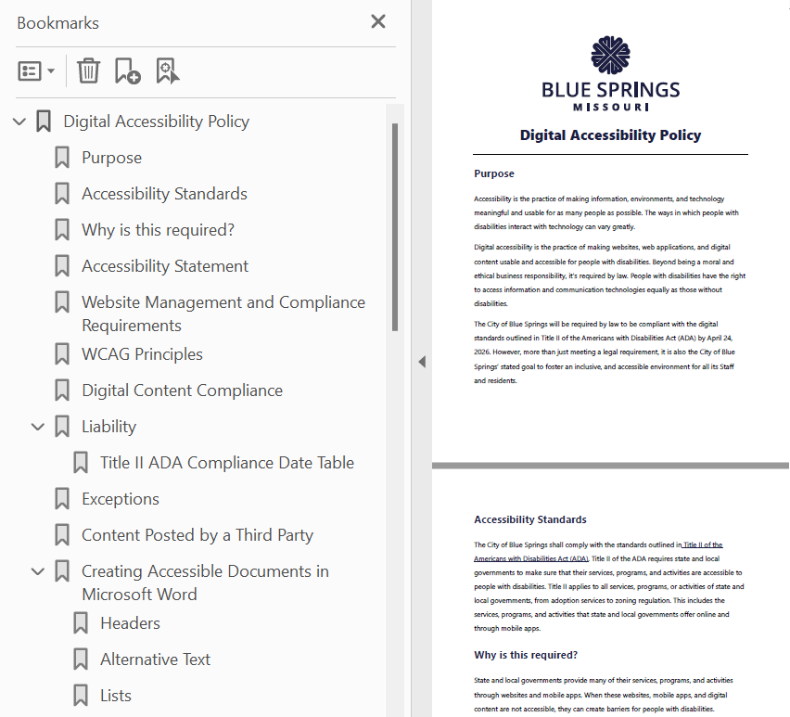
Step 11: Maintain and Monitor Accessibility Through the Accessibility Plan
Sample City Policy/Plan Blue Springs, MO
Notes:
We wanted to take the time to share some examples from City Government shared with us, in this case Blue Springs, MO. See this screenshot of their plan outline, which looks similar to the other example we shared. This example is linked on the last page of the presentation.

Slide 24
Step 12: Testing and remediation of internal systems and documents
State Government Step (not part of the ADA Title II update law)
The state’s accessibility law and standard included accessibility of specific internal content adapted from Federal Section 508.
This step also supports the state’s 2019 Missouri as a Model Employer Initiative and 2023 Missouri Employment First Act.
Non-State Government Organizations: Strongly consider making this part of your organization’s digital accessibility plan.

Slide 25
Communication Plan
Create an internal Roadmap communication page and consider including an FAQ page.
Set up ongoing touch-base meetings with Digital Accessibility Coordinator(s) and other key staff who oversee accessibility implementation.
Create a shared document space for accessibility audit and inventory templates, to easily access status information.
Think about weekly email status report communication.
Create a space for key stakeholders to review progress report information.
Include measurable % complete information.
Automate with project management tools.
Notes:
For the state’s roadmap project, these are

Slide 26
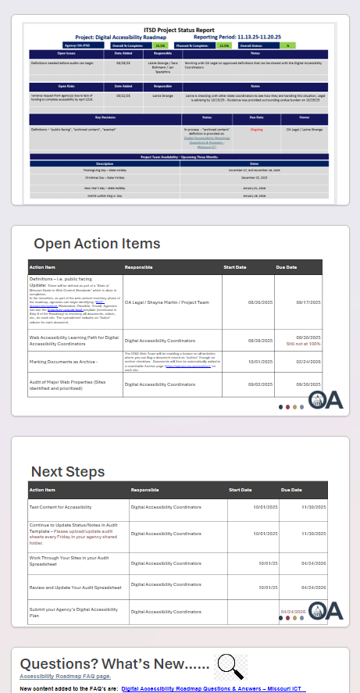
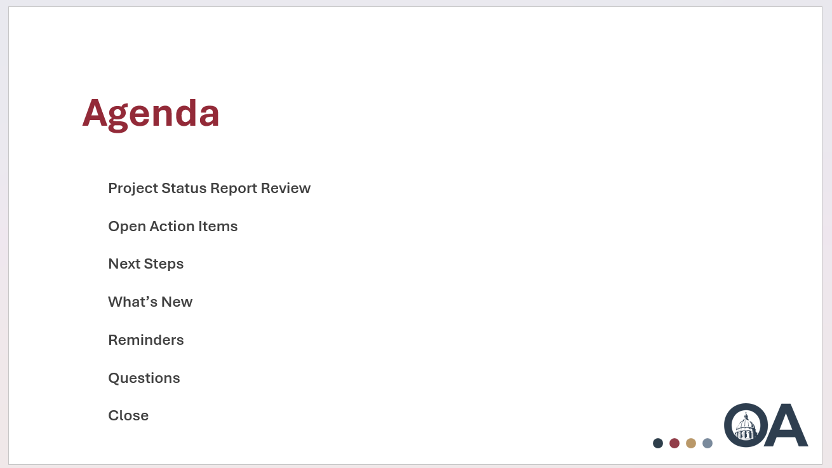
Example Roadmap Status Report/Bi-Weekly Presentation
Notes:
This might also include legal staff and project manages within Communications and website/application development.

Slide 27
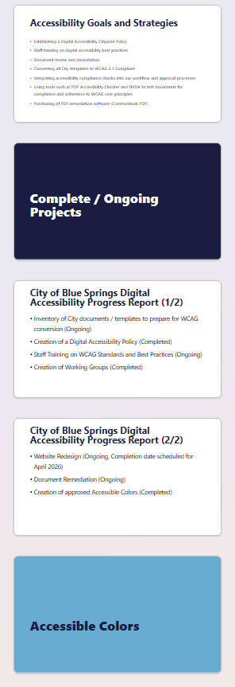
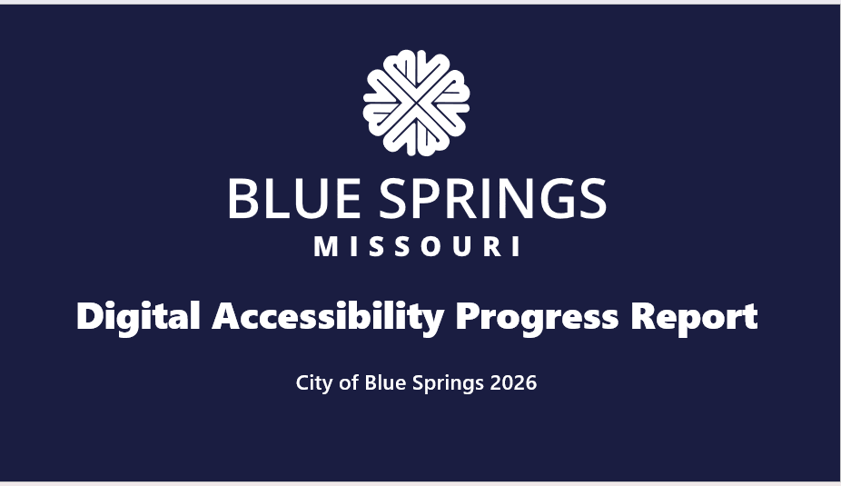
Example Status Report Presentation – Blue Springs, MO
Notes:
Here’s another status report example from the City of Blue Springs with similar topics.

Slide 28
Accessibility Roadmap and Plan Templates
Sample Accessibility Roadmap Template
Sample Digital Accessibility Plan
Sample web properties audit spreadsheet
Sample content inventory spreadsheet
Role-based accessibility training
Sample Employee Accessibility Toolkit Site
Sample Accessibility Policy/Plan – Blue Springs
Sample Progress Report – Blue Springs
Sample Roadmap Status Report – State of MO
Examples of Title II Exceptions
Accessibility Definitions
Accessible Use of Brand Colors (DHSS)
State of Missouri Digital Accessibility
Notes:
This might also include legal staff and project manages within Communications and website/application development.

Slide 29
Contact Lainie
“True accessibility doesn’t end with a checkbox checked at the end of your roadmap…
…It is integrating an accessibility mindset into everyday practice. Create, design and develop accessible content from the start!”
lainie.strange@oa.mo.gov
State of Missouri Digital Accessibility
Notes:
I’ll close with this message: “True accessibility doesn’t end with a checkbox checked at the end of your roadmap…
…It is integrating an accessibility mindset into everyday practice. Create, design and develop accessible content from the start!”
Focus on improvement and progress, not perfection!

