Slide 1
Integrating User Research with People with Disabilities into Accessible Design and Development David Sloan, Chief Accessibility Officer MO Digital Accessibility Summit, April 29, 2026

Slide 2
0. Introductions

Slide 3
Outline
Why user experience research (or UX research) with people with disabilities is a critical part of a digital accessibility strategy
UX research activities that contribute to accessibility efforts
Effective strategies for ensuring user research includes people with disabilities
Making best use of the data gathered from user research

Slide 4
1. User research in digital accessibility strategy

Slide 5
Accessibility standards have limitations
Accessibility activities that focus on standards such as WCAG are important, but they have limitations:
Standards-based audits focus on identifying barriers that already exist, rather than avoiding introducing barriers in the first place.
They are generic, so need expertise to apply effectively to your product's specific design objectives and constraints, to design for a desired user experience.
They can't give you the first-hand, contextual experience of people with disabilities.

Slide 6
User-centered design puts a focus on users
User-centered design is a design approach based on research:
discovering as much as possible about a design problem from the perspective of users to inform product requirements
evaluating potential solutions for areas where they work well and where they could be improved.
For user-centered design to be inclusive, we need to involve people with diverse capabilities and characteristics, including people with disabilities.
Involving people with disabilities in the design process helps you gain a richer understanding of a design problem, design a solution that is sensitive to diverse user needs, and validate your efforts with the people you're designing for.

Slide 7
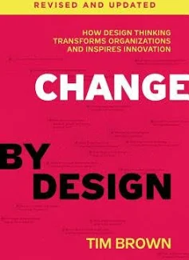
Tim Brown, Change by Design
"By concentrating solely on the bulge at the center of the bell curve, we are more likely to confirm what we already know than learn something new and surprising."

Slide 8
Benefits for digital products
Including people with disabilities in a user-centered design process helps product teams:
Develop a better understanding of a problem space from a disability perspective.
Design solutions for problems that might not otherwise have been considered, reducing focus on problems that might not be problems in reality
Validate technical accessibility efforts and reduce remediation costs.
Increase the overall quality of user experience for people with disabilities, and for other audiences as well.

Slide 9
Benefits for the organization
For an organization building and providing digital products, involving people with disabilities in user-centered design can have long-term benefits:
Build empathy and understanding of people with disabilities; strengthen processes.
Establish positive connections and reputation with disability advocacy organizations, and with individuals with disabilities.
Help you provide better services in a more efficient way.
Reduce the risk of unlawful disability discrimination.

Slide 10
Benefits for people with disabilities
Involvement in user research provides benefits for people with disabilities:
An opportunity to give opinion and influence design decisions, and change the perceptions that decisions are being made about people with disabilities without consultation.
Participation in research activities may lead to opportunities for networking, skills development and employment.
It's a way to reduce marginalization and social exclusion experienced by a sector of society that historically has faced significant exclusion and discrimination.

Slide 11
2. UX research activities that can advance accessibility

Slide 12
When to include people with disabilities in UX research
Ideal: include people with disabilities in any activity that involves gathering information from current, potential or former users of a digital product
Minimum: when a research activity has an accessibility focus, and feedback is needed from people who are particularly likely to benefit from this accessibility focus
And the research shouldn't be limited to asking "is it accessible?"

Slide 13
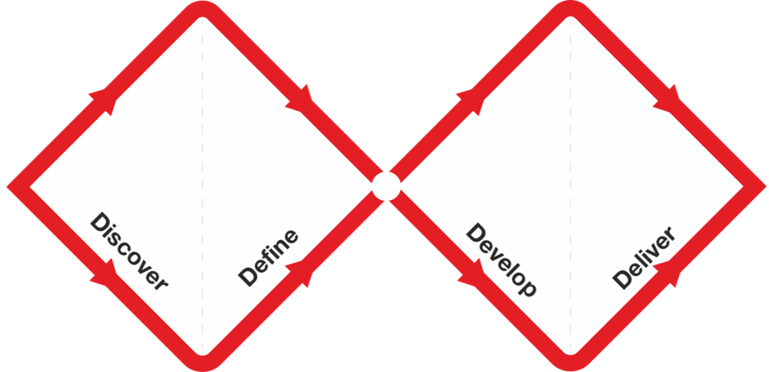
The Double Diamond model of design
The Double Diamond by the Design Council

Slide 14
Research methods for discovery
You can involve people with disabilities in research methods that help you discover more about a problem or opportunity:
Do this as early as possible in development of a new product/service or redesign of an existing product/service
This is about asking questions and understanding the participant's perspective
Example methods:
Contextual inquiry interviews
"Show-and-tell" demos
Surveys

Slide 15
Outputs from discovery research
Insights on the current state:
How do people with disabilities approach tasks? What do they use?
What works well? What doesn't? How do they get around issues?
What do people need?
Insights that inform and influence design decisions; uncover opportunities for innovation.
Evidence:
Quotes
Stories
Demonstrations

Slide 16
Research methods for evaluation
You can involve people with disabilities in research methods that help you evaluate how well a developed solution solves a problem:
Do this frequently in design and development of a product/service and especially before launch
This is about asking participants to use a design for a meaningful purpose and recording how well it works
Example method: Usability evaluations of prototypes or functional products

Slide 17
Outputs from evaluative research
Key data:
Location and impact of barriers to success for specific disability groups
Insight on where and how to focus efforts on improving designs
Evidence of what works well (and doesn't need to be changed)
"Nice to have" data:
Insights in which a user's assistive technology or accessibility settings influence how they approach a task
Task performance for benchmarking
Recordings of participants with disabilities using the product

Slide 18
3. Practical tips for including people with disabilities in user research

Slide 19

Wendy Chisholm
"I encourage you to fail in interacting with people with disabilities because you will learn a bunch.
You will learn what not to say and what people care about.
You'll learn about where the obstacles are - both the designed, physical barriers and the constructed emotional ones that exist within yourself."

Slide 20
Key concerns UX researchers might have
What can I do with limited time and budget?
How many people do we need for the study to be useful?
How will we find participants?
What are the ethical concerns of research with people with disabilities?
How do I make sure the research activity is accessible and that I can communicate with participants?

Slide 21
How many people?
Short answer - even one person is better than none!
Longer answer - it depends! On:
The type of research you're doing, the questions you'd like to answer and the data you need to gather to help answer the questions
Budget and time available.
Number of different disability profiles to cover
Costs and time increase with more participants, but so too does the reliability of the data

Slide 22
Which disability groups to include?
You might want to focus on a wide range of disabilities for:
Studies that recruit a large number of participants
Evaluations intended to get feedback on accessibility efforts
You might want to focus on a specific disability group for:
Exploratory research to understand a design challenge from the group's perspective
You want to evaluate functionality specifically intended to improve the user experience for that group

Slide 23
Balancing other selection criteria
Be mindful of the target audience of the product you're building - your participants should ideally be representative of that audience
For example, user research to inform the design of an online tax payment tool should ideally focus on taxpayers of different types and ages
But being too focused on other inclusion criteria can reduce the pool of people with disabilities you can recruit from
You may need to consider tradeoffs when recruiting

Slide 24
How do we find participants?
For remote research activities, you can focus on online methods to publicize your research to potential participants with disabilities:
Social media, online discussion forums focused on disability
For face-to-face research activities, recruitment is geographically limited to nearby participants
Consider organizations that can help publicize your research to potential participants:
Local disability advocacy/support organizations, independent living centers
College or university disability support centers
Setting up a pool of participants that you can call on can make recruitment more efficient - just be aware that over time their expertise and behaviors may change

Slide 25
How do we compensate participants?
Recognize the costs of participation of participants with disabilities - particularly time, transport, physical effort:
Providing compensation ensures you recognize the effort of participants to help you with your research, so budget for this in your planning.
Be sensitive to the potential implications of receiving monetary payment on income support status; consider cash alternatives such as gift cards.

Slide 26
Addressing ethical concerns
Design the activity so that you can focus on collecting the data that you need - and not data you don't need
Focus on gathering data on how people use technology and accessibility issues they encounter, rather than medically sensitive information about a disability
Share upfront what participants will be asked to do, what data you'll gather, and how it'll be used
Seek informed consent before going ahead with the research
Where possible, allow participants to use their own tech
Give participants enough time during the activity; plan for breaks and watch for signs someone may be distressed or tired

Slide 27
Where should we conduct the research activity?
For UX research with participants with disabilities, there are two main options for location:
Remote, where researchers and participants are in separate places
In-place, where researchers and participants are in the same place
The restrictions of the Covid-19 pandemic shifted balance towards remote activities

Slide 28
Comparing remote and in-place studies
Remote | In-place
Researchers and participants don't have to travel | Researchers and participants may have to travel
No need to find a suitable venue | Locating a venue may be challenging, unless visiting participants at their homes/offices
Recruitment and scheduling constraints are low | Significant recruitment and scheduling constraints
Remote observation is easy to set up | Additional effort required to broadcast sessions to observers
Limitations in what data can be captured | With appropriate effort, can capture rich data of participant experience
Possible technical demands on participant to make sure everything is working | Researchers perform set-up and troubleshooting, reduced effort for participant

Slide 29
Accessible remote research activities
For screen recording, you can use specialist UX software, or common solutions like Zoom or Teams
Make sure that the screen recording software will record any assistive technology output - this may be limited, especially for recording adjusted displays, and on mobile devices
Provide an accessible way for you and participants to communicate - ask them for their preferences
Platform's chat facility for text-based communication
Captioning support
ASL interpreter as an additional person on the call

Slide 30
Accessible in-place research, where participants are
More convenient for participants, as they don't have to travel, can participate in a familiar setting, using familiar technology.
Make sure to:
Allow extra time to travel between sessions, to set up and test equipment, and to reduce the chance of disturbances during the session
Make sure the participant's own technology is accessible to you so you can observe and record interactions
Tidy up cables and locate camera tripod legs so that they're not a trip hazard

Slide 31
In-place, a central venue
Convenient for researchers, as you can schedule end-on sessions more easily, have observers attend, and reduce set-up time.
Make sure to:
Choose a venue that's accessible, familiar, and easy to get to for your participants
Provide clear, accessible directions in advance, and a phone number should participants have trouble finding you
Choose a room that's easily accessible and findable from the building's main entrance, and large enough for researchers, participants and any companions, including interpreters and service animals.

Slide 32
Managing use of technology
For research that involves using technology, be aware of the limitations of requiring participants to use technology not set up to their needs
Assistive technology settings are highly individualized. Unfamiliar or incorrectly configured AT can significantly affect participant performance, reducing data quality
Wherever possible, allow participants to use their own device and AT
If not possible, find out participant's preferences in advance, set up the test device to mirror those settings, and give them time to check and adjust settings before starting the study
Always test in advance; dry runs can help identify issues before the first participant session

Slide 33
Accessible communication
Follow accessibility guidelines when creating participant information.
Always ask participants for their communication preferences and do your best to meet these preferences.
Introduce all research staff present and explain if there are remote observers.
Tell participants when you start and stop recording a session.
Talk to participants directly, rather than to an interpreter or companion.
With their permission, consider sending a courtesy follow-up note to participants after the study with an outline of how the research influenced your work (you don't have to go into details).

Slide 34
Additional accessibility considerations for exploratory user research activities
Contextual inquiry interviews
Make sure that you can communicate effectively with participants
Surveys
Make sure the survey tool is accessible, and your target audience can complete it
Avoid overly complex question types, and ones that rely on a specific sensory capability
Be aware of biases in response rates, and design to identify bias in aspects like technical expertise

Slide 35
Additional accessibility considerations for evaluative research
Avoid using a usability study to identify barriers in the resource being tested that you could identify from an expert inspection or accessibility testing
Focus on learning about task completion and user experience
If the resource being tested has known barriers that can't be removed in advance, design the study so that participants avoid encountering them
Or be creative in presenting ideas and concepts in different ways
Watch out for participant behaviors that might not be representative, or where assistive technology behavior is interfering with user experience

Slide 36
4. Making user research impactful

Slide 37
Research output that educates and informs
Depending on the nature of a research activity, you can generate high-impact output in different forms for different audiences:
Output that shares experiences, educates, and builds empathy
Explains how people with disabilities use technology
Stories of problems (and successes!)
Participant quotes
Video recordings of participant experience using different assistive technologies to interact with web sites, apps and other digital resources

Slide 38
Research output that influences design and development
Output that informs decision-making:
Personas and scenarios that incorporate accessibility needs, which are used in design and development
User stories and other expressions of requirements
Prioritized list of issues to fix
Quantitative performance data, which could be used for benchmarking and comparison
Where possible, share learnings and impact with participants - let them know how their input helped

Slide 39
Socializing user research with people with disabilities
Arranging remote live observation of research sessions is a great opportunity to raise awareness of disability, accessibility and inclusive design across your organization.
An opportunity for engaging leadership in accessibility efforts
Connections established with participants may help with recruitment for future studies, and to build communication channels with disability groups.

Slide 40
In conclusion

Slide 41
Key takeaways
UX research with people with disabilities is a valuable complement to a standards-based accessible product development
UX research methods can be effectively adapted to be inclusive of disability
Research doesn't have to be academically robust, large scale or expensive. Even involving one person can give you valuable insights and challenge assumptions
Preparation and focus on inclusion helps ensure you get the best value from UX research effort
Embedding research with people with disabilities into digital accessibility practices helps build awareness and skills, and helps you build better products and experiences for everyone

Slide 42
Further Reading
Accessible UX Research, by Dr Michele Williams. Published in 2026, this is an excellent book covering the practicalities of including people with disabilities in UX research
Doing Accessible Social Research: A Practical Guide, by Daniela Aidley and Kriss Fearon. Published 2021, a helpful walkthrough of ways to ensure research activities are inclusive to participants with disabilities
Just Ask, by Shawn Henry, First published in 2007, focuses on involving people with disabilities throughout the design process: http://www.uiaccess.com/accessucd/
The UK's Government Data Service (GDS) has several useful blog posts on the practicalities of including people with disabilities in user research: https://userresearch.blog.gov.uk/

Slide 43
Questions

Slide 44
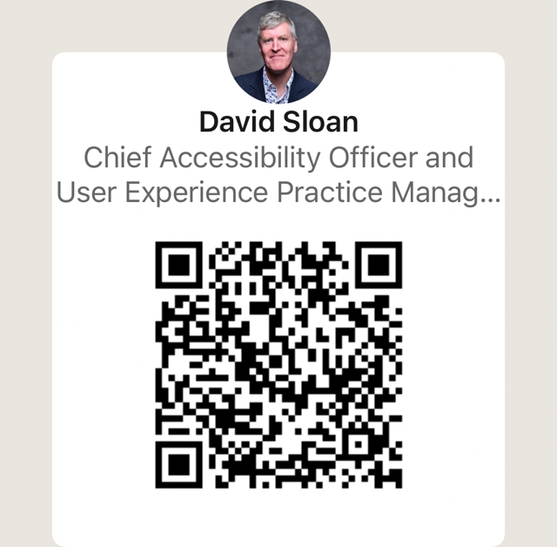
Contact me!
dsloan@vispero.com
www.linkedin.com/in/sloandr/

