Slide 1
Web Accessibility
Awareness &
Word Document Accessibility
Lainie Strange
OA-ITSD, Web Accessibility Specialist
Notes:
(Audience for this presentation is all state government office level staff)

Slide 2
Objectives
Module 1: What is Web Accessibility and Who Is It For?
Module 2: Assistive Technology & Examples
Module 3: Accessibility Law, Standards and the POUR Concept
Module 4: Document Accessibility Features
Module 5: Summary, Next Steps & Being an Accessibility Champion

Slide 3
Module 1: What is Web Accessibility and Who Is It For?

Slide 4
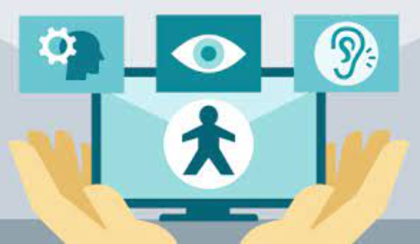
What is Web Accessibility?
The practice of creating usable and understandable websites, applications and digital documents for ALL people.
Physical “Curb Cut”
Digital “Curb Cut”
Notes:
Web Accessibility is The practice of creating usable and understandable websites, applications and digital documents for ALL people.
Think of it as the ‘digital or electronic’ version of what you know as a sidewalk curb cut.

Slide 5
Who is Web Accessibility For?
Adults identifying as having some type of disability
1 in 4
(28.7%)
American Adults
(73.4/244.5 million)
Almost 1 in 3 (31.3%)
Missouri Adults
(1.5/4.65 million)
Data from: CDC Disability and Health Data Systems

Slide 6
Think About the Impact…
If you were to exclude 1.5 million Missouri citizens from accessing websites, it would be like blocking access to Kansas City and the surrounding area (20 total counties)
Data from: CDC Disability and Health Data Systems
Notes:
These twenty counties have varying populations, and are located in the West and West-Central portion of the state.
This example include: Buchanan, Clinton, Caldwell, Livingston, Platte, Clay, Ray, Cartoll, Jackson, Lafayette, Saline, Cass, Johnson, Pettis, Cooper, Bates, Henry, Benton, Morgan and Moniteau Counties!

Slide 7




Disability Types
Those with:
Visual Impairments
Blind, Low Vision, Colorblind, Glasses/Contact Users
Hearing Impairments
Deaf, Hard of Hearing, Hearing Aid Users
Motor Disabilities
Physical Weakness/Limitation
Cognitive/Learning Disabilities
Affects Processing of Information
Notes:
Disability types include:
Visual Impairments
Blind, Low Vision, Colorblind, Glasses/Contact Users
Hearing Impairments
Deaf, Hard of Hearing, Hearing Aid Users
Motor Disabilities
Physical Weakness/Limitation
Cognitive/Learning Disabilities
Affects Processing of Information
These users will use various devices, software and methods to interact with your content. Next, we will talk about what devices and software, called Assistive Technology, are used by these different disability types.

Slide 8

Cognitive & Learning
Examples:
Attention deficit hyperactivity disorder (ADHD)
Autism
Dyslexia
Learning disabilities like reading comprehension
Brain injury
Aging
Notes:
Let’s talk about cognitive and learning disability examples in a bit more detail. This category can be misunderstood or overlooked when incorporating accessibility
Examples like:
Attention deficit hyperactivity disorder (ADHD)
Autism
Dyslexia
Learning disabilities like reading comprehension
Brain injury
Aging

Slide 9
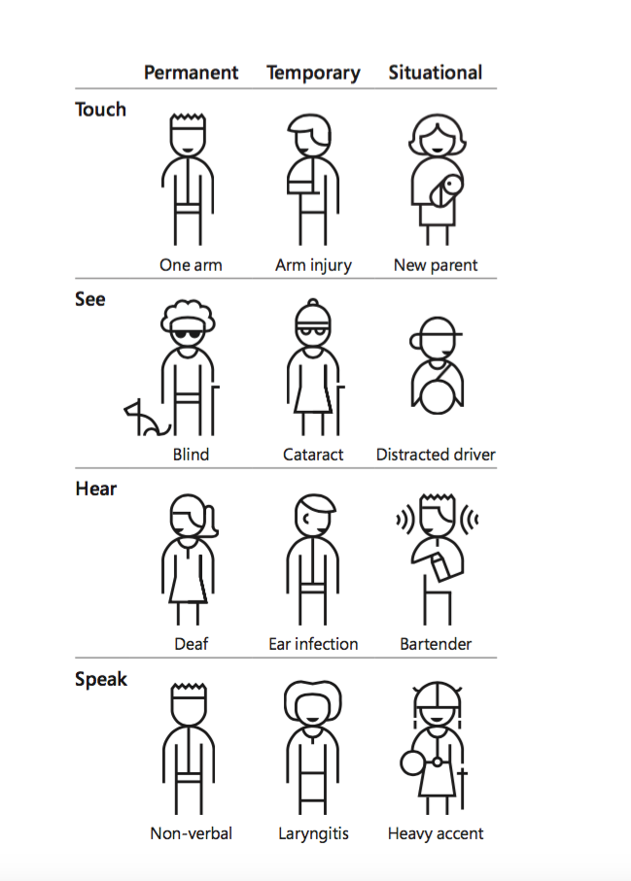
Did You Know?
Effective web accessibility positively affects everyone!
Users with temporary and situational disabilities
also benefit from accessible websites!
Notes:
The primary target audience for web accessibility guidelines and laws are providing equal access for those with permanent disabilities. But did you know? Effective web accessibility positively impacts everyone!
Users with temporary and situational disabilities also benefit from accessible websites!
Here are temporary and situation disabilities we can all relate to:
Mobility challenges like an arm injury or being a new parent holding a baby
Sight challenges like cataract vision loss or distracted driving
Hearing challenges like an ear infection or working in a loud environment
Speech challenges like laryngitis or someone with a heavy accent
These examples can help us better understand these challenges

Slide 10
Module 2: Assistive Technology & Examples

Slide 11
What is Assistive Technology?
It’s common for those with disabilities
to use assistive technology
“Assistive Technology is any tool, device, or product that helps people with disabilities perform tasks that they might not be able to do without it.”
Notes:
First let’s define Assistive Technology.
“Assistive Technology is any tool, device, or product that helps people with disabilities perform tasks that they might not be able to do without it.”
Next, let’s look at assistive technology examples by disability types.
“Assistive Technology is defined as any tool, device, or product that helps people with disabilities perform tasks that they might not be able to do without it.”
Next, let’s get familiar with different types of assistive technology to gain a better understanding of user needs.
With a better understanding of user needs

Slide 12

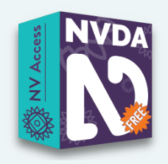

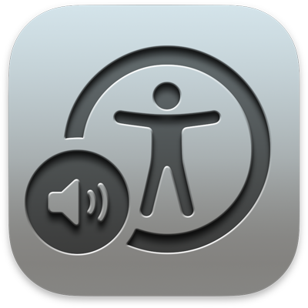
Visual: Blind
Screen Readers (Narration Software)
Screen readers are used to navigate a website by reading
out loud what is on the screen to the user.
Used in combination with a keyboard or braille display, but not a mouse.
Voiceover
Notes:
Blind users are the primary users of screen readers (also known as narration software). Screen readers are used to navigate a website by reading out loud what is on the screen.
They are used in combination with a keyboard or braille display, but not a mouse.
This helps people that not only have visual impairments but those with cognitive impairments, such as language comprehension problems or dyslexia as well. Examples include NVDA, Apple Voiceover, Windows Narrator and JAWS.
Examples include NVDA, Apple Voiceover, Windows Narrator and JAWS.

Slide 13


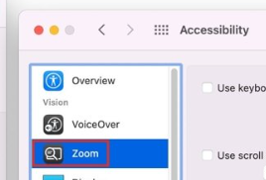
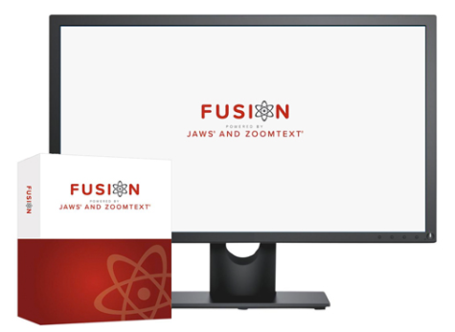
Visual: Low Vision
Screen Magnification
Magnification programs help the user enlarge everything that is found on the screen.
Windows Magnifier
Apple Zoom
ZoomText and JAWS
Notes:
Low vision users use screen magnification software. Magnification programs help the user enlarge everything that is found on the computer screen while maintaining clarity in the magnification, and they also increase color contrast and provide options of visual themes that make the screen readable (i.e. white fonts on black background, yellow on blue, or gray color scales/low contrast for migraines, etc.).
These types of magnification application help a variety of people, from those wearing regular reading glasses to those that may have severe visual impairment.
Some magnification software can also read outloud similar to the narration software, working as a hybrid. This allows the users to use both features or toggle back and forth.
Some hybrid tool examples include Fusion and ZoomText with Speech. There are also built-in accessibility tools such as Microsoft Magnifier and Apple Zoom.

Slide 14
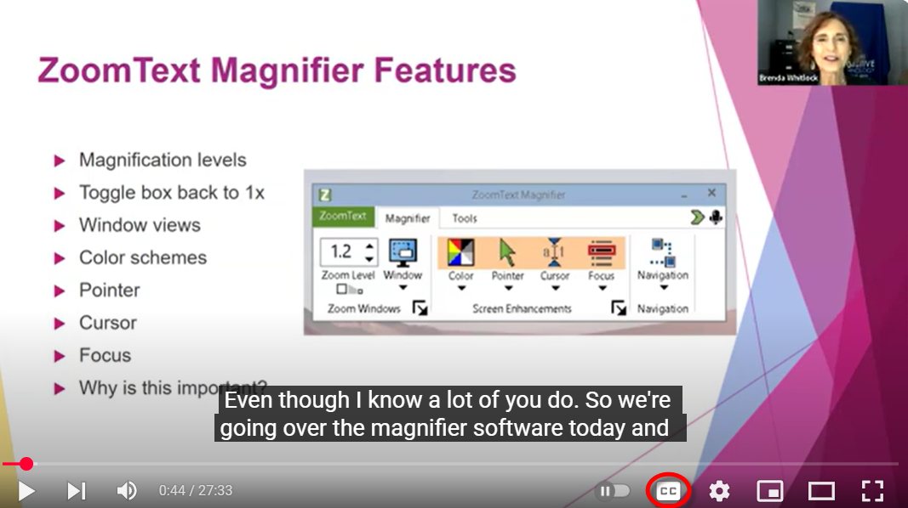
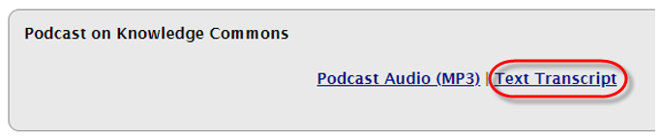
Deaf & Hard of Hearing
Closed captioning of videos and text transcripts of audio-only content allow users to read information that would otherwise be inaccessible.
Notes:
Closed captioning of videos and text transcripts of audio-only content allow deaf users to read information that would otherwise be inaccessible.
For example, closed captioning can be enabled in this YouTube video example. Major video platforms even allow you to automate this captioning. Keep in mind, eviewing the captioned text for accuracy is important.
In this next example, we have a link to a podcast episode, followed by a text version transcript link of this podcast episode.
This can be useful for those that are hearing impaired as well as for those people who do not process information verbally/orally. For some who have information processing disabilities or for presenters who have strong accents, being able to read and listen to content at the same time increases their understanding. Text based transcripts also give you the ability to key word search for specific content in the video or audio file.

Slide 15
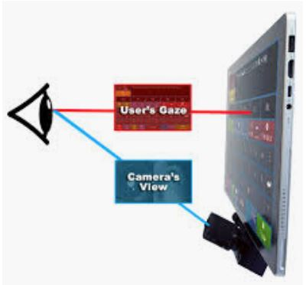

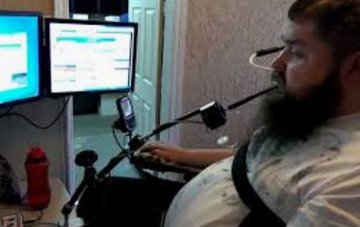
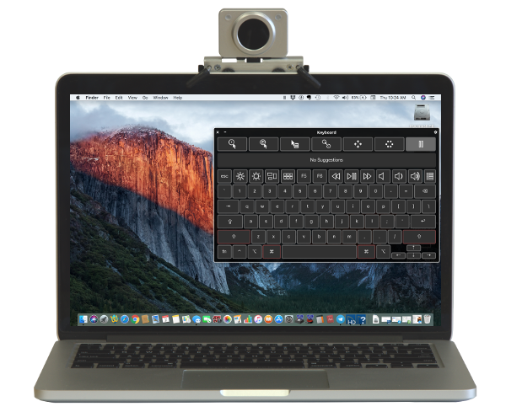
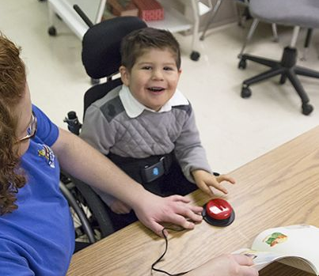
Motor & Physical Disabilities
Motor or physical disabilities are weakness
and limitations of muscular control
Eye Gaze Technology
Mouth Movement
Speech to Text
Head Mouse
Switch
Notes:
Motor or physical disabilities are weakness and limitations of muscular control.
Because of this, users will use alternative devices in place of a standard keyboard and mouse.
In the examples here, eye gaze technology uses eye movement, head mouse uses head movement, and a mouth joystick uses mouth movement to interact with content.
A switch is another type of mouse/keyboard alternative that uses an onscreen keyboard in combination with a physical input (the switch).
Speech to Text software is another great tool for those with mobility issues.
These devices help those with severe physical limitations, like muscle control, as well as missing limbs. Creating accessible content for these types of assistive devices helps those with both severe physical limitation as well as assist people with more mild physical impairments such as arthritis in the hands.

Slide 16
Cognitive & Learning
Impacts how people process information
Users will:
Navigate web content using different strategies
Access information using speech-to text, screen readers, captions or other formats
Change the presentation of the content according to needs and preferences
Content creators can:
Use plain language at 6th-8th grade reading level
Include white space between major thoughts or important points
Use bulleted or numbered lists to simplify content
Notes:
Let’s discuss common ways those with cognitive disabilities may process your information differently.
Users will:
Navigate web content using different strategies
Access information using speech-to text, screen readers, captions or other formats
Change the presentation of the content according to needs/preferences
What can you do as a content creator to make content more east to understand?
Use plain language at 6th-8th grade reading level
Include white space between major thoughts or important points
Use bulleted or numbered lists to simplify content

Slide 17
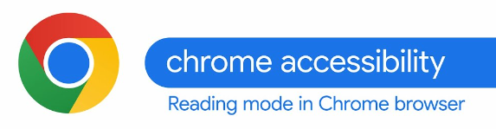
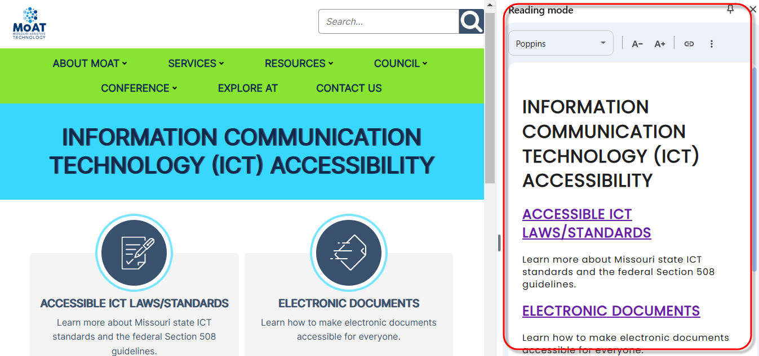

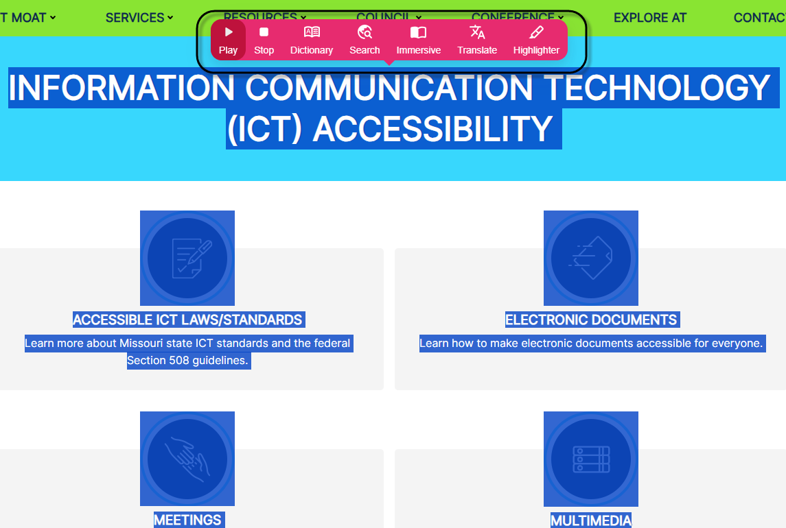
Cognitive & Learning Tool Examples
Chrome Reading Mode located under Chrome Settings – More Tools
Helperbird Browser Extension
Notes:
Here are examples of tools that can improving cognition and learning.
In this first example, we see a Chrome browser feature called the Chrome Accessibility Reading Mode. It can remove distracting menus and images for easier reading.
In this second example, we have a Chrome extension called Helperbird, which can read aloud content on the page, readability features like text spacing, text sizing or increasing contrast as well as simplified reading modes.

Slide 18
Module 3: Accessibility Law, Standards and the POUR Concept

Slide 19
Federal Laws
Rehabilitation Act of 1973
  Section 504
  Federally funded govt. agencies and projects, postsecondary institutions (2024 Update)
  Section 508
  Federal government
Americans with Disabilities Act
  Title II
  State and Local Government (2024 Update)
Individuals with Disabilities Education Act (IDEA)
Notes:
These are the laws that include web accessibility language, with Section 508 being the first one to include it.
Section 504 prohibits discrimination against people with disabilities in programs that receive federal funding. It affects programs and activities in public education, healthcare, and transportation.
Section 508 of the Rehabilitation Act of 1973 requires that federal agencies make their technology communications accessible to all people.
Title II of the ADA requires state and local governments to make sure that their services, programs, and activities are accessible to people with disabilities.
IDEA ensures that children with disabilities receive a free and appropriate public education.

Slide 20
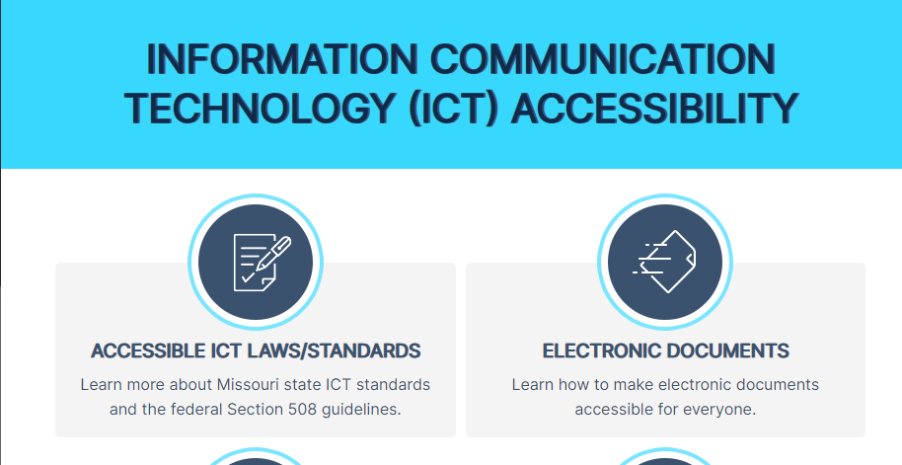
Missouri State Law
Missouri State Statute – effective 1999
Missouri State Standard – effective 2003
  Agency public sites
  Like accessing information about a local state park
  Web applications (interactive websites)
  Like applying for a job on https://jobs.mo.gov
  Contracted sites/licensed web software
  Contracted site like mocareers.mo.gov
  Licensed web software like Wufoo form creator
  Intranet sites
  Like accessing personnel policies on your agency’s intranet
  Social media content
  Like a Facebook post with image
Notes:
The state created a web accessibility statute in 1999, referencing the Federal guidance of section 508.
A state standards document soon followed in 2003, outlining what specific guidelines the state will follow (called the Web
Missouri State Statute – effective 1999
Missouri State Standard – effective 2003
Examples of content covered by these laws include:
Agency public sites
Like accessing information about a local state park
Web applications
Like applying for a job on https://jobs.mo.gov
Contracted sites/licensed web software
Contracted site like mocareers.mo.gov
Licensed web software like Wufoo form creator
Intranet sites
Like accessing personnel policies on your agency’s intranet
Social media content
Like a Facebook post with image

Slide 21
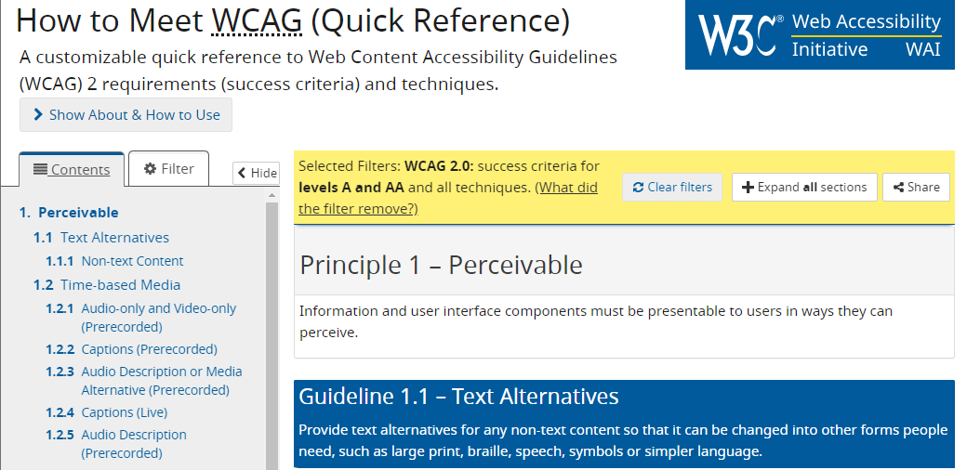
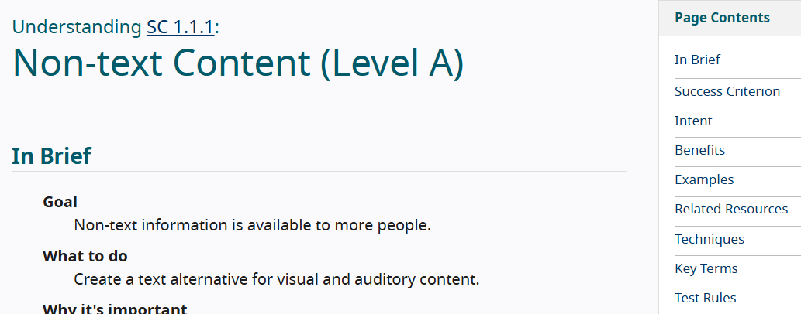
How is Web Accessibility Measured?
Web Content Accessibility Guidelines (WCAG)
  International standard developed by the World Wide Web Consortium (W3C)
  Each guideline includes a list of testable success criteria to help create accessible content.
Missouri Standard
  WCAG Version 2.1 effective September 2024
  WCAG Version 2.2 effective October 2025
Notes:
Web Content Accessibility Guidelines (WCAG)
International standard developed by the World Wide Web Consortium (W3C)
Each guideline includes a list of testable success criteria to help create accessible content. This makes it easy to check if something meets a specific standard.
Missouri Standard
WCAG Version 2.1 effective September 2024
WCAG Version 2.2 effective October 2025
Most recently, our Missouri standard incorporated WCAG version 2.1 in September 2024 and WCAG 2.2 in October 2025.

Slide 22
Accessibility Principles
P
O
U
R
Perceivable
Operable
Understandable
Robust
Users can identify content by way of sight, sound, and/or touch, regardless of device or operating system.
A website should work correctly whether visitors are using a mouse, a keyboard, voice commands, or other device.
Navigation and design should be predictable and consistent, content is written clearly and simply and tasks are easy to complete.
When content is well-designed/well-planned, it doesn’t matter what technology a citizen uses to access it.
Notes:
WCAG is organized under four guiding principles, called POUR
Each letter of POUR is part of this acronym and represents: P for perceivable, O for operable, U for Understandable and R for Robust.
Perceivable - Users can identify content by way of sight, sound, and/or touch, regardless of device or operating system.
Operable - A website should work correctly whether visitors are using a mouse, a keyboard, voice commands, or other device.
Understandable - Navigation and design should be predictable and consistent, content is written clearly and simply and tasks are easy to complete.
Robust - When content is well-designed/well-planned, it doesn’t matter what technology a citizen uses to access it.

Slide 23
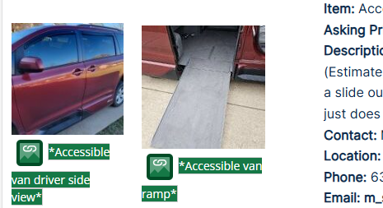
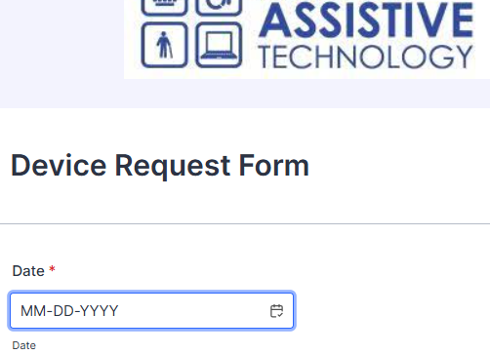
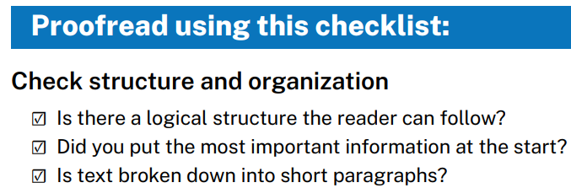
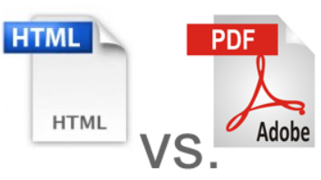
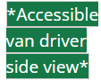

Examples of Applying POUR
P
O
U
R
Perceivable
Operable
Understandable
Robust
Review and apply accurate and descriptive alternative text for images (visually impairments)
People can fully operate your website or application using keyboard alone.(visual or motor impairments)
Review your content for clear and simple language using guides like the Plain Language Quick Reference Guide.
Webpage content is automatically more accessible versus formatting as a document. Ensure you have a need to offer content as a document/PDF.
Notes:
To better understand POUR, let’s review examples for each.
For Perceivable, an example would be to “Review and apply accurate and descriptive alternative text for images. This especially benefits those with visual impairments. We have an example here displaying alternative text for two images of a handicap accessible van, each describing different angles of the van.
Next is Operable. An example is that “People can fully operate your website or application using keyboard alone.(visual or motor impairments)” The examples shows a form field with a blue outline showing keyboard focus.
For Understandable, review your content for clear and simple language using guides like the Plain Language Checklist for Web. Below that is an image of some of the checklist items for Plain Language, including using logical structure, displaying the most important information at the beginning and grouping text into multiple smaller paragraphs.
Finally, Robust. The example here is that Webpage content is automatically more accessible versus formatting as a docment. Make sure you have a specific need to offer content as a document/PDF.

Slide 24
Module 4: Document Accessibility Features

Slide 25
Document Accessibility Features
Specific Color Contrast for Text and Images
Alternative Text for Images
Structured Headings
Structured Data Tables
Descriptive Hyperlinks
Descriptive Title within Document Properties
Other Accessibility Tips
Notes:
A majority of state employees create documents as part of their work. Many of these documents are posted on agency websites, intranet sites, or social media platforms. Because of this, there are required accessibility features document creators need to consider.
These include:
Specific Color Contrast for Text and Images
Alternative Text for Images
Structured Headings
Structured Data Tables
Descriptive Hyperlinks
Descriptive Title within Document Properties
Other Accessibility Tips

Slide 26
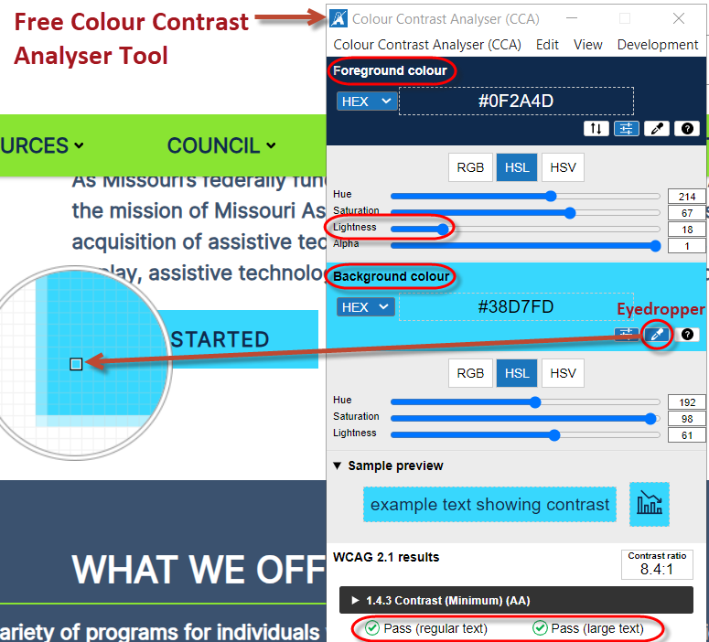
Text & Color Contrast
Color contrast is the ratio of the foreground text color and the background color
Minimum 4.5:1 ratio for regular sized text
Minimum 3:1 ratio for large sized text
(18pt+ or 14pt+ bold)
Exception: Logos
Users impacted: Low vision, colorblindness, cognitive impairments
Free tools to test color contrast
Notes:
Color contrast is the ratio of the foreground text color and the background color
Minimum 4.5:1 ratio for regular sized text
Minimum 3:1 ratio for large sized text
(18pt+ or 14pt+ bold)
Exception: Logos
Users impacted: Low vision, colorblindness, cognitive impairments
Tools such as the Colour Contrast Analyser or WebAIM Contrast checker. The tools will give you feedback whether contrast passes or fails contrast.
Refer to the resource links as part of this course.
This example is the color contrast analyser tool, you can pick your colors through the color dropper or grab the color code in the website style sheet. If your colors didn’t pass, you can adjust the lightness slider to find a passing color.
These include those that have visual impairments and some cognitive impairments.

Slide 27
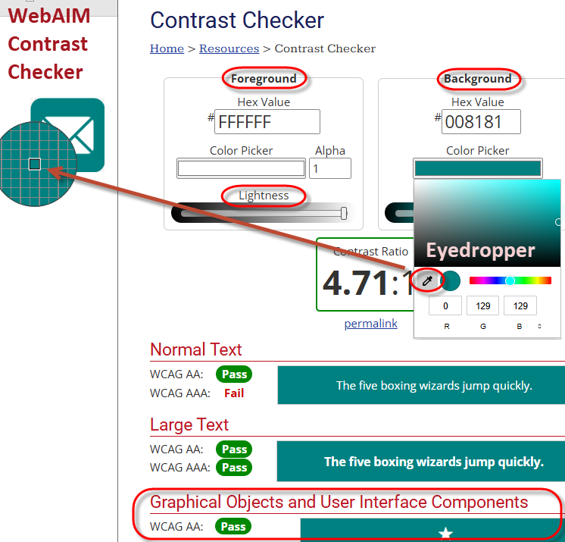
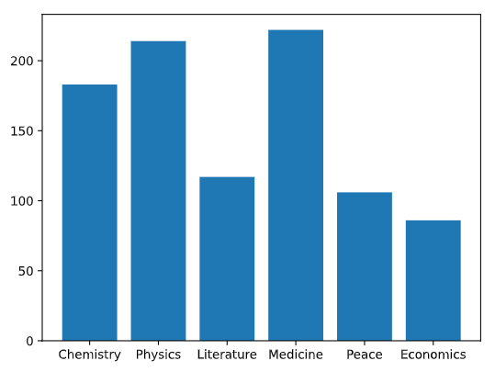


Non-Text Color Contrast
Non-text examples include:
  Components like a form input field outline or a checkbox
  Graphical object like a print icon button or bars in a bar chart
Minimum 3:1 Ratio
Notes:
There is also a color contrast standard for non-text elements. Examples include form input fields outline (like this search box), or checkboxes, graphical objects (like this email icon button) or elements in a chart (like the blue bars in this bar chart). This type of contrast is equally important to text contrast for readability.
In this example to the right, we are using the WebAIM contrast checker. We checked the background color using an eye dropper, checking to see whether it passed under the “Graphical Objects Component” section. Had this color combination not passed, we could have adjusted the lightness slider to move it within a passing range, then used the new color to update the icon.

Slide 28
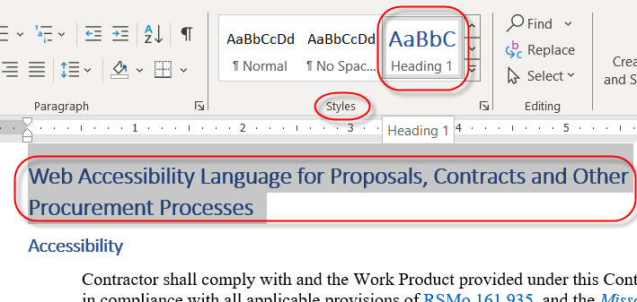
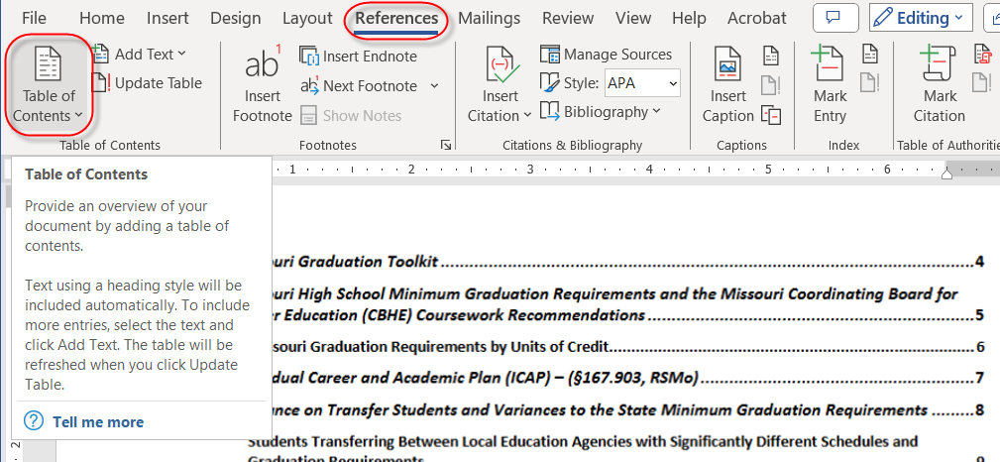
Heading Structure
Create a uniform heading structure through use of styles. This allows screen reader navigation.
This also gives the ability to quickly create a table of contents.
Notes:
Implement the use of the styles menu to create a uniform structure.
Formatting text manually outside the styles menu will not add this needed structure. At minimum, identify a heading 1, the main document subject. When reviewing a document, if you see areas that are logically grouped with a subject title, convert those to a heading 2.
In the first example here, we are applying a heading 1 to the text at the top of this document, on the Home ribbon, under styles.
The added benefit of applying heading styles throughout your document is the ability to automatically add a table of contents at the beginning of your document, as you see here in this second screenshot. To insert a table of contents, go to Reference – Table of Contents.

Slide 29
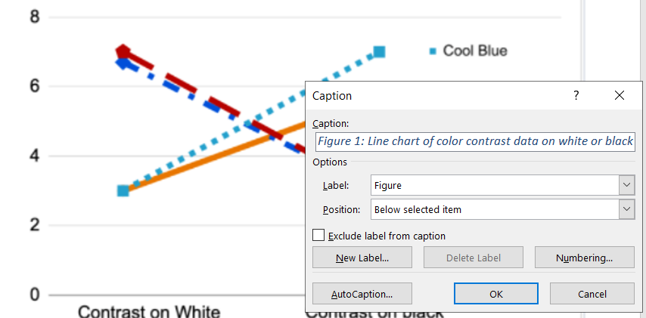
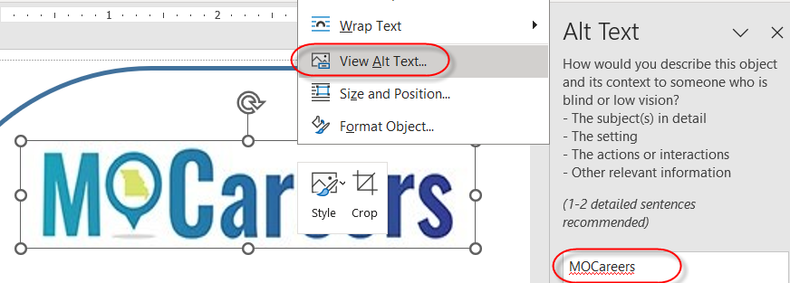
Image Text Alternative
Text alternatives are used by people who do not see the image
Alternative text: Conveys the purpose of an image
  Represents the image function
  Provides an equivalent user experience
Notes:
Next, we will talk about Image text alternative
Text alternatives are used by people who do not see the image, for example, a screen reader user.
Alternative text: Conveys the purpose of an image
Represents the image function
Provides an equivalent user experience
In this first example Word document, we are adding an alternative text by right-clicking the MOCareers image, selecting view alt text and setting the alt text to the wording in the image.
In this second example, we have an icon that we are going to make a link. This is where we evaluate the function of this image. Would the appropriate alt text be “envelope” or “email”? We evaluate how it is being used and set the alt text. In this case, the alt text would be “email”.
In this third example, you will see the use of the caption option, where you place information below or above the image. This is not a substitution for alt text but can be added for more clarity. You add captions under References – Insert Caption or by right-clicking image and Insert caption

Slide 30
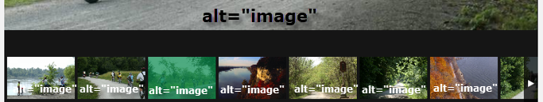



Label Images Correctly
Provide meaningful alternative text to understand the web page content.
Notes:
Provide meaningful
Let’s look at some other examples, in this first image, we have rotating images of a Missouri State Park, showing different features of the park. The alt is set to the word “image” for each image. The appropriate alt would have been to set to a concise but descriptive explanation of the image.
In the second image, we have a series of Conservation nature areas with appropriate, descriptive alternative text (read out each alternative text)

Slide 31
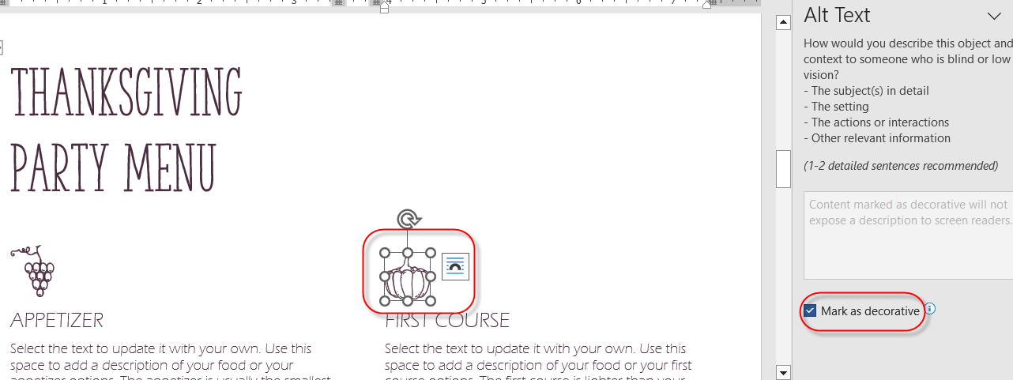
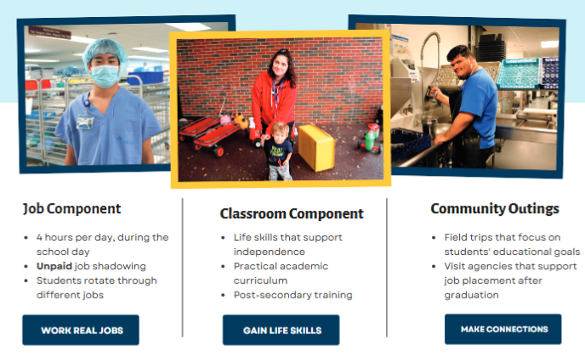
Label Images Correctly
Decorative imagery which supports the webpage design, alt=“”
Using generic stock photos don’t automatically mean a decorative image
Review how the image is being used. Don’t indicate an image as decorative because you are unsure what it should include.
Notes:
In some cases, images are used purely for decoration. They do not provide additional or supporting information the text content. In this first example, we have included some decorative icons above the document topics. These do not require alternative text. You will right-click the image, and check the decorative image option.
Also, when using stock photos (like a photo subscription service), don’t assume the alt text will be decorative. Review the way the photos are being used. In this second example, this document is explaining different career exploration opportunities. You could apply career type information to the alternative text (like, “job shadowing in the medical field”)
If you use stock photos, this doesn’t automatically mean to indicate as a decorative image. In the example to the right, looking at the context of the images, you could apply career type information to the alternative text (like, “job shadowing in the medical field”)
Unsure of what alt text should be? Discuss with any staff who helped develop the content.

Slide 32
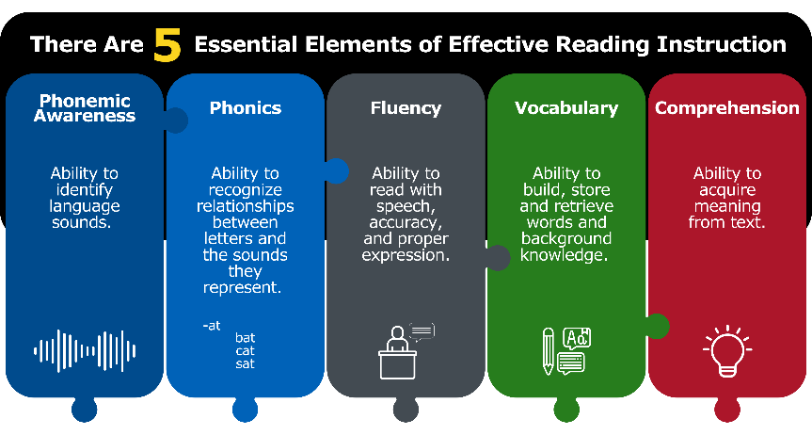
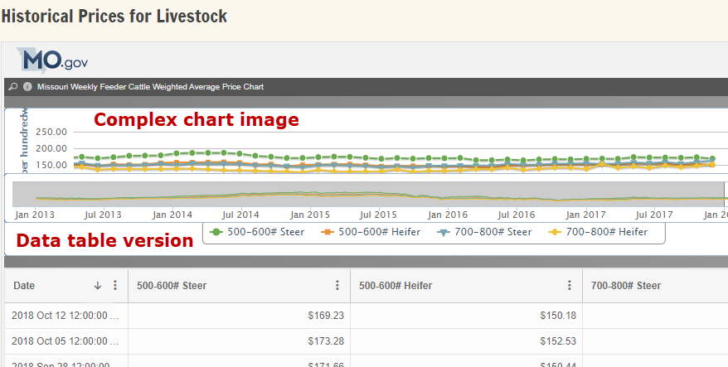
Label Images Correctly
Alternatives for complex images
  Data table (adjacent or linked)
  Bulleted or numbered lists
  Live PowerPoint presentations don’t require a data alternative for complex images, but the downloadable version does.
Notes:
Also, it is also common to incorporate complex images such as charts, regional maps or a workflow. In many cases, a descriptive alternative would become way too long than the recommended maximum of around 125 characters (or roughly 25 words). In these cases, alternatives might be an accessible data table, text outline or a bulleted or numbered list.
This first image displays five essential elements. An appropriate alternative version would be a numbered list. In this second example, the bar chart image is followed by an accessible data table, which serves as its alternative version.

Slide 33
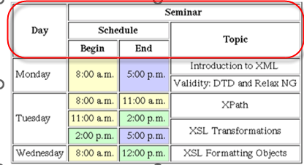
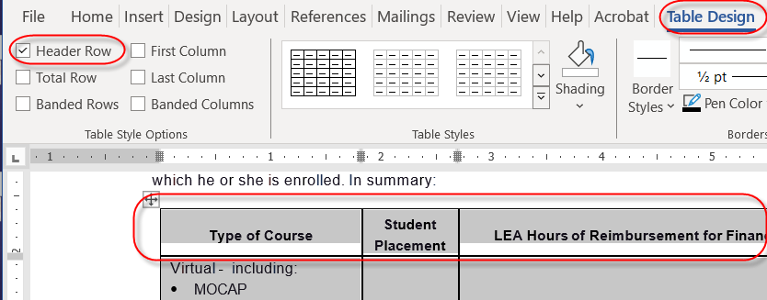
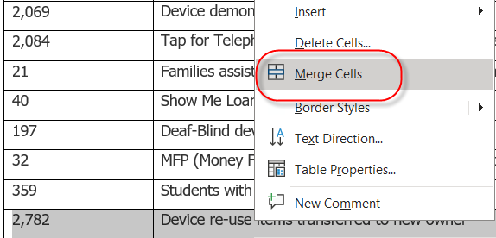
Data Tables
Accessible data tables need a clear table structure and table headers to help guide a screen reader user.
To add headers to the first row, highlight the table, select Table Design > Table Style on the ribbon, then choose the Header Row.
Avoid complex tables
Avoid merging or splitting cells
Avoid tables for layout purposes.
Notes:
Accessible data tables need a clear table structure and table headers to help guide a screen reader user.
To add headers to the first row, highlight the table, select Table Design > Table Style on the ribbon, then choose the Header Row.
Avoid using tables for layout purposes.
Be careful of using overly complex tables that have multiple nested column or row headers, there is no way to make these accessible in Word and difficult in a document converted to PDF.
Evaluate complex tables to see if they can be divided into multiple tables.

Slide 34
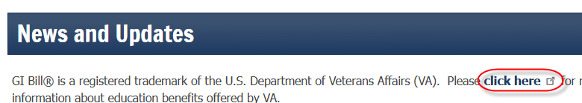
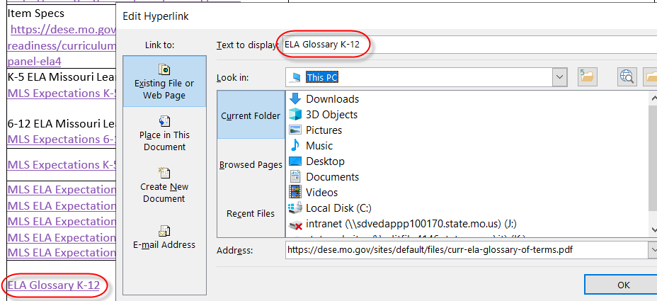
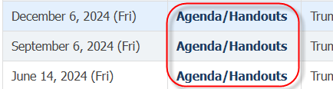
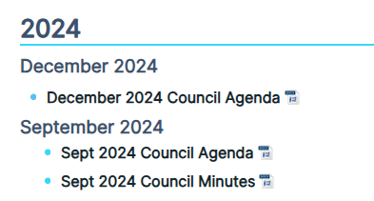
Descriptive Hyperlinks
Link text should convey clear and accurate information about the destination
Avoid “click here”, “more information”, or long web addresses
Create unique links (January 2024 Agenda vs. Agenda)
Notes:
Link text should convey clear and accurate information about the destination
Avoid “click here”, “more information”, or long web addresses
Create unique links
Look at the three examples on the left. The first example shows a vague, click here link. The second examples shows repeated links called “Agenda/Handouts”. In the third example, we show distinct, descriptive links.
To the right, we show an example of how to set a link. Highlight the link, click Link and paste in the link. You can also adjust your link text right here.

Slide 35
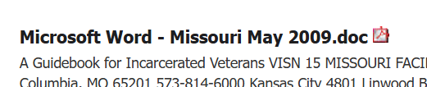
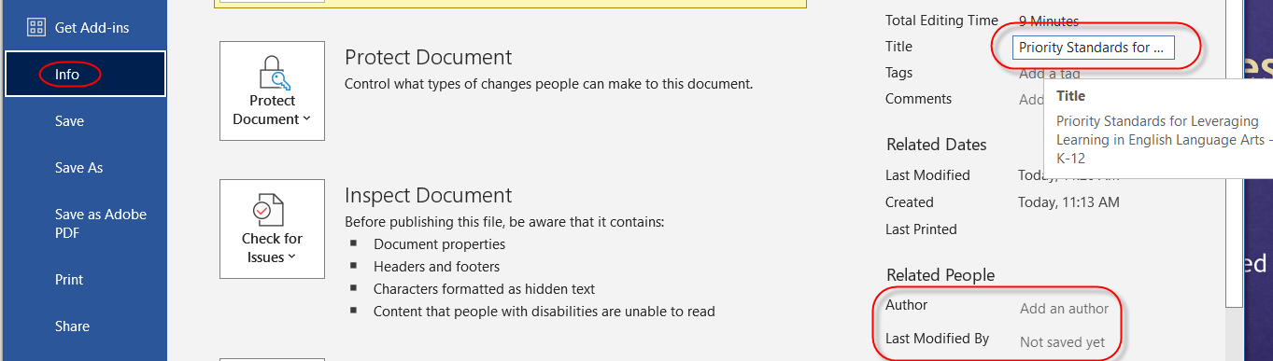

Document Properties - Title
File > Info
Add descriptive title for document
Review Author section to see if it needs to be deleted or updated
Notes:
It is important to include the title in your document property. The title will typically be whatever you have identified as a heading 1 style.
To access the title, Go to File – Info, Add a descriptive title in the title box. Review the Author information to see if a user’s name should be removed.
Descriptive titles lead to increased search engine optimization. In these two examples to the right, these are search engine results. The first title is substituted with the ambiguous file name since a title was not set. The second title was set, but is extremely vague.

Slide 36
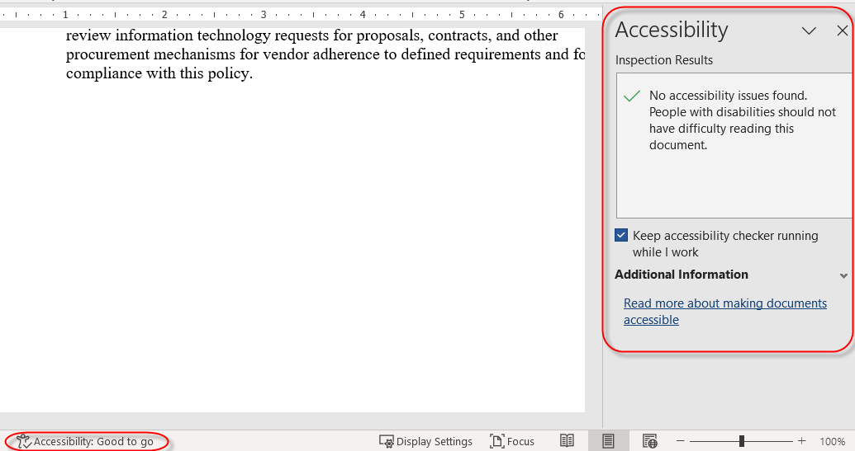
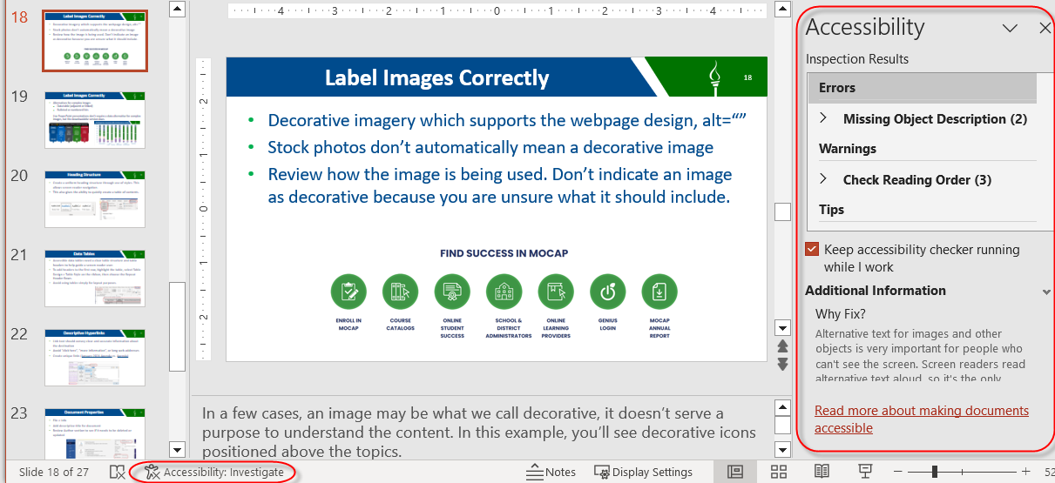


Microsoft Accessibility Checker
Alert located in bottom task bar – Accessibility: Good to Go or Investigate
Checker does check: Text contrast, presence of alt text, table headers
Checker does not check: Image color contrast, vague link text, missing headings, missing document title
Notes:
Alert located in bottom task bar – Accessibility: Good to Go or Investigate. Another way to access the accessibility check is under File – Info – Check for issues
Checker does check: text contrast, presence of alt text, table headers
Checker does not check: Image color contrast, vague link text, missing headings, missing document title

Slide 37
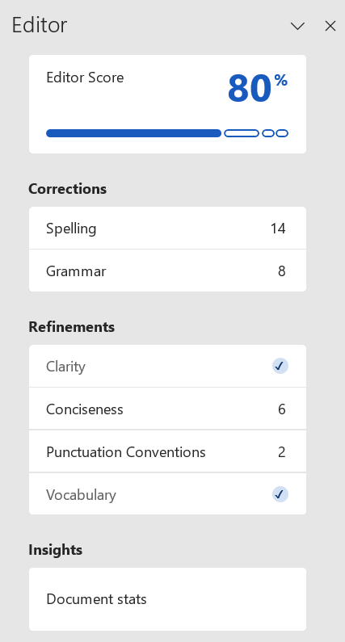

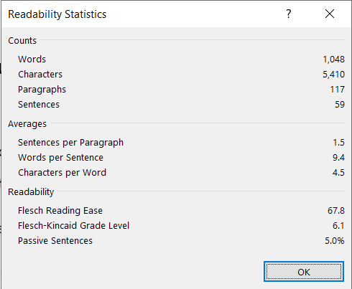
Other Accessibility Tips
Use plain language (plain writing) to better manage “cognitive load”
  Recommended 6th-8th grade reading level for most content
  Identify your audience
  Keep content meaningful and to the point
  Keep sentences as short as possible and paragraphs
  2-3 sentences
  Use active voice, not passive voice
  Use common, everyday words, using a conversational style
  Organize information -- important information first and use headings for easy scanning
  Simplify content with bulleted/numbered lists and simple data tables
  Ask others to review your content for feedback
Review the Editor feature under the Review option
Notes:
Use plain language (plain writing) to better manage “cognitive load”
When too much information is presented, it can affect how much work it takes to understand the content. (also known as cognitive load)
Recommended 6th-8th grade reading level for most content
Identify your audience
Keep content meaningful and to the point
Keep sentences as short as possible and paragraphs 2-3 sentences
Use active voice, not passive voice
Use common, everyday words, using a conversational style
Organize information -- important information first and use headings for easy scanning
Simplify content with use of lists and simple data tables
There is an editor in Word that gives you feedback on things such as readability score, grade level, clarity, and passive voice - beyond the usual grammar and spelling checks. Take a look at grade level under document stats and then go back and review recommendations under the Refinements section to help reword or simplify content.
Implementing plain language using the items on this list all help make sure the information you are sharing is understood by the widest people audience.

Slide 38
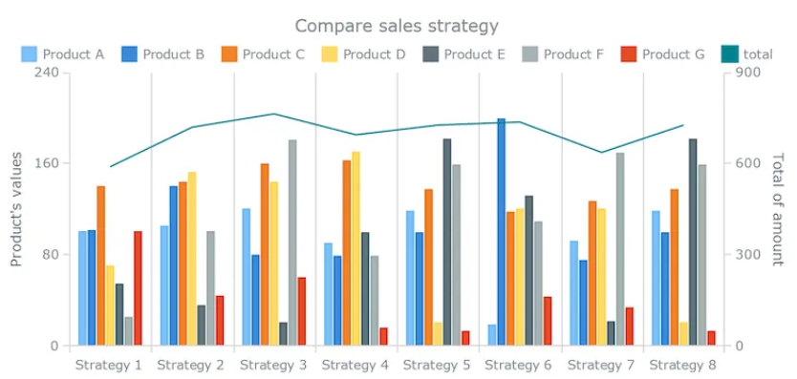
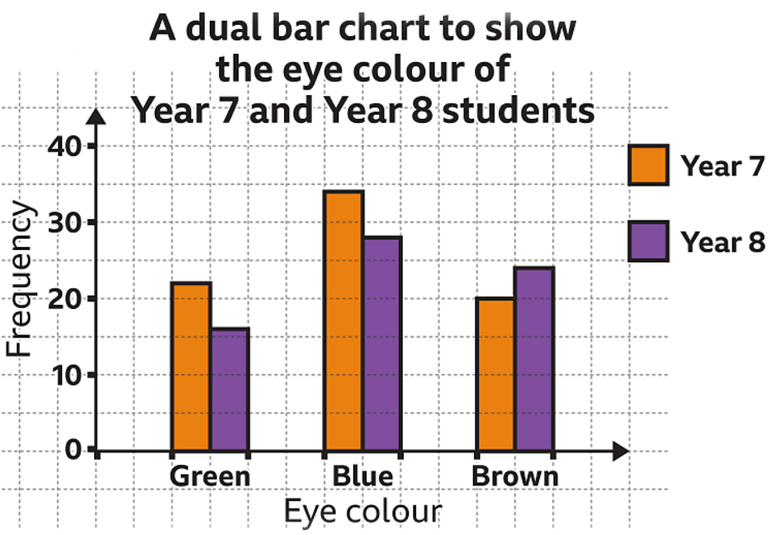




Other Accessibility Tips
Avoid cognitive or information overload in charts, graphs and other complex images. Narrow down to the most meaningful data
Do not use underlined text unless it’s a link
Saving to PDF format
Do not use File > Print
to create a PDF
Use File > Save As > PDF
Notes:
Avoid cognitive or information overload in charts, graphs and other complex images. Narrow down to the most meaningful data
In these two chart examples to the right, the first one is a bar chart with 8 bar chart groupings along the X axis with 7 products in each grouping. Some of the bar chart colors do not pass color contrast. Y axis indicates product value. It also includes a blue line chart overlay with a different Y Axis to the right. This chart is very busy and having two different vague Y axes to the left and right are confusing. Separating this into multiple, simplified charts would be a better approach.
Below that is an accessible chart, using accessible color contrast with clear labels.
Use bulleted or numbered lists to break up text or simplify content when possible
Do not use underlined text unless it’s a link
Implementing these and the other plain language recommendations will not only help people with cognitive disabilities but also those who are not familiar with your content.
Last but not least, Do not use File > Print to create a PDF
Use File > Save As > PDF
The most common document format on the web is PDF. Using file – print creates an untagged PDF document. Untagged means all the underlying document structure and alternative text information is removed.

Slide 39
Other Accessibility Tips
First, ask yourself, "Does this have to be a document?"
Reasons for a document or PDF
The content is exceptionally long (manual)
Primary purpose is for printing or printing in a precise layout (brochure or form)
Benefits as webpage content
Easier to apply accessibility guidelines
Predictable, consistent user experience
Easily responsive to different screen sizes
Quicker to load
A Document is Forever
Post a document on your site and anyone can download it.
It become tricky when posting a new version, or document is deleted.
Users might continue to use old versions.
Include clear version numbers or dates in updated document
Notes:
Now that we’ve covered the ways to make a document accessible, let’s not forget to evaluate whether content should be a document in the first place.
Reasons for a document or PDF
The content is exceptionally long, like a reference manual
Primary purpose is for printing or printing in a precise layout, like a brochure or a form.
Benefits of website content
Easier to make accessible
Predictable, consistent user experience
Responsive to different screen sizes
Easier to apply accessibility guidelines
Quicker to load
A Document is Forever
Post a document on your site and anyone can download it.
It become tricky when posting a new version, or document is deleted.
Users might continue to use old versions.
Ensure version numbers or dates are clearly stated in documents that are updated over time.

Slide 40
Module 5: Summary, Next Steps and Being an Advocate

Slide 41
Web Accessibility Benefits
Improved User Experience
Accessible websites are easier to use for people with permanent disabilities as well as temporary and situational challenges.
Search Engine Optimization (SEO)
Accessible sites perform better in search engines, resulting in content that is easier to find.
Positive Business Reputation
Organizations that prioritize accessibility are often seen as more socially responsible, with a commitment to inclusion and equal opportunity.
Notes:
As you take this information and incorporate it into your daily work, know there are huge benefits for Missouri citizens and fellow state employees.
These benefits are:
Improved User Experience
Accessible websites are easier to use for people with permanent disabilities as well as temporary and situational challenges.
Search Engine Optimization (SEO)
Accessible sites perform better in search engines, resulting in content that is easier to find.
Positive Business Reputation
Organizations that prioritize accessibility are often seen as more socially responsible, with a commitment to inclusion and equal opportunity.

Slide 42

How Can You Play a Part in Web Accessibility?
Be an Accessibility Champion!
If you notice accessibility issues:
Fix as a content creator, or
Report content you see
Typically, you can report issues through
your agency’s Communications office.
Notes:
Your call to action - be an advocate!
If you notice accessibility issues:
Fix as a content creator, or
Report content you see
Typically, you can report issues through your agency’s Communications office.

Slide 43
Next Steps!
Accessibility References for State Web Content or Document Creators
Includes:
Information about Web Accessibility Law
Checklists for Microsoft Office and Plain Language
Testing Tools Training
Expand Accessibility Skills – MOVERS Learn, Advanced PDF Accessibility and other topics
Copy of this presentation
Notes:
There were many references to different resources throughout this course. Bookmark this information as an ongoing resource in your accessibility work.
This reference includes:
Information about Web Accessibility Law
Checklists for Microsoft Office and Plain Language
Testing Tools Training
Expand accessibility skills – MOVERS Learn, Advanced PDF Accessibility and other topics
Copy of this presentation
State of Missouri Accessibility Resources for State Web Content or Document Creators
Why we are doing this work
Web Accessibility Law (State and Federal)
Checklists to Make Your Work Easier
Word, PowerPoint, Excel Accessibility Checklists
Plain Language Checklist
Copy of this Web Accessibility Presentation
Tools to Make Your Testing Easier
WebAIM Color Checker (can check both website and desktop software contrast)
Color Contrast Analyser (free desktop tool)
Adobe Acrobat Professional Web Accessibility Checker
PAC 2024 PDF Accessibility (free desktop tool)
Accessibility Testing Toolkit for Loan https://at.mo.gov/ict-testing-kit/
Further Training to Grow Your Accessibility Skills
MOVERS Learn
This course is part of a learning path titled: Accessible Communications in the Workplace
Word Accessibility Awareness/Word Document Accessibility (this course)
MS Office/PDF Accessibility
Accessible Meetings/Virtual Meetings
Accessible Audio, Video, Multimedia
Accessible Social Media
Advanced Accessible PDF Course https://www.linkedin.com/learning/advanced-accessible-pdfs-21974253/
Explore other free topic-based accessibility training options https://at.mo.gov/ict-training/
State’s Web Accessibility Site https://at.mo.gov/it-access/

